Slide 1


Číslo projektu | CZ.1.07/1.4.00/21.1405
Název sady materiálů | MY COUNTRY
Název materiálu | VY_32_INOVACE_11_River, dam, lakes
Autor | Svojtková Hana

Slide 2
RIVERS
WHAT IS THE LONGEST RIVER IN THE CZECH REPUBLIC?
THE VLTAVA RIVER
THE LABE RIVER
THE MORAVA
THE DYJE
THE SÁZAVA
THE ODRA
klik

Slide 3
DAM
WHAT IS THE LARGEST WATER RESERVOIR IN THE CZECH REPUBLIC?
THE LIPNO DAM
WHERE IS IT?
IT IS THE PART OF THE VLTAVA CASCADE
WITH HYDROELECTRIC POWER STATION
KLIKNI NA OBRÁZEK

Slide 4
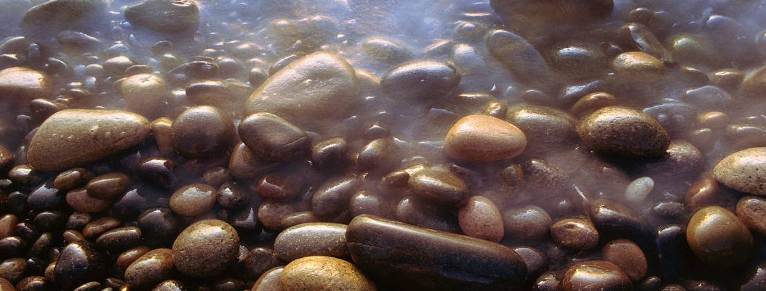

LAKE
Klikni na obrázek
WHAT IS THE BIGGEST AND DEEPEST LAKE IN THE CZECH REPUBLIC?
BLACK LAKE
IT IS OF GLACIAL ORIGIN
WHERE CAN YOU FIND IT?
IN ŠUMAVA MOUNTAINS

Slide 5
Zdroje:
Klipart Microsoft Office
Vlastní

