Slide 1
Clothes and colours

Slide 2











What is the colour?

Slide 3
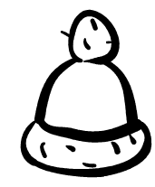
What is it?

Slide 4
Red cap

Slide 5

OKAY!!!

Slide 6
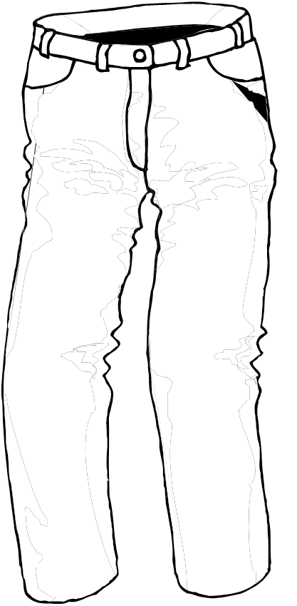
What is it?

Slide 7
Green trousers

Slide 8
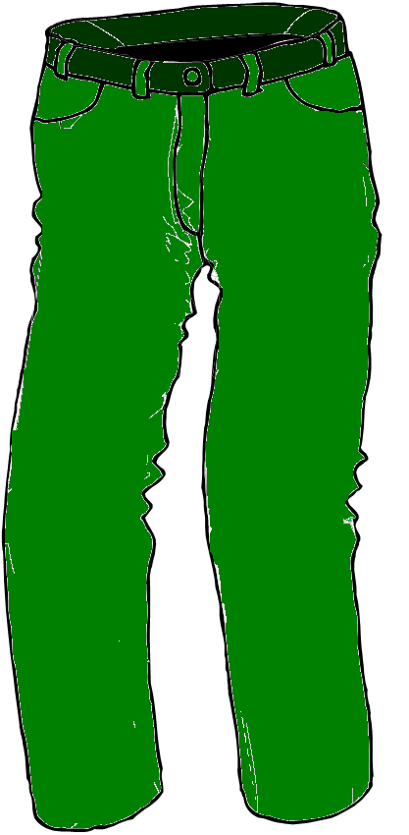
OKAY!!!

Slide 9
What is it?

Slide 10
Brown shoes

Slide 11

OKAY!!!

Slide 12
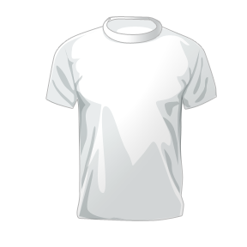
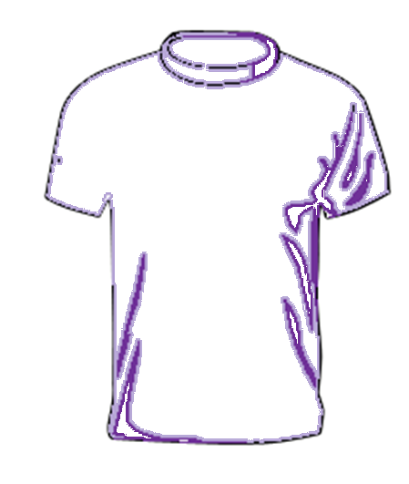
What is it?

Slide 13
Purple T-shirt

Slide 14
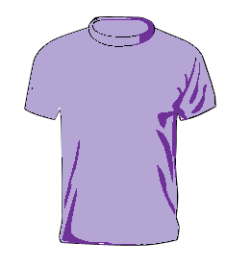
OKAY!!!

Slide 15
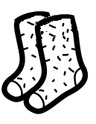
What is it?

Slide 16
Orange socks

Slide 17

OKAY!!!

Slide 18
What is it?

Slide 19
Blue jacket

Slide 20
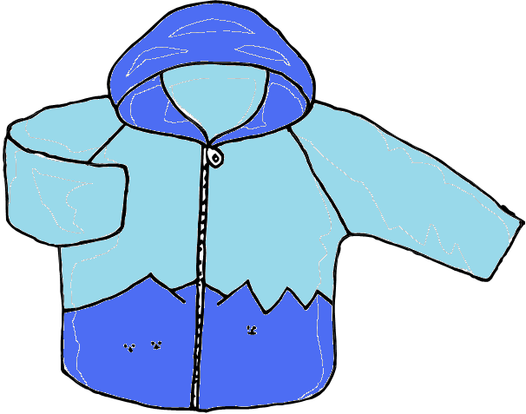
OKAY!!!

Slide 21

Excellent!!!

Slide 22
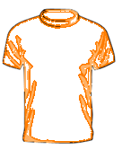
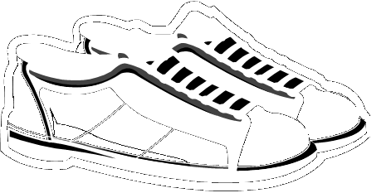
Pracovní list - Clothes and colors

Slide 23
Zdroj obrázků:
Barvy - vlastní
čepice, kalhoty, boty, tričko, ponožky, bunda - Klipart, MS PowerPoint, licence ve vlastnictví ZŠ a MŠ Rokytnice – product ID – 89396-707-0117471-65535
- Všechny obrázky upraveny v programu malování

