Slide 1


Číslo projektu | CZ.1.07/1.4.00/21.1405
Název sady materiálů | MY COUNTRY
Název materiálu | VY_32_INOVACE_19_Clementinum, Transport in Prague, animals,
Autor | Svojtková Hana

Slide 2
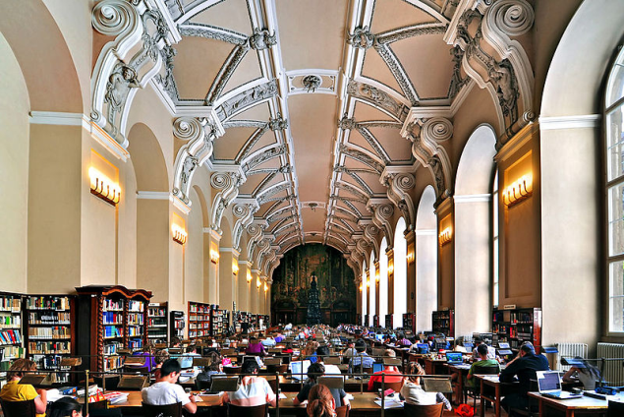
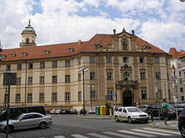
CLEMENTINUM
WHAT DOES IT MEAN
THIS BUILDING FOR PEOPLE? CLICK
CKICK
WHO FOUNDED THE LIBRARY?
IT IS THE LARGEST AND MOST FAMOUS PUBLIC LIBRARY IN THE CZECH REPUBLIC
THE EMPRESS MARIA THERESA OF AUSTRIA FOUNDED AN OBSERVATORY, LIBRARY AND UNIVERSITY HERE.

Slide 3
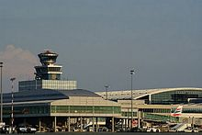
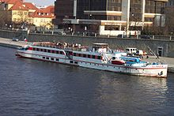
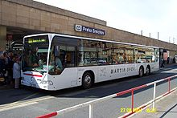
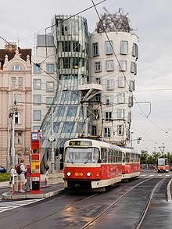
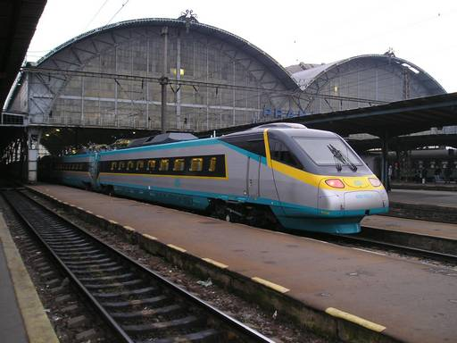
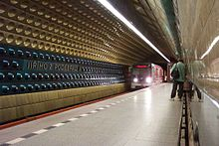
TRANSPORT IN PRAGUE
AIRPORT
STEAMSHIP
BUS - COACH
RAILWAY STATION
TRAM
UNDERGROUND
- METRO

Slide 4
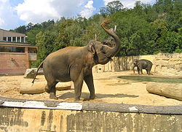
ANIMALS IN PRAGUE
WHEN WAS PRAGUE ZOO OPENED?
ZOO PRAGUE IS WELL KNOWN THROUGH
SAVING (ANIMAL)
DO YOU KNOW ANY ANIMALS? (STUDENTS´ OWN ASWERS)
IN 1931
CLICK
THE PRZEWALSKI HORSE

Slide 5
Zdroje
http://cs.wikipedia.org/wiki/Praha
http://cs.wikipedia.org/wiki/Zoologick%C3%A1_zahrada_Praha
http://cs.wikipedia.org/wiki/Soubor:Klementinum,_v%C3%BDchodn%C3%AD_vchod.jpg
vlastní

