Slide 1

EASTER
NÁZEV: VY_32_INOVACE_16_ Jazyk anglický
NÁZEV ŠKOLY: ZŠ a MŠ Osoblaha, příspěvková organizace
AUTOR: Miroslava Jarkulišová
TEMA: Easter in the czech Republic
ČÍSLO PROJEKTU: CZ.1.07/1.4.09/21.0816

Slide 2
Datum vytvoření projektu | duben 2011
Ročník | 5. – 8.
Popis prezentace | Zopakování a procvičení tématu- Easter- spojení obrázků se slovy, použití slovní zásoby v jednoduchých větách, tradice a symboly velikonoc, krátké vyprávění, práce se slovníky

Slide 3
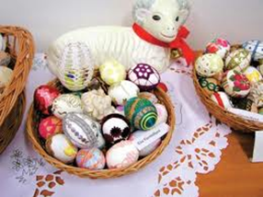

And do you welcome spring ?
Do you celebrate Easter ? Do you know Easter traditions ?
Easter is a Christian holiday in March or April. For many people it is the best time of the year. People like to welcome the new season – Spring -. Season of new life – new born baby animals, spring flowers and trees in blossom.

Slide 4
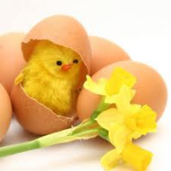
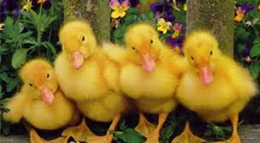
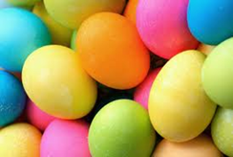
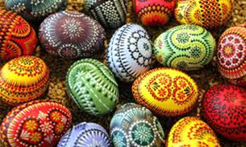
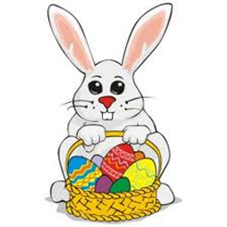

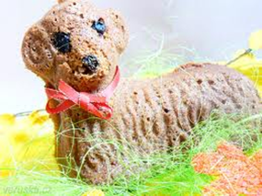
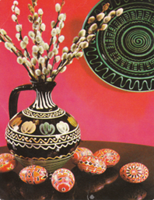
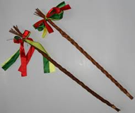






What are Easter symbols ?
duclings
painted eggs
coloured eggs
chicks
a primrose
a plaited willow
cane
a lamb
a rabbit
pussy willow
a violet
a dandelian
a snowdrop
a tulip
tree in blossom
a daffodil

Slide 5
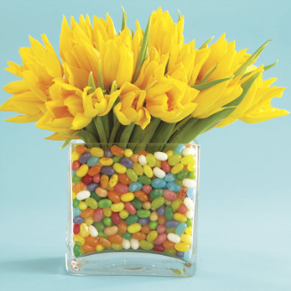

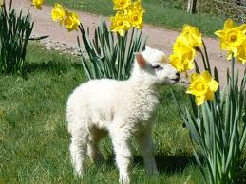
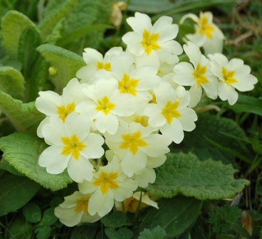

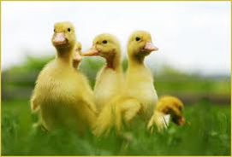
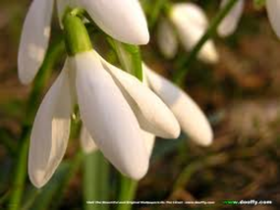

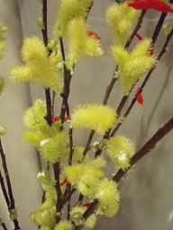
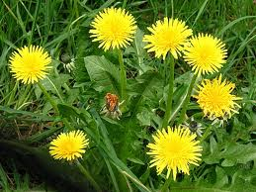
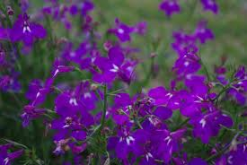
What are Easter symbols ?
Baby animals + spring
flowers
1.
4.
3.
8.
4.
11.
1. TULIP
9.
2. DANDELION
10.
3. PRIMROSE
7.
4. DAFFODIL
5. VIOLET
5.
6. PUSSY WILLOW
2.
7. SNOWDROP
8. LAMB
9. DUCKLING
6.
10.RABBIT
11. CHICK

Slide 6
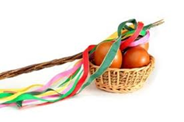

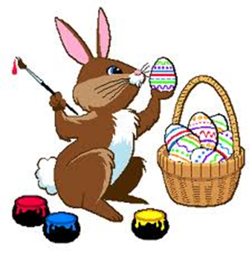
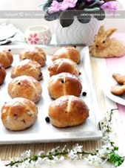
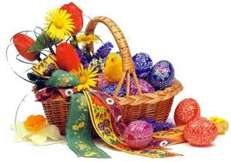


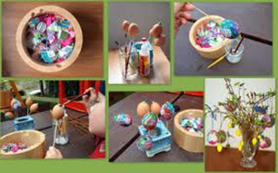
What are Easter symbols ?
Other Easter symbols
painted eggs
an Easter
egg
Easter
Bunny
Hot cross
buns
An Easter
card
Coloured
eggs
Easter wish
plaited willow
canes
Sweet cake- lamb

Slide 7
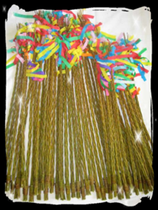
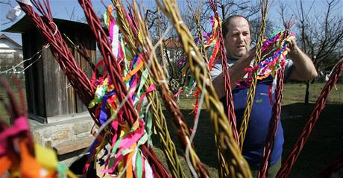
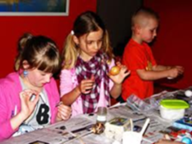

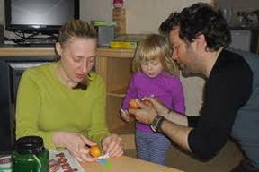
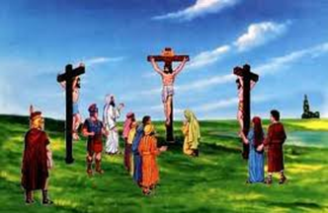

Easter traditions in our country – the Czech
Republic
Boys prepare plaited willow canes.
A big holiday, Easter, is celebrated in Spring in our country. Easter is one of the most important Christian festivals, marking the Crucifixion and Resurrection of Christ. People keep many folk traditions and customs, which are very popular in the Czech Republic.
The canes are decorated
with ribbons.
Girls colour eggs. The most popular colour is red
    Girls paint or decorate eggs. They use straw for it.

Slide 8
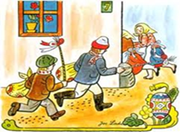
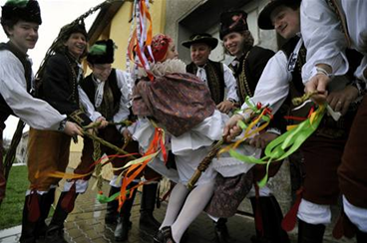
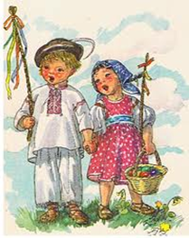
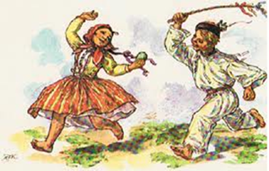
Easter traditions in our country – the Czech Republic
Boys go from house to house with their canes on Easter Monday, chase girls and whip them.
They say traditional rhymes and ask for Easter eggs.
Some boys have water in a bucket or a bottle and they splash girls with it.
Girls try to hide or run away.

Slide 9
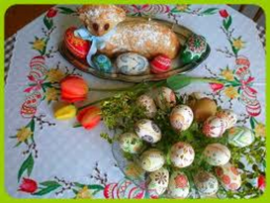
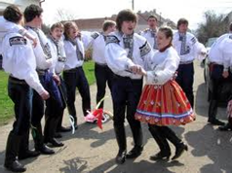
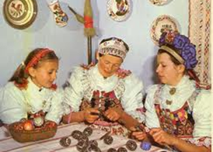
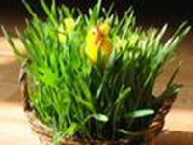
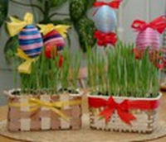
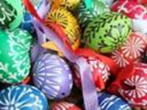
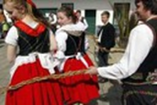
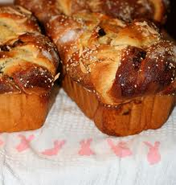
Easter traditions in our country – the
Czech Republic
The girls give the boys
rewards ( some sweets,
chocolate Easter eggs or
painted eggs..)
We grow grain in flowerpots and decorate
it with painted eggs.
We eat sweet cakes called mazanec
decorated wih a cross on the top.

Slide 10
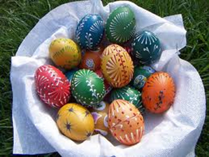

Check
Complete these sentences
Before Easter, boys have to prepare
plaited willow cane decorated with
ribbons.
Girls have to colour, decorate or paint
eggs.
On Monday morning ,the boys with
their canes go from house to house.
They chase the girls and they whip
them saying traditional rhymes.
The girls give the boy rewards –
Easter painted eggs.

Slide 11
Použité zdroje
http://www.pivovargroll.cz/velikonoce-v-grollu-7-9-4
http://www.ubytovani-liberec-apartma.cz/novinky/zprava/Velikonoce-2010-60.html
http://blog.veruska.cz/?tag=velikonoce
http://blog.veruska.cz/?tag=velikonoce
http://www.mamaaja.cz/ActiveWeb/Article/3114/velikonoce_s_detmi.html
http://jizdakralu.vlcnov.cz/page.php?pid=1441
http://klarcin-casopisek.blog.cz/rubrika/kecy
http://ekonomika.idnes.cz/asijske-prouti-nahrazuje-tradicni-ceske-pomlazky-fvq-/ekonomika.aspx?c=A100329_154514_ekonomika_spi
http://oblibena.oblibena.cz/
http://www.wallpaper.cz/priroda/flora/jarni_kvetiny
http://www.vysocina-news.cz/clanek/bledule-jarni-rozkvetly/
http://www.zahradnictvifous.cz/zahradnictvi-fous.php?s=cibulnate-a-hliznate

Slide 12
Použité zdroje
http://www.volny.cz/nohap/
http://www.velikonoce.com/
http://www.manetin.cz/mesto/materska-skola/fotogalerie-2010-2011-1/velikonoce/
http://www.ireceptar.cz/zajimavosti/velikonoce-uzijte-si-svatecni-zvyky-a-recepty/
http://www.praha14.cz/~listy/2006/4/velikonoce.htm
http://www.ireceptar.cz/zajimavosti/velikonoce-uzijte-si-svatecni-zvyky-a-recepty/
http://www.ireceptar.cz/zajimavosti/velikonoce-uzijte-si-svatecni-zvyky-a-recepty/
http://www.stopin-praha.cz/blog/czech-easter
http://www.ebai.cz/eshop/proutena-mrskacka-zila-na-velikonoce-50cm-p-862.html
http://www.meteocentrum.cz/zpravy/page.php?page=12040600
http://www.praha14.cz/~listy/2006/4/velikonoce.htm

Slide 13
Použité zdroje
http://kytickovany.blog.cz/0709/tulipany
http://www.theflowerexpert.com/content/mostpopularflowers/morepopularflowers/violets
http://www.nabytek-aldo.cz/krasne-velikonoce-s-nabytkem-aldo/
http://hra-farmerama.blog.cz/1104/velikonoce
http://www.rodina.cz/clanek5612.htm
http://www.lidovky.cz/ln-bydleni.asp
http://www.adam.cz/search.php?rskolik=25&rskolikata=6&rstext=all-phpRS-all&rsautor=nic&rstema=2&rskde=vse&rsvelikost=sab&rsrazeni=datum_90
http://www.ceska-beseda-zg.hr/cz/archiv_zprav/2010-04/
http://www.englishbaby.com/blog/irene_forever/view_entry/64123?page=5
http://www.spektrumzdravi.cz/bylina-k-uvolneni-bloku-a-negativnich-stavu/
http://www.supersticker.com/graphic.php?graphic=94

