Slide 1


VY_32_INOVACE_12_ANGLIČTINA 5.ROČNÍK_VÁNOCE
ZŠ Týnec nad Labem
AUTOR: Alena Darebná
Téma: VÁNOCE
CZ.1.07/1.4.00/21.1921
Vytvořeno: prosinec 2011

Slide 2
Anotace
CHRISTMAS
Výklad a procvičení tématu Vánoce
Vhodné pro opakování v 5. ročníku
Možno použít na PC i interaktivní tabuli

Slide 3



Christmas tree
star
mistletoe
sweets
decoration
bells
candel
present
holly

Slide 4
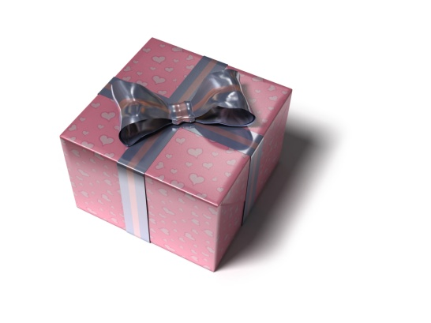

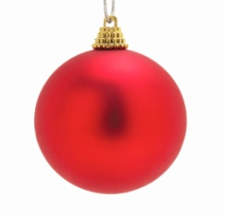

Match
CANDEL
DECORATION
MISTLETOE
BELL
PRESENT
STAR
CHRISTMAS TREE

Slide 5

Christmas time – write words
At Christmas time we decorate ____________.
On the top of tree is a ___________
People sing ___________.
Under the christmas tree are some ________.
____________ gives presents in Great Britain.
In Great Britain people like to eat __________.
Christmas plant is a hanging ___________
For solution, ring the bells

Slide 6
Christmas time – solution
Christmas tree
At Christmas time we decorate ____________.
On the top of tree is a ___________
People sing ___________.
Under the christmas tree are some ________.
____________ gives presents in Great Britain.
In Great Britain people like to eat __________.
Christmas plant is a hanging ___________.
star
carols
presents
Father Christmas
pudding
mistletoe

Slide 7
Použité zdroje
http://microsoft.com

