Slide 1

NÁZEV: VY_32_INOVACE_3.2.6.2. O 10
NÁZEV ŠKOLY: Základní škola Strančice, okres Praha - východ
AUTOR: Mgr. Lenka Kulhavá
TEMA: Angličtina
ČÍSLO PROJEKTU:
CZ.1.07/1.4.00/21.2976

Slide 2
ANOTACE:
Prezentace je určena pro žáky 8. a 9. tříd ZŠ k procvičení situace „U kadeřníka“.
Na začátku prezentace se žáci dozvědí některé slovní obraty a fráze vztahující se k danému tématu.
Dále ve cvičení doplňují podle obrázků vhodné výrazy do vět.
V dalších částech děti čtou rozhovor a následně doplňují výrazy do textu nebo si rozšiřují slovní zásobu, apod.
Poslední rozhovor slouží jako vzorový dialog pro samostatný rozhovor žáků.

Slide 3

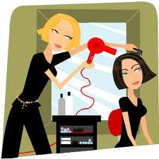
AT THE HAIRDRESSER´S
Lenka Kulhavá

Slide 4

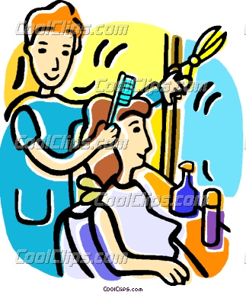
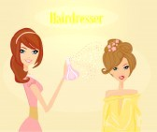
At the hairdressers
These are some of the English phrases you will need when having your hair cut or coloured at the hairdressers.
I'd like a haircut, please
do I need to book?
are you able to see me now?
would you like to make an appointment?
would you like me to wash it?
what would you like?
how would you like me to cut it?
I'll leave it to you
I'd like ...
a trim
a new style
a perm
a fringe
some highlights
it coloured
just a trim, please

Slide 5

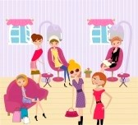
how short would you like it?
not too short
quite short
very short
grade one (shaven to a length of 3mm)
grade two (shaven to a length of 6mm)
grade three (shaven to a length of 9mm)
grade four (shaven to a length of 12mm)
completely shaven
do you have a parting?
that's fine, thanks
what colour would you like?
which of these colours would you like?
would you like it blow-dried?
could you trim my beard, please?
could you trim my moustache, please?
would you like anything on it?
a little wax
some gel
some hairspray
nothing, thanks
how much is that?

Slide 6




Can I make __________ for a cut this afternoon please?
a reservation
an appointment
a meeting
a schedule
Please don't cut much off, just a little __________.
snip
shave
trim
clip
Her hair isn't naturally blond. She has to go to the hairdresser's every six weeks because the dark __________ start to show.
tops
tips
ends
roots
I'm going to the hairdresser to have my hair __________. I'm bored with being a brunette!
dyed
died
painted
all of the above

Slide 7


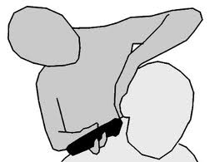
Please can you cut __________ into my hair? I want it to hang just above my eyes.
a curl
a layer
a fringe
a hairpiece
My sister had a terrible haircut last month. She hates it but it's going to take months to __________.
grow better
grow through
grow up
grow out

Slide 8
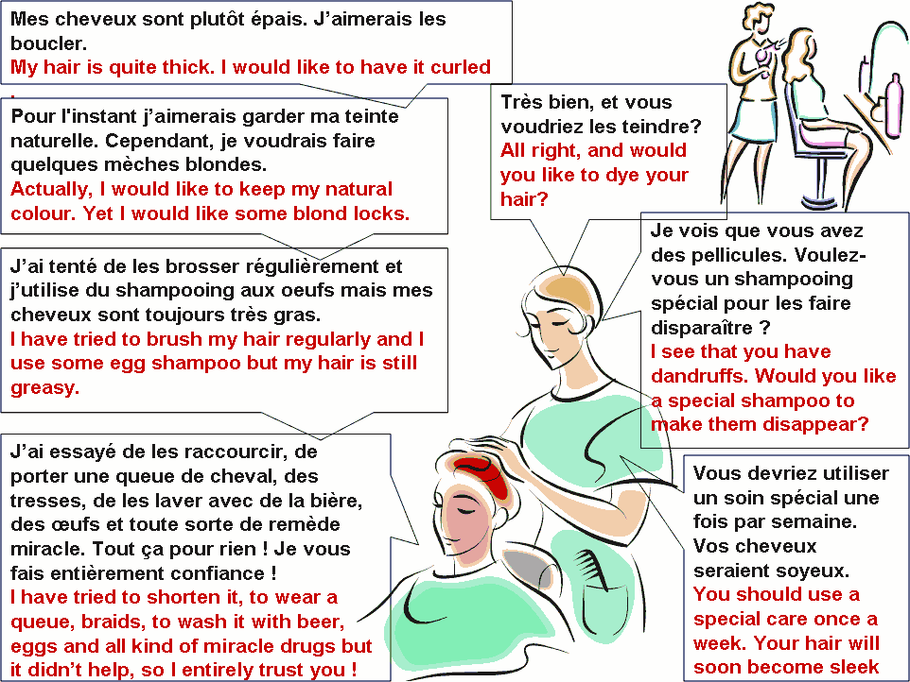

Slide 9
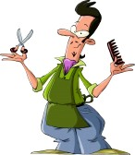
My hair is quite …………( H I K T C ) . I would like to have it …………….
( C R E L U D ) .
-All right, and would you like to dye your ………………( R I H A ) ?
-Actually, I would like to keep my natural ………………( C O O R L U ) . Yet I would like some ……………………………( D C O O L K S N L B ) .
(2 words)
-I see that you have ……………( D F R N A S F U D ) . Would you like a special …………………( S A P O O M H ) to make them disappear?
-I have tried ………………..( T B O U R S H ) my hair regularly (2 words) and I use some ……………..( G G H M E S P O A O ) (2 words) but my hair is still ……………..( G E A S R Y ) .
-You should use a special ……………..( A R C E ) once a week. Your hair will soon become……………. ( E S L K E ) .
-I have tried to…………………… ( O R N T E H S ) it, to wear a……………….. ( U U E E Q ) , ………………….( B R A S D I ) , to……………… ( H S W A ) it with beer, eggs and all kind of miracle ………………( U R S G D ) but it didn’t help, so I entirely trust you !

Slide 10

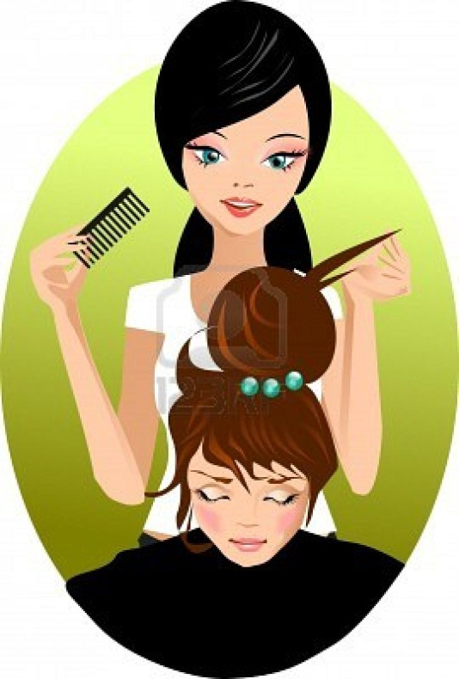
Put sentences in the right order:
Can you name some of these things?
hairdryer
combs
trimmer
Scissors
What else does the hairdresser need?

Slide 11
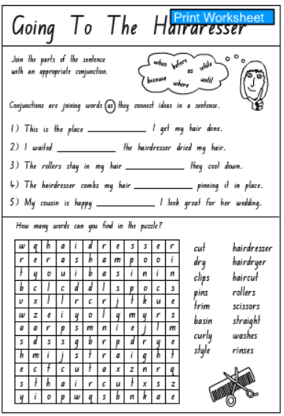
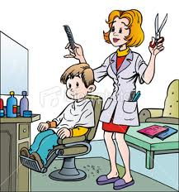
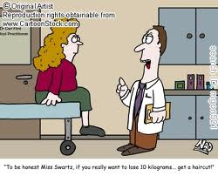
Read the joke:

Slide 12

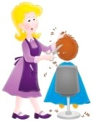
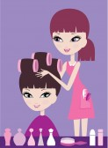
S: Good morning, Mary.
H: Good morning, Mrs. Smith. What can I do for you today?
S: I'd like something a little different today, Mary
H: Why don't you change the colour?
S: Oh, I don't know. What colour do you think would suit me?
H: How about red?
S: Oh no. That's too different. Well, perhaps a few red highlights.
H: Highlights it is then. Shall I cut it as well?
S: Yes, but don't take too much off.
H: No, I'll just trim it to give it a bit of shape.
Game: http://www.agame.com/games/hairdresser/hairdresser.html

Slide 13
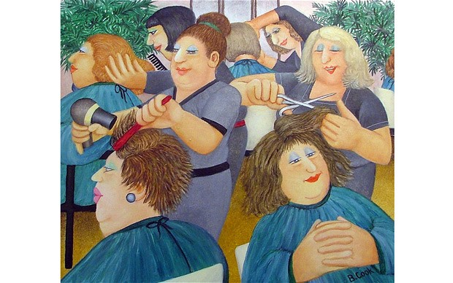
ZDROJE:
Hairdresser Stock Photos and Images. 123RF [online]. 2012 [cit. 2012-06-24]. Dostupné z: http://www.123rf.com/stock-photo/hairdresser.html
Learning English - Quiznet. BBC Learning English [online]. 2012 [cit. 2012-06-24]. Dostupné z: http://www.bbc.co.uk/apps/ifl/worldservice/quiznet/quizengine?ContentType=text/html;quiz=1538_hairdressers
Dialogue : At the hairdresser's. Tolearnenglish.com [online]. 2012 [cit. 2012-06-24]. Dostupné z: http://www.tolearnenglish.com/exercises/exercise-english-2/exercise-english-8346.php
Going To The Hairdresser Sheet 4. Studyladder [online]. 2012 [cit. 2012-06-24]. Dostupné z: http://www.studyladder.com/learn/literacy/activity/2962?retUrl=%2Flearn%2Fliteracy%2Ftype%2Fworksheet-524
Hairdresser. Agame.com [online]. 2012 [cit. 2012-06-24]. Dostupné z: http://www.agame.com/games/hairdresser/hairdresser.html

