Slide 1

NÁZEV: VY_32_INOVACE_3.2.6.2. O 16
NÁZEV ŠKOLY: Základní škola Strančice, okres Praha - východ
AUTOR: Mgr. Lenka Kulhavá
TEMA: Angličtina
ČÍSLO PROJEKTU:
CZ.1.07/1.4.00/21.2976

Slide 2
ANOTACE:
Prezentace je určena pro žáky 8. a 9. třídy k procvičení tématu telefonování. Prezentace zahrnuje jak telefonický rozhovor formální tak neformální.
V první části prezentace se žáci učí slovní zásobu a potřebné fráze. Následuje ukázka formálního rozhovoru. Děti mají za úkol upravit pořadí slov ve větách dialogu.
Následuje neformální rozhovor, jehož věty žáci tentokrát řadí do správného pořadí.
V poslední části prezentace se žáci učí vhodným frázím podle jednotlivých situací a postoje volajícího a volaného.
Výsledkem prezentace by měla být schopnost žáků vytvořit svůj vlastní formální a neformální rozhovor.

Slide 3
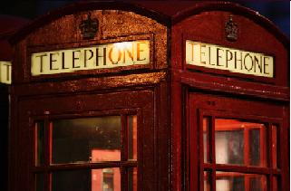
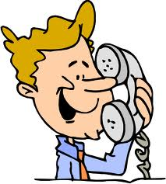
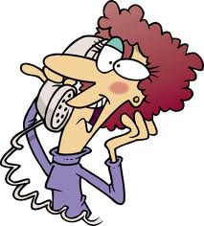
ON THE PHONE
Lenka Kulhavá

Slide 4

a receiver
a telephone call
the right number
the wrong number
the dialling tone
the operator
a directory
the line
a local call
a trunk-call
a long-distance call
a reverse-charge call
a voice
a question
an answer
a conversation
a subscriber
engaged
to insert a coin
to call someone
to lift the receiver
to dial a number
to listen to
to talk to
to give someone a ring
Do you understand these expressions?
Can you use them in sentences?
Examples :
Can I make a phone call, please?
I have coins for the telephone-box !
The phone is ringing.
I'm making a trunk-call, and later I must make a local-call.
The line was engaged, now it's free.
Can you ring back please ?
What is the dialling code for New-York ?
Do you have a directory please ?

Slide 5
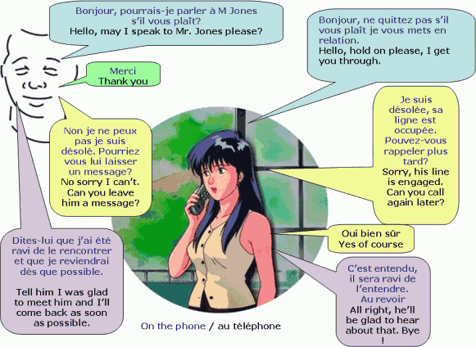
On the phone (formal)

Slide 6

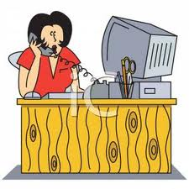
I may Hello; mister speak to Jones please?
2. please, Hello; get you through. hold I on
3. engaged. Sorry his line is
4. you Can call later? again
5. can't. sorry No, I
6. Can leave you him a message?
7. of course. Yes
8. was him. I Tell him to meet glad
9. back soon as come possible. I'll as
10. glad about hear be that, bye. right, to he'll All
Hello; may I speak to mister Jones please?
2. Hello; hold on please, I get you through.
3. Sorry his line is engaged.
4. Can you call again later?
5. No, sorry I can't.
6. Can you leave him a message?
7. Yes of course.
8. Tell him I was glad to meet him.
9. I'll come back as soon as possible.
10. All right, he'll be glad to hear about that, bye.

Slide 7
Can you translate these sentences?
1. Oh no ! The line is busy , she is probably talking to her husband.
2. I'm inserting a coin into the phone box.
3. I'm talking to someone on the phone as a practical joke.
4. I was lifting the receiver, because I thought it was my favourite singer. It's so stupid.
5. Where is your directory please? I'd like to find out Maxim's number.
6. Have you got a phone ? I'd like to call my daughter.
7. Hold the line please, an operator will assist you.
8. He is calling from the telephone-box to find out the results of his exams.
9. I had a conversation with Maria for one hour about her children.
10. I don't have any coins for the telephone-box, what can I do ?
11. I'm dialling the number of your grandmother.
12. Be quiet! Grandad is calling your sister.
13. Oh ! It's the second time I have dialled a wrong number ! What is the right number ?
14. Ben, can I use your phone? I'd like to phone my daughter ! What is the dialling code here ?
15. Mike, can I make a telephone call with your phone? Mine is out of order !

Slide 8

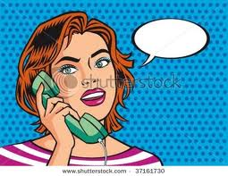
Put the sentences in the right order to make a dialogue:
No, I'll phone back later, thank you !
Hi, Penny.
Do you want him to phone you back?
You're welcome ! Bye Penny !
Oh dear, I needed to speak to him urgently.
Is Steve in, please?
Hello, is that Ann? This is Penny.
Bye Ann!
Norwich 21523, good morning !
I'm afraid he's just gone out.
Norwich 21523, good morning !
Hello, is that Ann? This is Penny.
Hi, Penny
Is Steve in, please?
I'm afraid he's just gone out.
Oh dear, I needed to speak to him urgently.
Do you want him to phone you back?
No, I'll phone back later, thank you !
You're welcome ! Bye Penny !
Bye Ann !

Slide 9
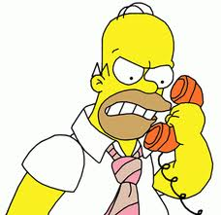
Making contact: Hello/Good morning/Good afternoon ..
This is John Brown speaking.
Could I speak to .......... please?
I'd like to speak to .......... please.
I'm trying to contact ..........
Giving more information: I'm calling from Tokyo/Paris/New York/Sydney
I'm calling on behalf of (Mr. X ...)
Taking a call: X speaking
Can I help you?
Asking for a name/information: Who's calling please?
Who's speaking?
Where are you calling from?
Are you sure you have the right number/name?
Asking the caller to wait: Hold the line please
Could you hold on please
Just a moment please
Connecting: Thank you for holding
The line's free now ..... I'll put you through
I'll connect you now / I'm connecting you now.
Giving negative information: I'm afraid the line's engaged. Could you call back later?
I'm afraid he's in a meeting at the moment
I'm sorry. He's out of the office today / He isn't in at the moment.
I'm afraid we don't have a Mr/Mrs/Miss ... here
I'm sorry. There's nobody here by that name.
Sorry. I think you've dialled the wrong number.
I'm afraid you've got the wrong number.

Slide 10

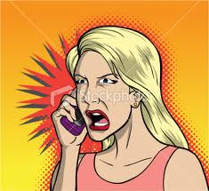

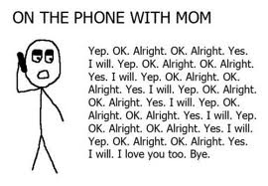
Telephone problems: The line is very bad. Could you speak up, please?
Could you repeat that please?
I'm afraid I can't hear you.
Sorry. I didn't catch that.
Could you say that again please?
Leaving/taking a message: Can I leave/take a message?
Would you like to leave a message?
Could you give him/her a message?
Could you ask him/her to call me back?
Would you like him/her to call you back?
Could you tell him/her that I called?
Could you give me your name please?
Could you spell that please?
What's your number please?

Slide 11

Telephone language
Answering the phone
Good morning/afternoon/evening, York Enterprises, Elizabeth Jones speaking.
Asking for the caller’s name
Who’s calling, please?
Could I take your name, please?
Introducing yourself
This is Paul Smith speaking.
Hello, this is Paul Smith from Smith Brothers Ltd.
Asking for someone
Could I speak to John Martin, please?
I’d like to speak to John Martin, please.
Could you put me through to John Martin, please?
Could I speak to someone who …
Explaining absence
I’m afraid Mr Martin isn’t in at the moment.
I’m sorry, he’s in a meeting at the moment.
I’m afraid he’s on another line at the moment.

Slide 12
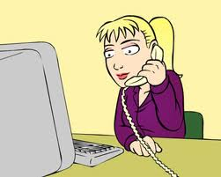
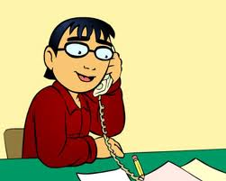
Putting someone on hold
Just a moment, please.
Could you hold the line, please?
Hold the line, please.
Problems
I’m sorry, I don’t understand. Could you repeat that, please?
I’m sorry, I can’t hear you very well. Could you speak up a little, please?
I’m afraid you’ve got the wrong number.
I’ve tried to get through several times but it’s always engaged.
Could you spell that, please?
Putting someone through (connecting someone)
One moment, please. I’ll see if Mr Jones is available.
I’ll put you through.
I’ll connect you.
I’m connecting you now.
Taking a message
Can I take a message?
Would you like to leave a message?
Can I give him/her a message?
I’ll tell Mr Jones that you called.
I’ll ask him/her to call you as soon as possible.

Slide 13
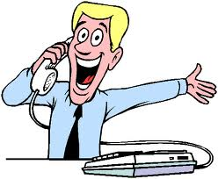
Communicating via telephone can be a very difficult task for non-native English speakers, even sometimes for native English speakers. There are so many different dialects, local words/phrases, and accents. There are some common phrases and words that are used. There are some common basic words and phrases that are commonly used to conduct a telephone conversation.
Common Telephone Phrases for the Person Make The Phone Call (Caller) :
Greeting:
Hi – Hello – Hello, how are you?
good morning – good afternoon -good evening
Introductions:
This is …. (give your name)
This is ….( give your name, from (state place, or company).
Hello this …(give your name)
Giving the reason for a call:
I’m phoning for some information on … I’d like some more detailed material … I’d like to meet someone from CNT … I need some information … I need to talk to an accountant.

Slide 14

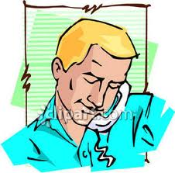
Requesting Someone:
May I please speak to …. (give the person’s name)
I would like to speak to…(give the person’s name)
Is ….(give the person’s name) available.
Is it possible to speak to ….(give the person’s name).
I need to speak to ….(give the person’s name)
Making offers
Shall I arrange for …?
Would you like me to send them …?
Promising action
I’ll put you through …
I’ll send them to you …
I’ll contact you …

Slide 15
When Party (the person you are trying to call) is Unavailable:
May I leave a message, please?
Do you know when he/she will be available?
Do you know when he/she will return to the office/home?
I will call back latter/in an hour/tomorrow.
Please tell him …..(give your name) called, and I will call latter/call again.
Please have him/she call me back.
May I leave my telephone number? My phone number is…..(give your number)?
Please have him/her contact at ……(state a place or a phone number).
Where/How can I reach him/her?
What is her/his mobile phone number/Cell/Cellular phone number?
Faxes: May I send you a fax?
What is your fax number?
Did you receive my fax?
I send a fax to….(person’s name), did he/she receive it?
Other Useful Telephone Phrases/Words:
The number is busy.
My I hold on the line.
I sorry can’t hear you.
I sorry I can’t understand you..
Who am I speaking to?
Who is calling?
Please speak slowly, I am having a difficult time understanding you
Please connect me to ….(give the name or the person, or the extensions)
The line was disconnected.

Slide 16
ZDROJE:
BUSINESS ENGLISH VOCABULARY. Learn English Today [online]. 2012 [cit. 2012-06-25]. Dostupné z: http://www.learn-english-today.com/business-english/telephone.html
Common Telephone Conversation Phrases. English Learners [online]. 2010 [cit. 2012-06-25]. Dostupné z: http://english-learners.com/2010/03/common-telephone-conversation-phrases.html
Telephone language. Speakspeak [online]. 2012 [cit. 2012-06-25]. Dostupné z: http://speakspeak.com/resources/general-english-vocabulary/telephone-language
A Colorful Cartoon of a Blonde Woman Talking on the Phone - Royalty Free Clipart Picture. Pictures Of... [online]. 2012 [cit. 2012-06-25]. Dostupné z: http://www.picturesof.net/pages/100805-189456-272053.html
I Hate Talking on the Phone. Stop Reading Into It. SBM [online]. 2010 [cit. 2012-06-25]. Dostupné z: http://www.singleblackmale.org/2010/11/16/hate-phone/#
How To Sell Life Insurance Over The Phone. Insurance Sales PRO [online]. 2011 [cit. 2012-06-25]. Dostupné z: http://insurancesalespro.co.uk/2011/09/test-2/
10. Talking on the phone. Listphobia [online]. 2012 [cit. 2012-06-25]. Dostupné z: http://listphobia.com/2012/03/22/10-ways-to-lose-calories-without-exercising/

