Slide 1

Jitka Vodrážková
VY_22_INOVACE_1A_30_BIG_TURNIP
Hello, kids!
3.
28.11. 2011
Storytelling- pohádka O veliké řepě v angličtině
Dramatizace pohádky, jednoduchá slovní zásoba

Slide 2
Příprava:
Čepice, šátek, obrázky psa, kočky, myši, korálek
Papíry
Míč, dva šátky

Slide 3
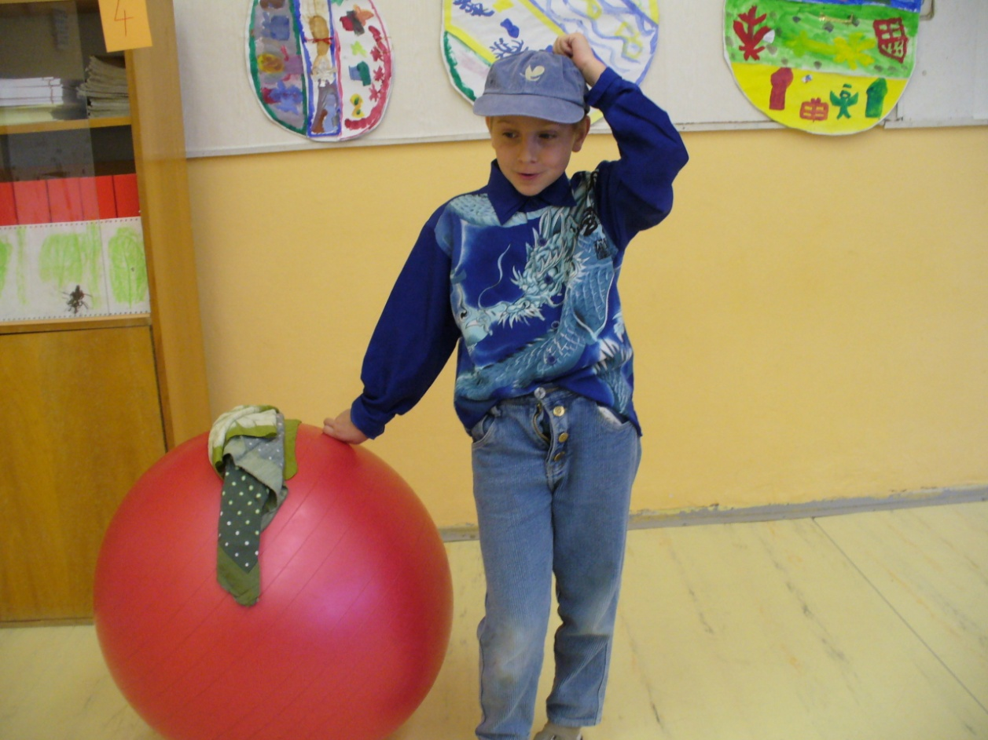
Once upon there was a grandpa. He had a small field. The grandpa had a seed
and he planted it.
Sun is shining and then it is raining ( s dětmi ukazujeme a opakujeme).
The grandpa came and watched big and big , great turnip!
He was surprised. He pulled the big turnip – but couldn´t pull it out…

Slide 4
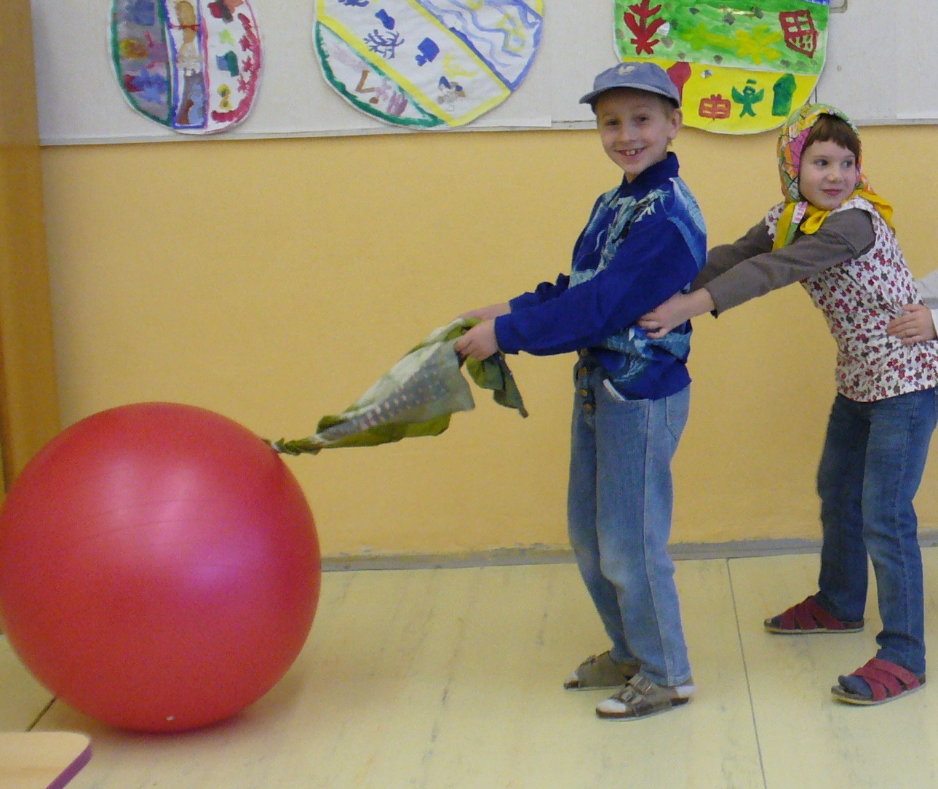
Grandpa called for grandma (voláme všichni): Grandma,come here!
Grandma held grandpa and they pulled, pulled – but they couldn´t pull it out…

Slide 5
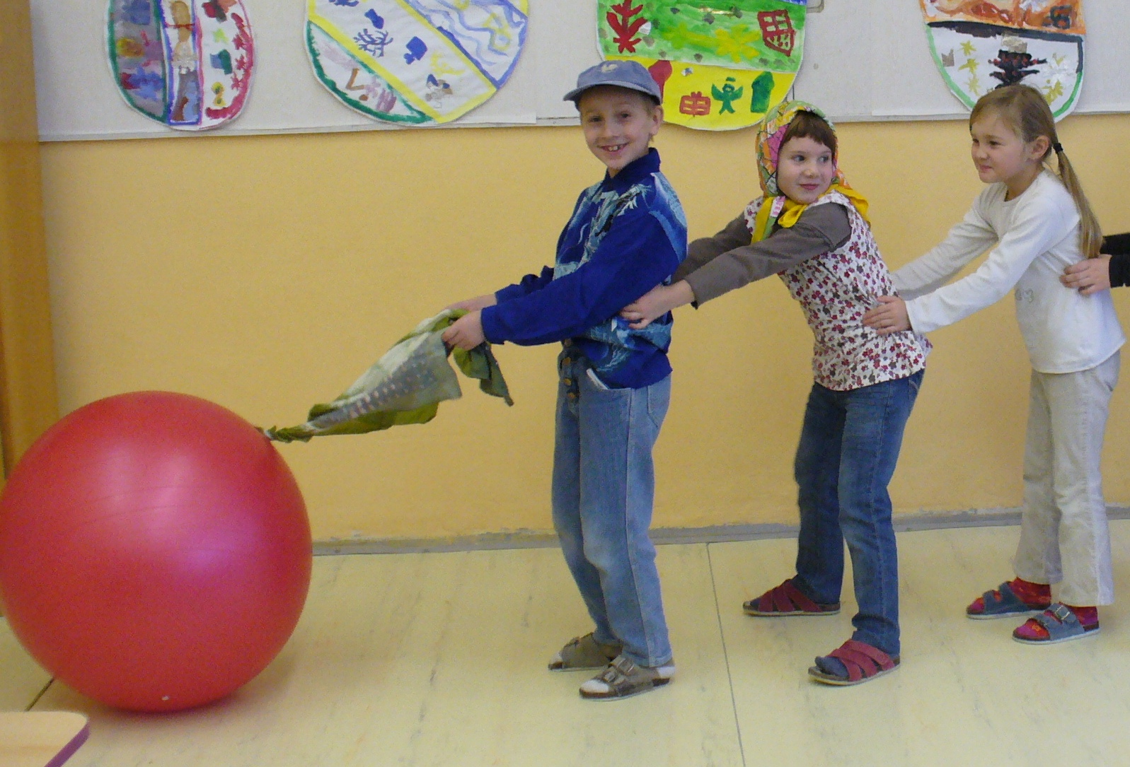
Grandma called granddaughter (girl) (všichni): Granddaughter, come here!
Girl held grandma, grandma held grandpa, they pulled,
pulled – but they couldn´t pull it out…

Slide 6
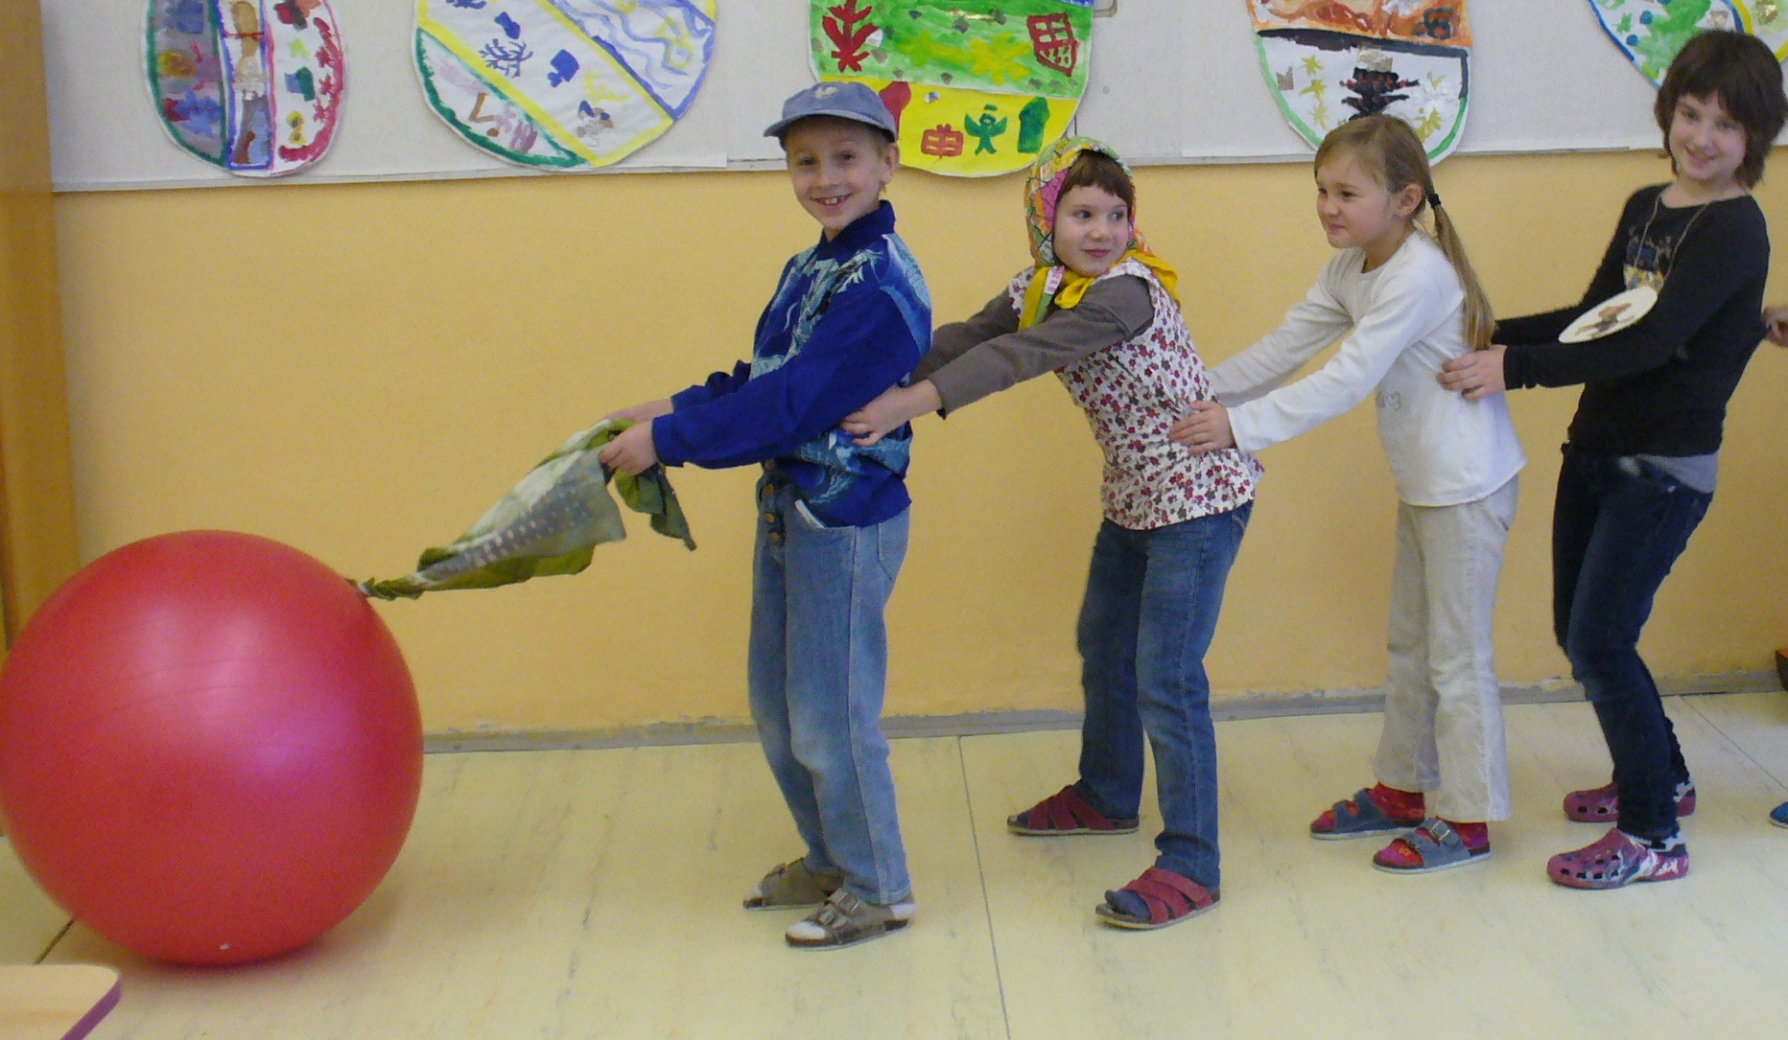
Granddaughter called a dog (všichni): Dog, come here!
Dog held girl, girl held grandma, grandma held grandpa, they pulled,
pulled – but they couldn´t pull it out…

Slide 7
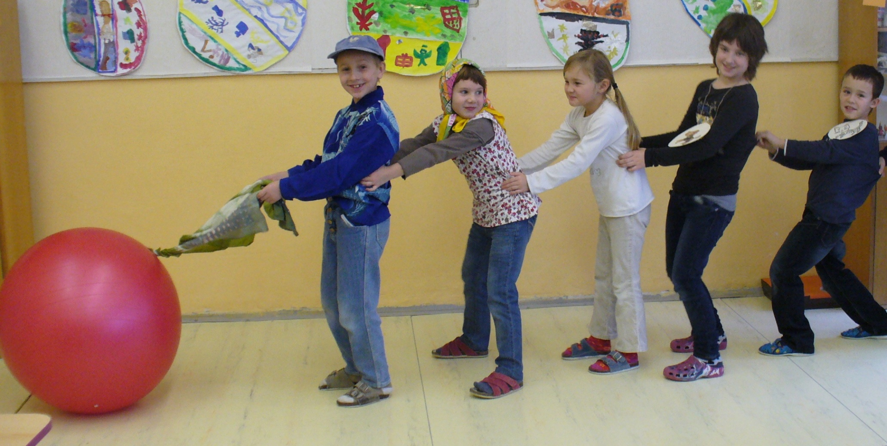
Dog called a cat (všichni): Cat, come here!
Cat held dog, dog held girl, girl held grandma, grandma held grandpa, they pulled,
pulled – but the turnip did not move…

Slide 8
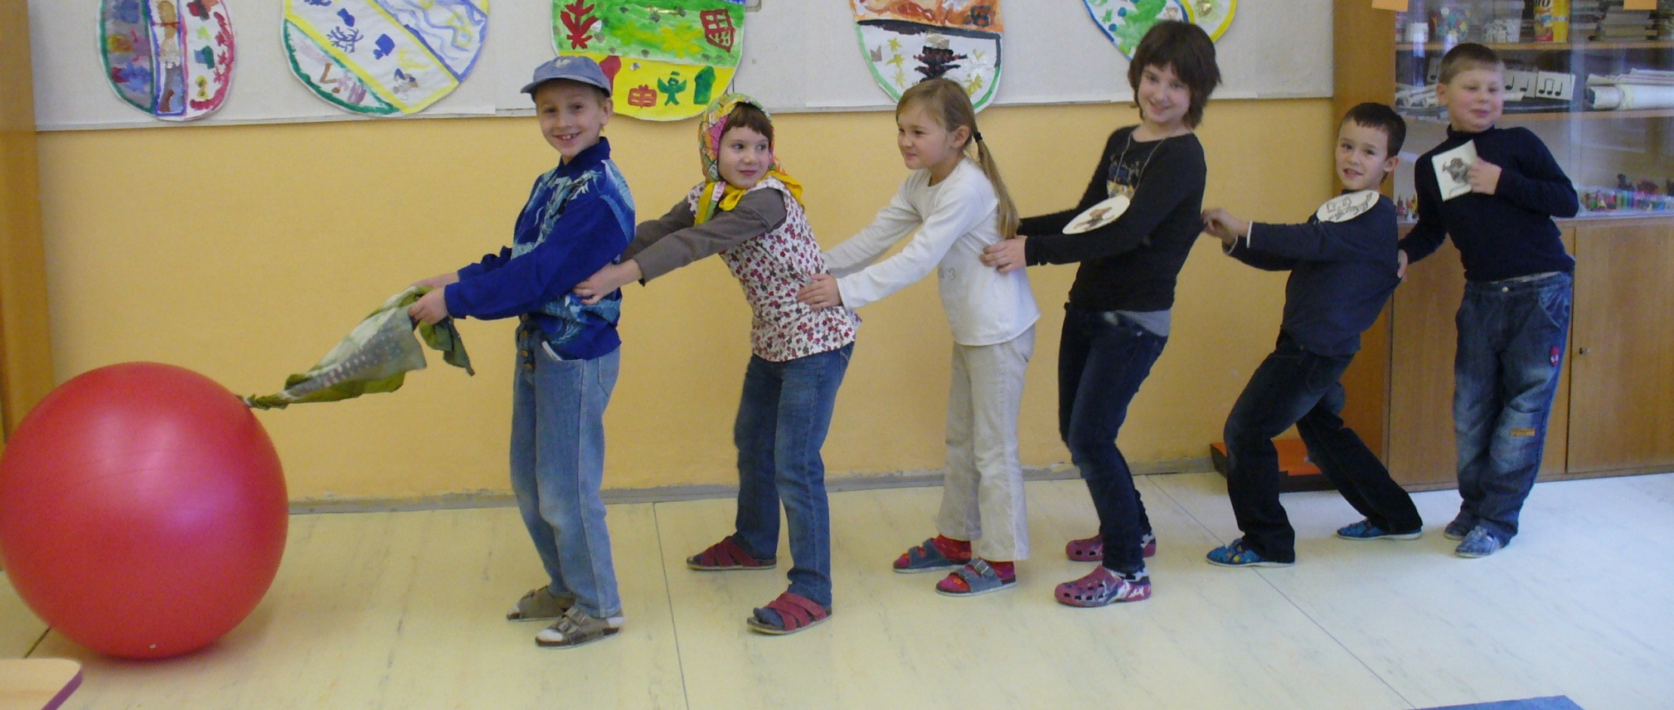
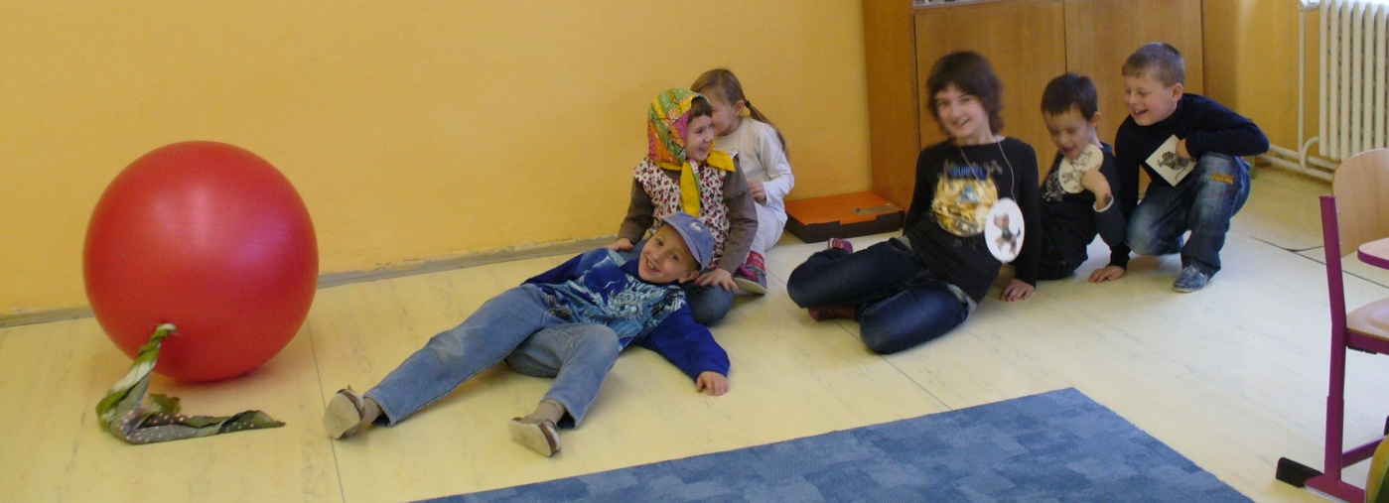
Cat called a mouse (všichni): Mouse, come here!
Mouse held cat, cat held dog, dog held girl, girl held grandma, grandma held grandpa, they pulled,
pulled – and big turnip moved out of the ground and everyone fell over!

Slide 9
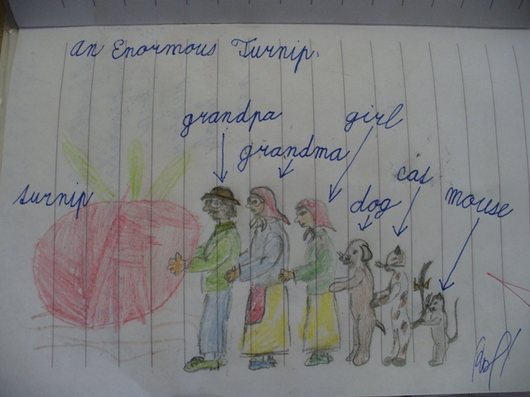
Nová slova si zapíšeme a za domácí úkol domalujeme obrázek.

Slide 10
Použité fotografie jsou vlastní výroby
Text volně zpracován podle:
http://www.youtube.com/watch?v=6Lq9VysZXkQ&feature=related

