Slide 1

NÁZEV: VY_32_INOVACE_04_Angličtina 9.ročník
NÁZEV ŠKOLY: ZŠ Dolní Benešov, přísp.organizace
AUTOR: Mgr. Marta Rozsívalová
TEMA: London
ČÍSLO PROJEKTU: CZ 1.07/1.4.00/211262

Slide 2
Anotace
Žáci se seznamují s historickými památkami Londýna
Čtou texty o památkách, překládají a na tabuli označují neznámá slovíčka, která si zapisují do slovníčku

Slide 3
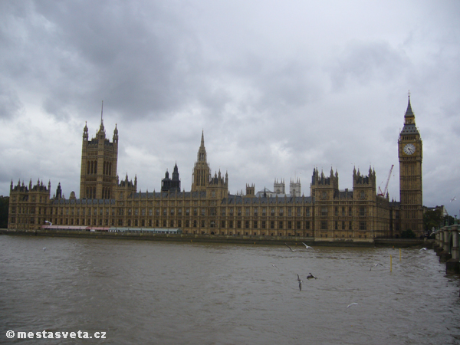
Houses of Parliament
                this is one of the centres of political
                life, government works there

Slide 4
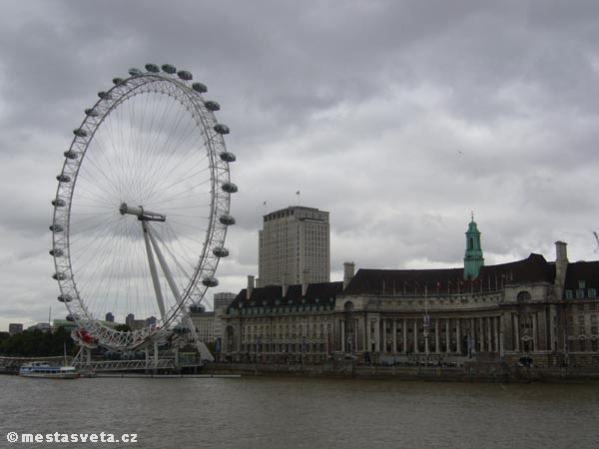
London Eye
                or Millennium Wheel is 135 m tall.
                It has become the most popular tourist attraction in the UK
                It is situated on the bank of the
                river Thames.

Slide 5
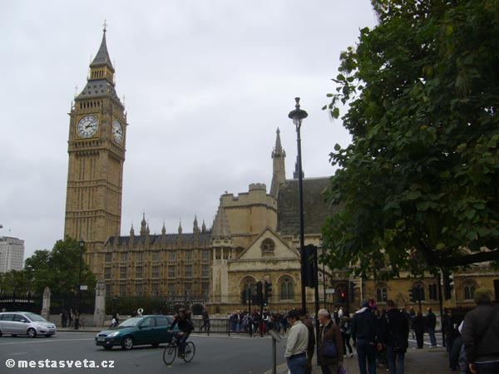
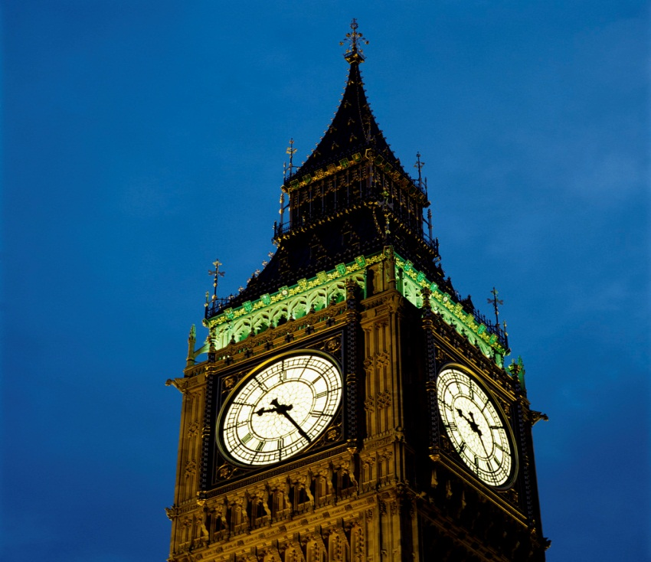
Big Ben
                is the nickname for the great bell of the clock at the north end of the Palace of Westminster in London

Slide 6
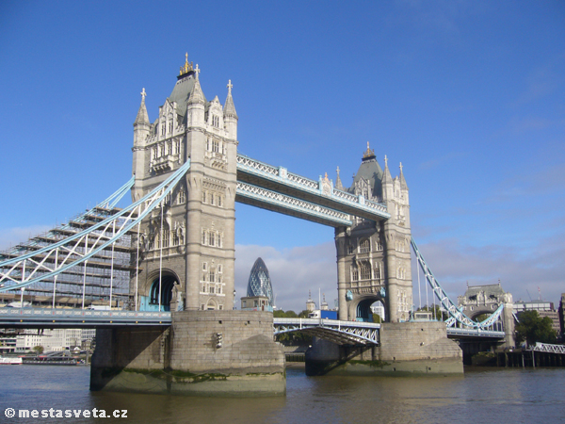
Tower Bridge
is one of the most famous symbolssssssssssssssss symbols of London
It can open and let large open in the middle ships go through.
It is over river Thames. Thames

Slide 7
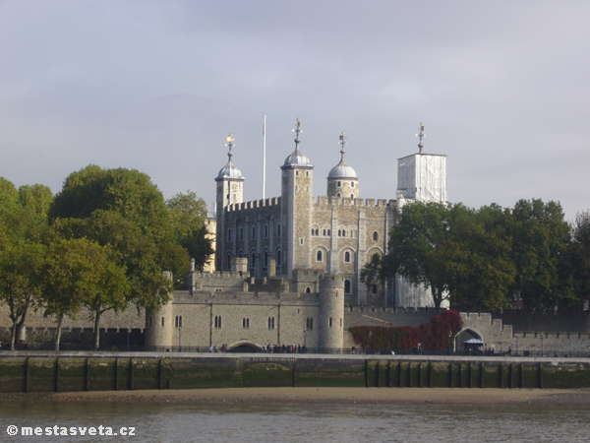
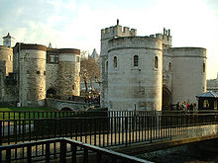
Tower of London
                this is a historical castle with museum near Tower Bridge
                there was prison

Slide 8
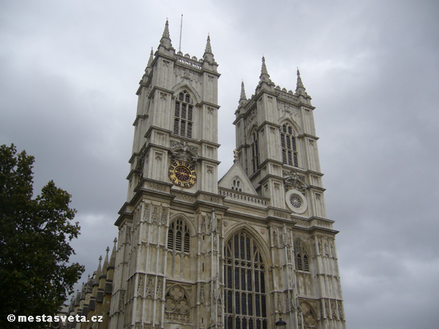
Westminster
                it is the gothic cathedral
                it was built by Ch. Wren

Slide 9
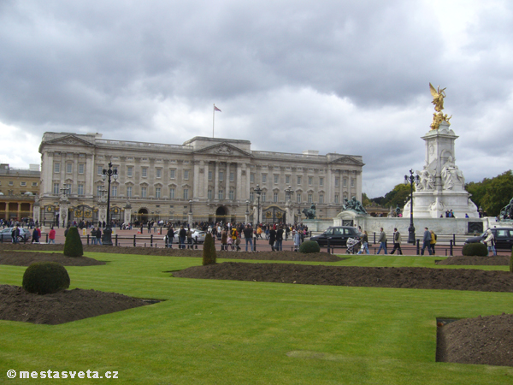
Buckingham Palace
is the residence of
the British Queen

Slide 10
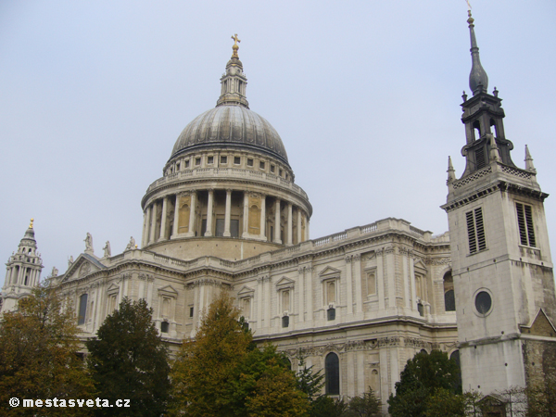
St.Paul´s cathedral
              the baroque cathedral built
              by CH. Wren.
              Prince Charles and Lady Diana were married there

Slide 11
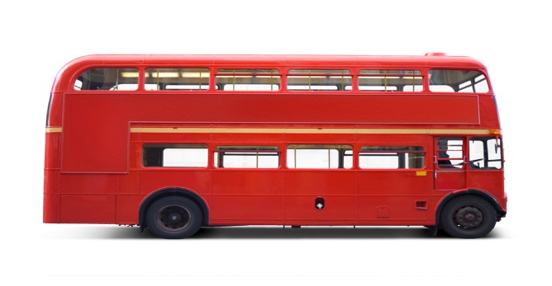
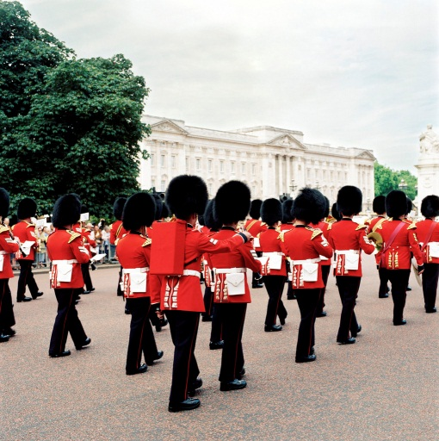
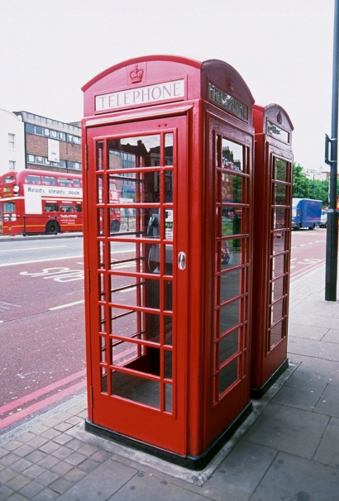
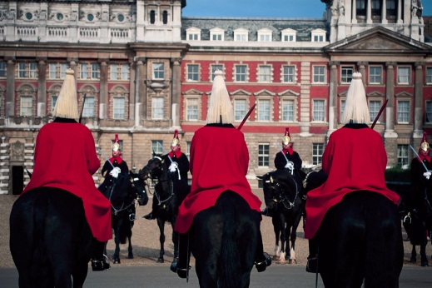
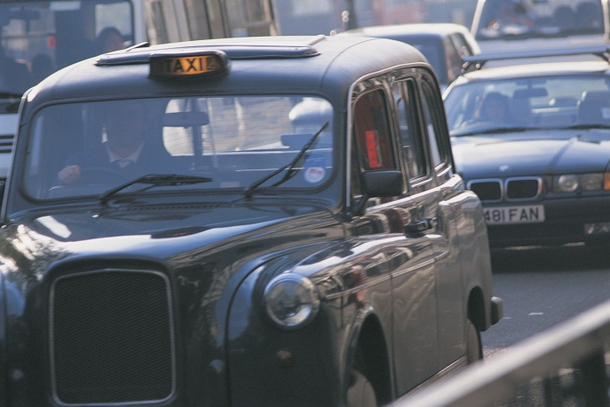
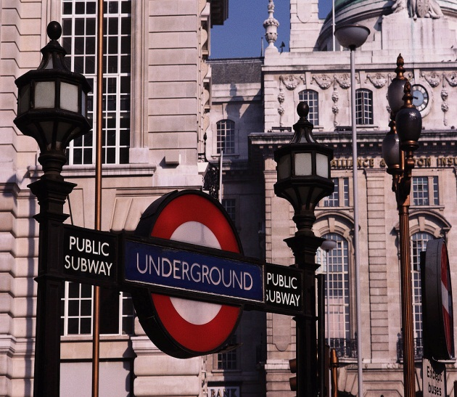
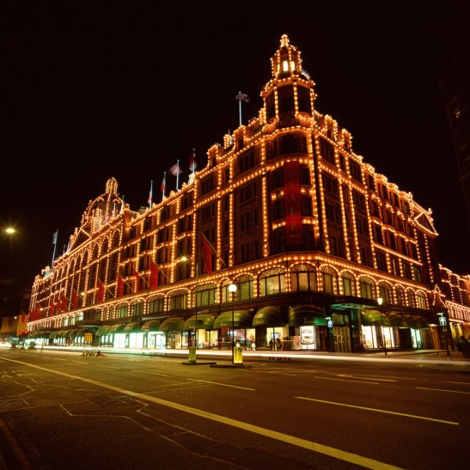
What you can see in London……

Slide 12
Citace:
Http://obrazky.cz/?step=20&filter=1&s=&size=any&sId=okAvJXGMwdHDlEyDuE-g&orientation=&q=london+m%C4%9Bsta+sv%C4%9Bta+pam%C3%A1tky [online]. 2011. 2011 [cit. 2011-09-09]. London města světa. Dostupné z WWW: <http://obrazky.cz/?step=20&filter=1&s=&size=any&sId=okAvJXGMwdHDlEyDuE-g&orientation=&q=london+m%C4%9Bsta+sv%C4%9Bta+pam%C3%A1tky>.
Č.12 Otevřená galerie Microsoft office
2011-09-09
Text je vytvořen autorem materiálu
2011-09-09

