Slide 1

Základní škola a Mateřská škola Choustník, okres Tábor
VY_32_Inovace_03C_holidays II

Slide 2
HOLIDAYS II
Talking about past actions
MORE 2 / UNIT 3

Slide 3
Talk about your holidays :
WHERE DID YOU GO LAST HOLIDAYS?
WHO DID YOU GO WITH?
HOW DID YOU GO THERE?
HOW LONG DID YOU STAY THERE?
WHAT DID YOU DO THERE?

Slide 4
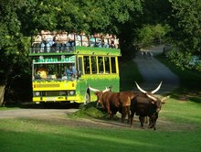
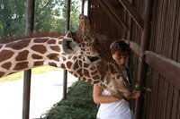
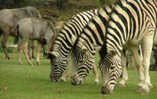
Dvůr Králové
to go on a school trip
to visit the ZOO
to hire a double-decker safaribus
to see 200 animals from Africa - zebras, giraffes, antelopes
to enjoy our meal in a garden restaurant

Slide 5
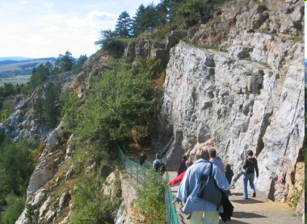
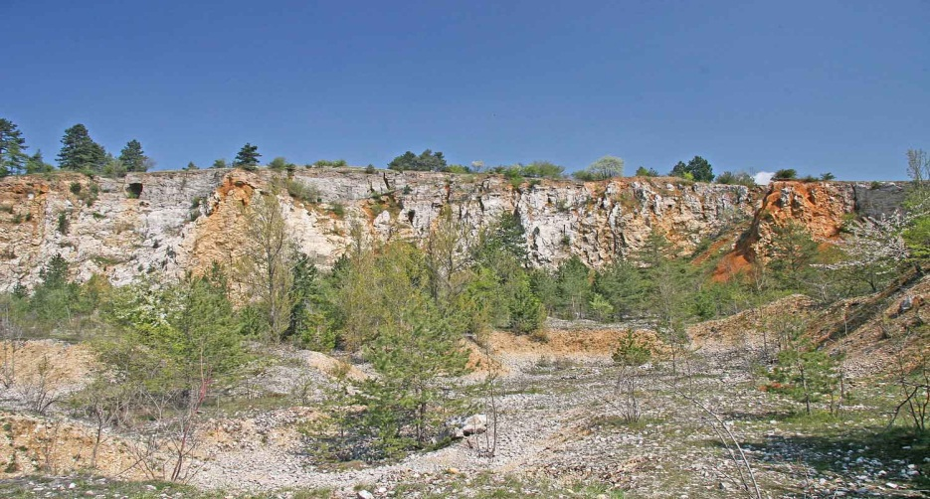
Koněpruské jeskyně
to go to the village of Koněprusy
to visit the greatest cave system of Bohemia
to walk 600 metres long rout of caves
to se lots of beautiful stalaktites
to watch bats sleeping in the caves

Slide 6
[Cit. 2011-01-06] dostupný pod licencí Creative Commons na WWW:
http://cs.wikipedia.org/wiki/Sn%C4%9B%C5%BEka
http://cs.wikipedia.org/wiki/Soubor:Schloss_Frauenberg.jpg
http://upload.wikimedia.7val.com/img/wikipedia/commons/d/d4/Hradschin_Prag.jpg
http://upload.wikimedia.org/wikipedia/commons/0/08/Lipno_nad_Vltavou%2C_p%C5%99ehradn%C3%AD_hr%C3%A1z%2C_p%C5%99ehrada.JPG
http://upload.wikimedia.org/wikipedia/commons/b/b5/Boub%C3%ADn2.jpg
http://cs.wikipedia.org/wiki/Soubor:View_to_P%C3%ADsek_from_Otava_River_(1).JPG
http://www.zoodvurkralove.cz/cs/
http://cs.wikipedia.org/wiki/Soubor:Vchod_do_Kon%C4%9Bprusk%C3%BDch_jeskyn%C3%AD.jpg

