Slide 1
SHOPPING

Slide 2
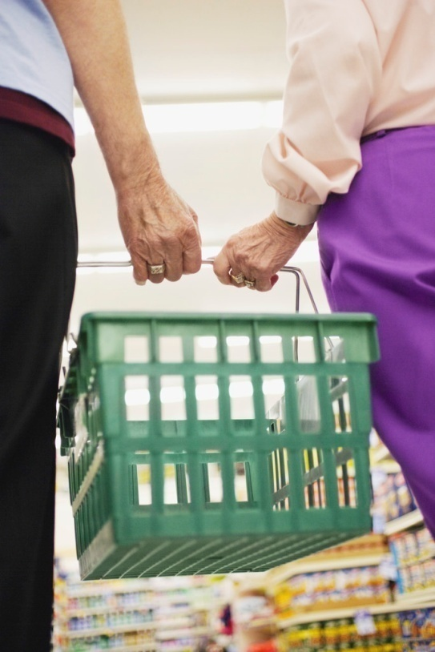
Complete the sentences. Choose one word from the box.
supermarket
have
you
honey
got
We’ve
1. Mum has the shopping list.
2. The boy is in the .
3. Can I three donuts, please?
4. He’s got the jar of .
5. Have got my lollipops?
6. got three bottles of milk.

Slide 3
Find and circle the food words.
licoricelollipopcookiesbutter
milkhoneysoup
sugarchocolate
riceteatomatoe
cheesepotatoes
Appleorangetoastcarrotpear

Slide 4
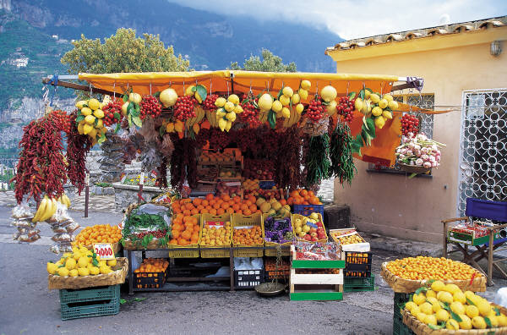
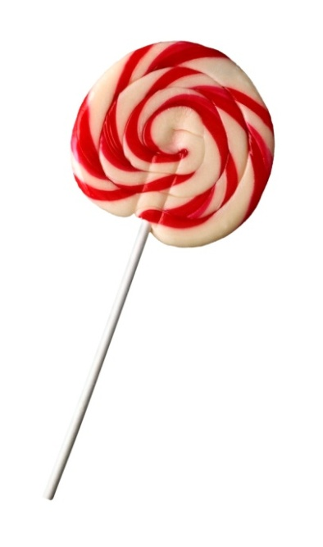
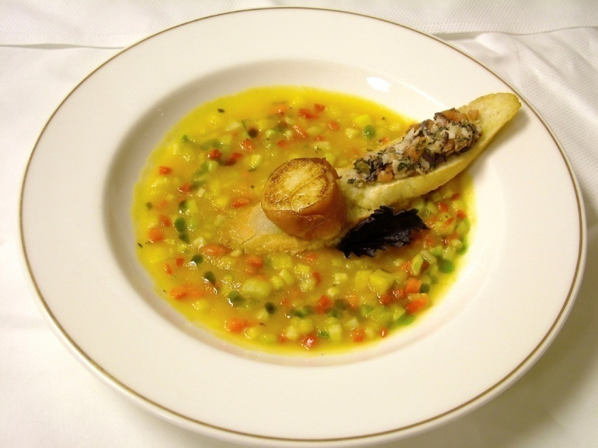
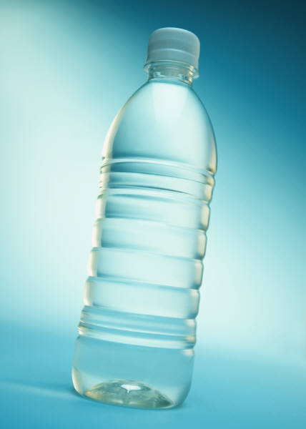
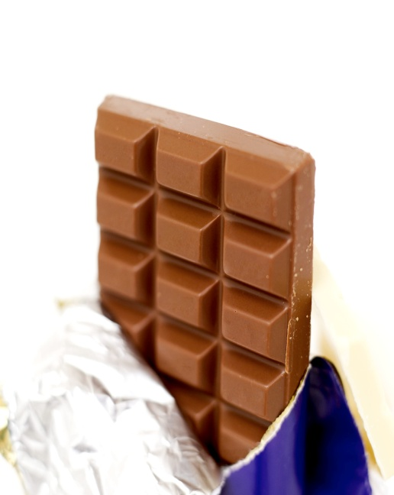
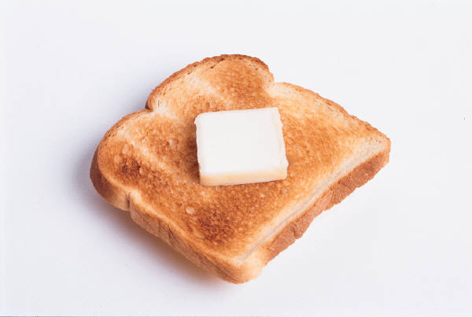
Look and match. What is it?
lollipop butter chocolate soup water market

Slide 5
Find 11 food words.
W | C | H | E | E | S | E | X | S | C
L | O | L | L | I | P | O | P | U | H
D | O | M | I | L | K | Z | A | G | O
S | K | N | C | B | I | N | T | A | C
O | I | D | O | U | D | H | U | R | O
U | E | A | R | T | A | O | R | D | L
P | S | Y | I | T | Y | N | D | A | A
A | I | T | C | E | S | E | A | Y | T
E | G | G | E | R | A | Y | Y | K | E
_____________________________________________________________________________________________________________________________________________________________________

Slide 6
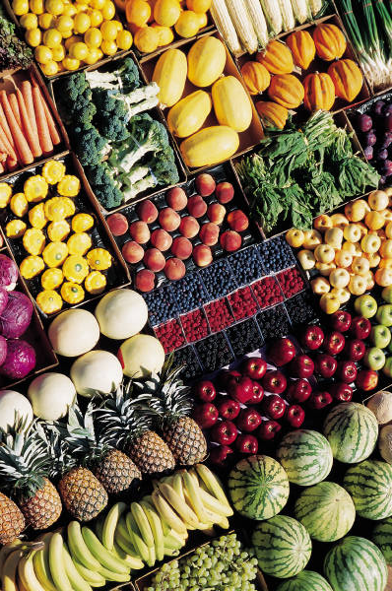
Answer the questions.
1. Can you see carrots?
2. Can you find potatoes?
3. Can you see lemons?
4. How many melons can you see?
5. Can you find tomatoes?
6. How many red apples can you see?
7. Are there bananas in the picture?

Slide 7
[cit. 2012-3-23]. Všechny obrázky pocházejí z klipartu Microsoft Office PowerPoint 2007. Licence ve vlastnictví ZŠ a MŠ Rokytnice – product ID – 89396-707-0117471-65535
Obchod, trh, lízátko, láhev, polévka, čokoláda, máslo, ovoce.

