Slide 1

Základní škola a Mateřská škola Choustník, okres Tábor
VY_32_Inovace_60_The United Kingdom

Slide 2
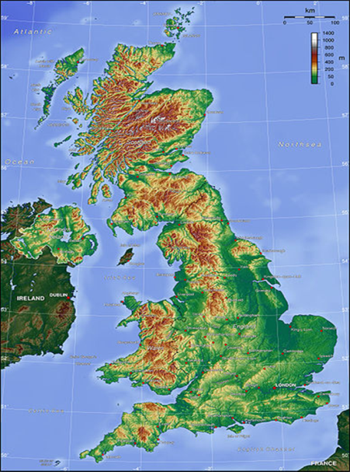
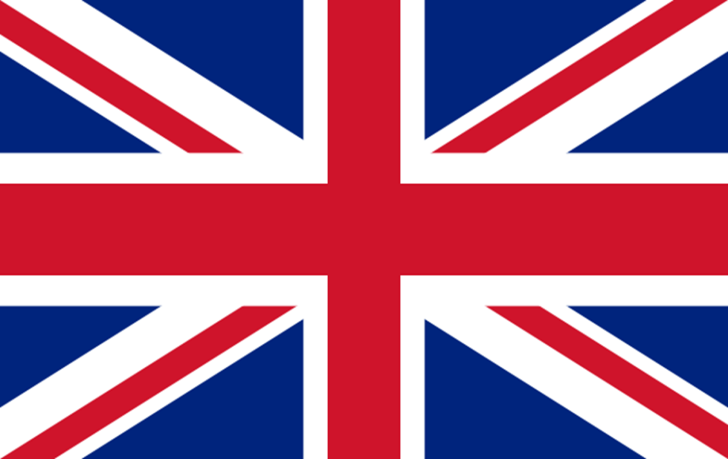
The United Kingdom of Great Britain and Northern Ireland

Slide 3
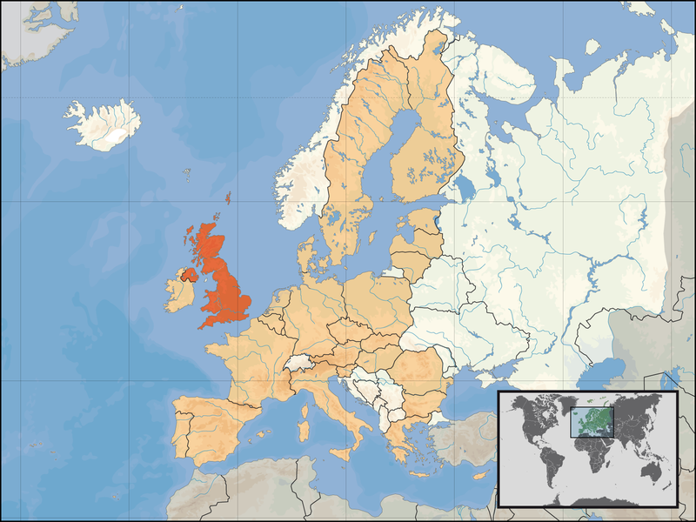
The United Kingdom of Great Britain and Northern Ireland
It is commonly known as the United Kingdom, the UK or Britain.
It is located off the north-western coast of continental Europe.

Slide 4
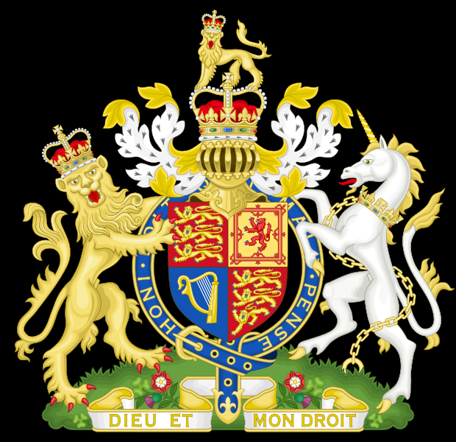
Royal Coat of Armsof the United Kingdom
The United Kingdom is a unitary state governed under a constitutional monarchy and a parliamentary system.

Slide 5
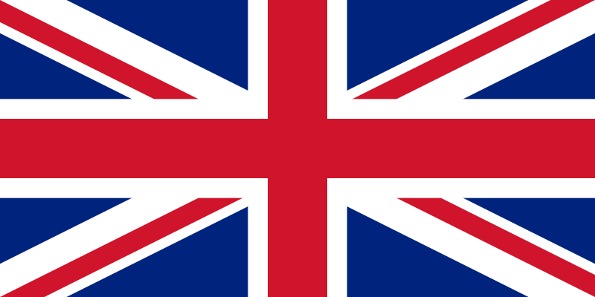
Flag of the United Kingdom
The Union Flag, also known as the Union Jack.

Slide 6

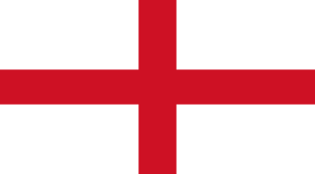

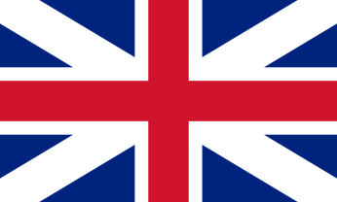
Flag of the United Kingdom
St Andrew´s cross
St George´s cross
St Patrick´s cross
Union Flag 1616

Slide 7
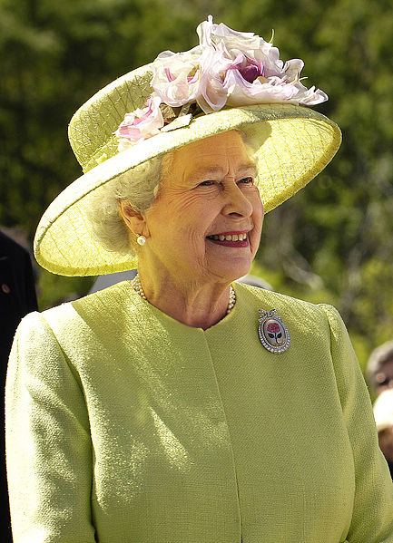
ELIZABETH II
There is a queen in the United Kingdom
She has been on the throne since 1953
She is the head of state, the head of the army,the head of the Church of England.

Slide 8
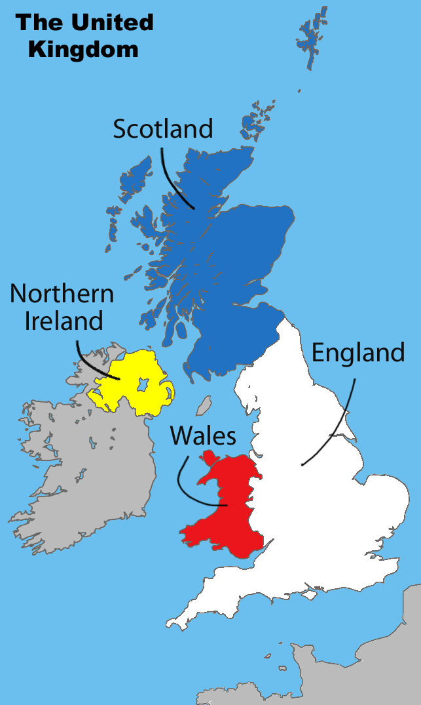
Consists of 4 parts:
England(London)
Scotland (Edinburgh)
Wales (Cardiff)
Northern Ireland
(Belfast )

Slide 9

The United Kingdom of Great Britain and Northern Ireland
Apart from this land border the UK is surrounded by:
the Atlantic Ocean,
the North Sea,
the English Channel
and the Irish Sea.

Slide 10
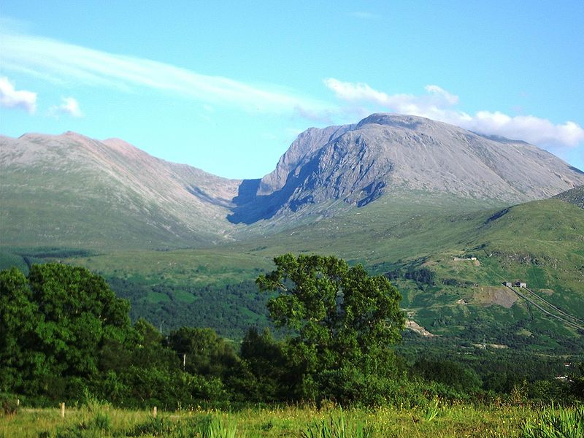
TOP 10 – 1/ MOUNTAINS
The highest peak in the U.K. is
BEN NEVIS
(1344 metres)

Slide 11
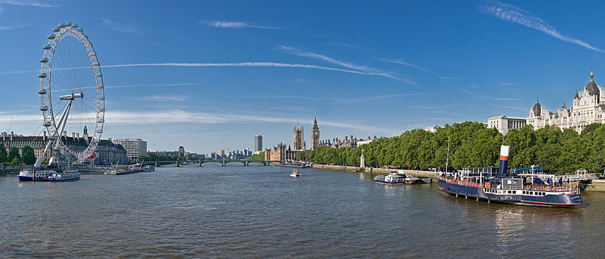
TOP 10 – 2/ RIVERS
The longest river in the U.K. is
the RIVER THAMES
(346 kilometres)

Slide 12
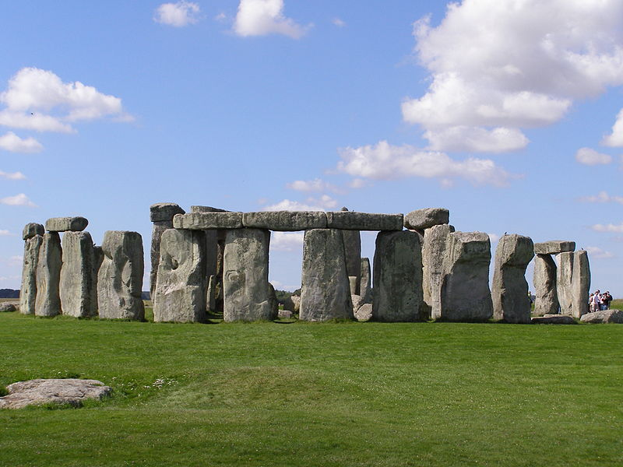
TOP 10 – 3/MONUMENTS
STONEHENGE is a well-known prehistoric monument.
It´s one of the most famous sites in the world.
It´s composed of earthworks surrounding a circular setting of large standing stones.
It is at the centre of the most dense complex of Neolithic and Bronze Age monuments in England.^{[1]}

Slide 13
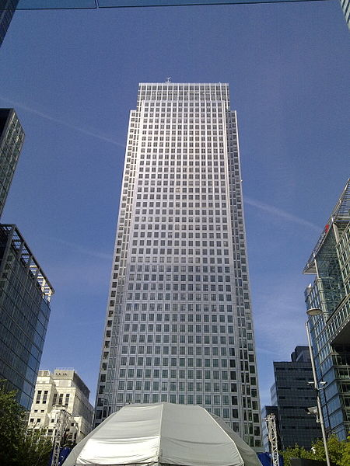
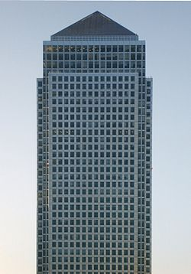
TOP 10 – 4/ SKYSCRAPERS
One Canada Square
The tallest building in the United Kingdom
General information
Location | London, England
Coordinates | 51°30′19.8″N 0°01′10.92″W﻿ / ﻿51.5055°N 0.0197°W﻿ / 51.5055; -0.0197Coordinates: 51°30′19.8″N 0°01′10.92″W﻿ / ﻿51.5055°N 0.0197°W﻿ / 51.5055; -0.0197
Status | Complete
Constructed | 1988-1991^{[1][2][3]}
Use | Offices^{[4]}
Height
Antenna or spire | 235.0 m (771.0 ft)
Roof | 195.0 m (639.8 ft)
Technical details
Floor count | 50^{[4]}
Floor area | 115000m^{2[5]}
Elevators | 32 + 2 freight + 2 firemen^{[4]}
Companies involved
Architect(s) | César Pelli & Associates^{[5][6][7][8]} Adamson Associates^{[9][6][8]} Frederick Gibberd Coombes & Partners^{[6][10][8]}
Structural engineer | MS Yolles & Partners^{[6]} Waterman Partnership^{[13][6]}
Contractor | Sir Robert McAlpine ^{[8]} Ellis Don^{[8]} Lehrer McGovern^{[8]} Bovis Olympia & York + approximately 40 sub-contractors
Developer | Olympia & York^{[11][2]}
Owner | Canary Wharf Group plc (current majority shareholder is Songbird Estates plc^{[12]})
Management | Canary Wharf Group plc
The tallest building in the U.K.
Is´s called ONE CANADA SQUARE
or CANARY WHARF
It´s 235 metres tall.
It has got 50 floors.

Slide 14
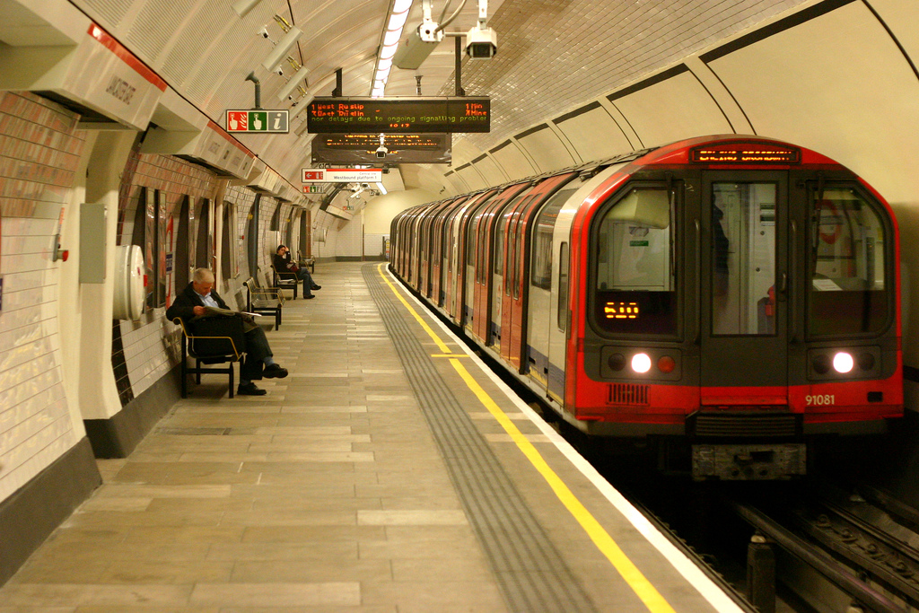
TOP 10 – 5/ THE TUBE
It is the oldest underground railway in the world
The first section was opened in 1863.
The Underground serves 270 stations and has 402 kilometres of track
It the second largest metro system in the world ( after the Shanghai Metro).

Slide 15
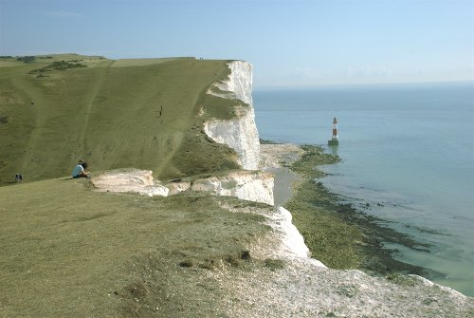
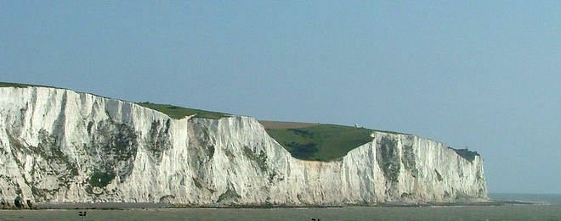
TOP 10 – 6/ THE FIRST VIEW
The earliest known name of Great Britain is Albion ( from the Latin albus meaning white)
the white cliffs of Dover, it is the first view of Britain from the continent

Slide 16
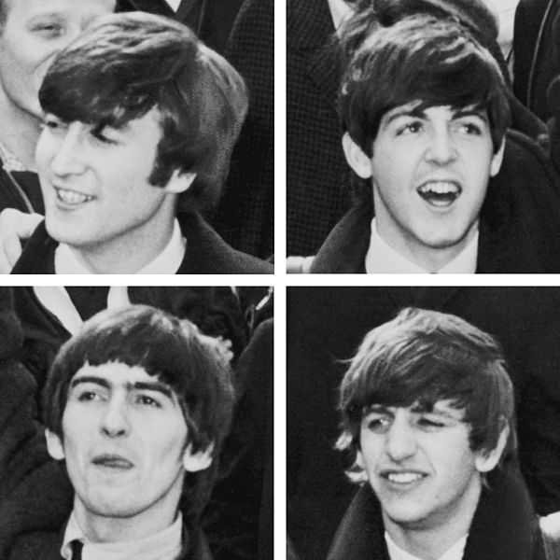
TOP 10 – 7/ BEATLES
they are one of the most successful English rock band
this English rock band was formed in Liverpool in 1960
the group consisted of:
John Lennon (rhythm guitar, vocals)
Paul McCartney (bass guitar, vocals)
George Harrison (lead guitar, vocals)
Ringo Starr (drums, vocals

Slide 17
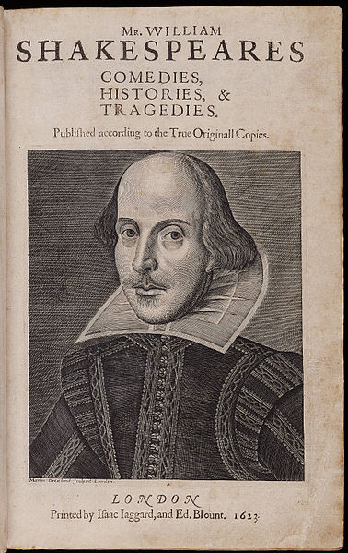
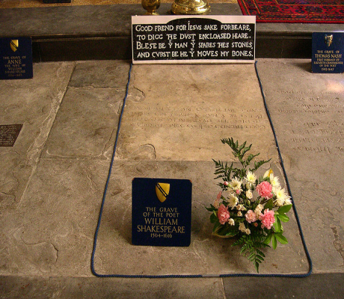
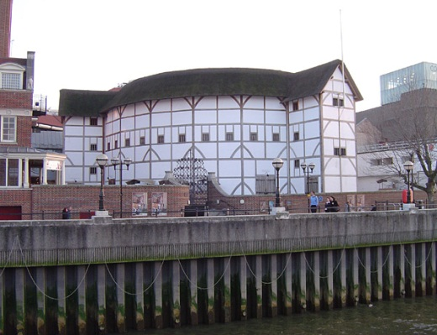
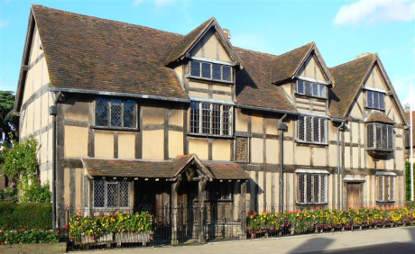
TOP 10 – 8/ SHAKESPEARE
26 April 1564- 23 April 1616
Stratford-Upon-Avon
the greatest writer in the English language and the world's pre-eminent dramatist.
His works consist of about
38 plays
154 sonnets
two long poems
His plays have been translated into every major living language and are often performed
Most of Shakespeare's greatest plays were written for the Globe, including Hamlet, Othello and King Lear.

Slide 18
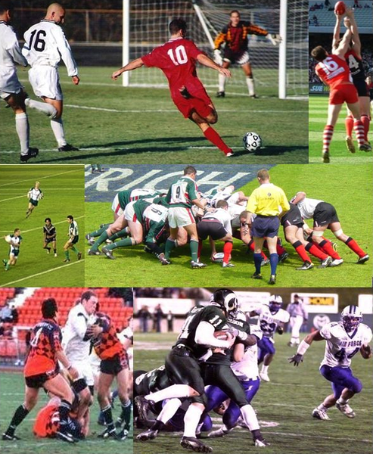
TOP 10 – 9/ SPORTS
The most popular sports in Great Britain are football (or soccer), rugby and cricket.

Slide 19
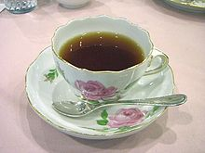
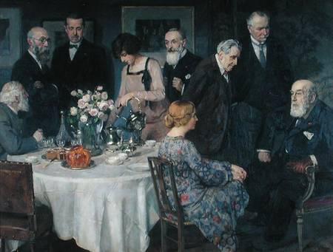
TOP 10 – 10/ TEA
Tea is usually served with milk and white sugar
Afternoon tea traditionally known as low tea, is a light meal snack typically eaten between 2pm and 5pm
The custom of drinking tea originated in England when Catherine of Bragança married Charles II in 1661 and brought the practice of drinking tea in the afternoon with her from Portugal.

Slide 20
[Cit. 2011-05-05].dostupný pod licencí Creative Commons na WWW:
http://en.wikipedia.org/wiki/United_Kingdom
http://simple.wikipedia.org/wiki/United_Kingdom
http://en.wikipedia.org/wiki/List_of_mountains_and_hills_of_the_United_Kingdom
http://en.wikipedia.org/wiki/River_Thameshttp://en.wikipedia.org/wiki/File:Stonehenge2007_07_30.jpg
http://en.wikipedia.org/wiki/List_of_tallest_buildings_and_structures_in_London
http://en.wikipedia.org/wiki/File:White_cliffs_of_dover_09_2004.jpg
http://en.wikipedia.org/wiki/The_Beatles
http://en.wikipedia.org/wiki/William_Shakespeare
http://en.wikipedia.org/wiki/Tea_(meal)

