Slide 1

NÁZEV: VY_32_INOVACE_18_Have got
NÁZEV ŠKOLY: Základní škola Hnátnice, okres Ústí nad Orlicí
AUTOR: Jana Hofrichterová
TÉMA SADY: Anglický jazyk II
ČÍSLO PROJEKTU: CZ.1.07/1.4.00/21.1871
DATUM: 26. 5. 2012
ROČNÍK: 4.

Slide 2
Anotace
materiál je určen k procvičení slovesa mít a rozšíření slovní zásoby: domácí mazlíčci
po výukové části si žáci učivo procvičují podle instrukcí na jednotlivých snímcích

Slide 3
To have got- pets

Slide 4

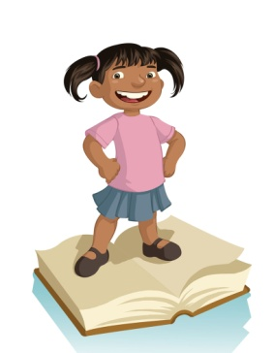
To have got
I have got - I’ve got
We have got - we’ve got
You have got - you’ve got
He has got - he’s got
You have got - you’ve got
She has got - she’s got
They have got - they’ve got
It has got - it’s got

Slide 5
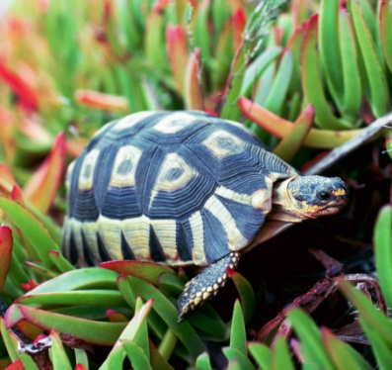
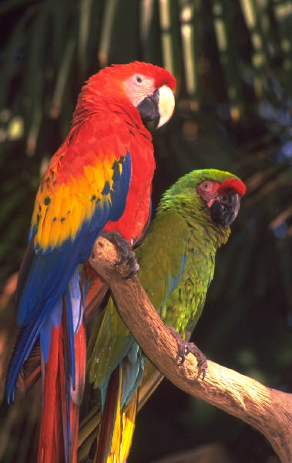
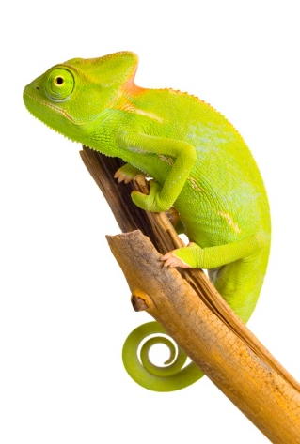
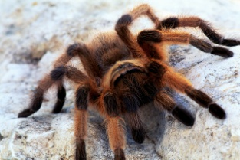
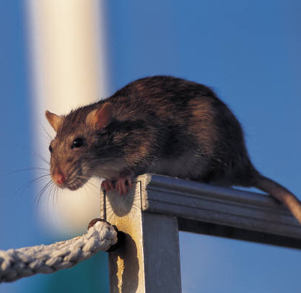
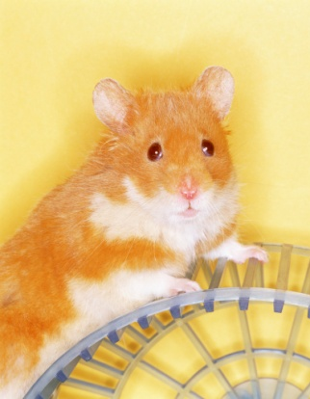
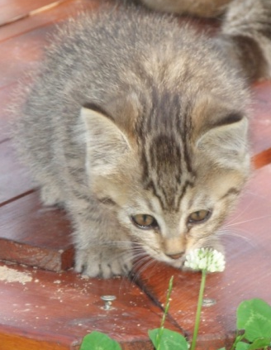
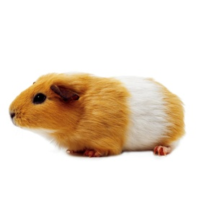
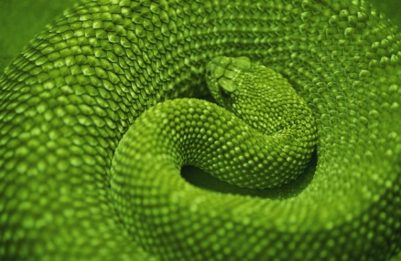
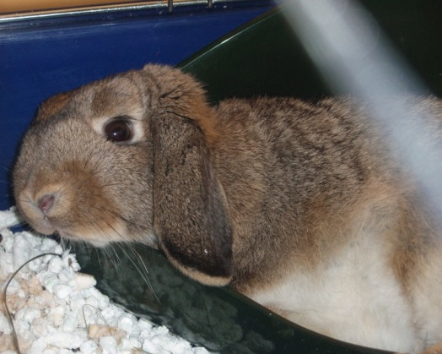
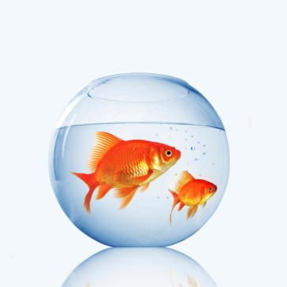
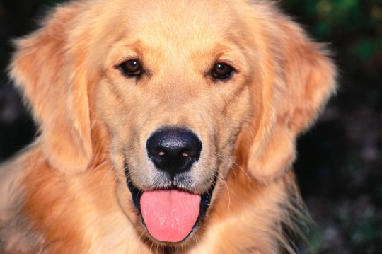
My pet
tortoise
parrot
spider
mouse
lizard
hamster
guinea pig
cat
snake
rabbit
fish
dog

Slide 6









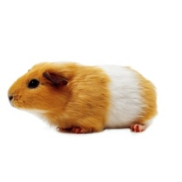





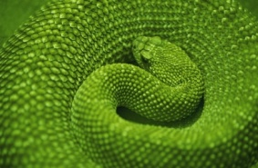



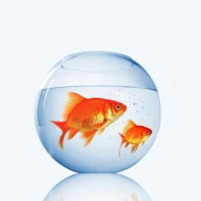




I´ve got
a fish.
I´ve got
a lizard.
We´ve got a parrot.
I´ve got
a dog.
Přiřaď dětem jejich domácí mazlíčky.
Kontrola je na dalším snímku – kliknutím na fotky dětí.
I´ve got
a mouse.
We´ve got a hamster.
I´ve got
a cat.
I´ve got
a spider.
I´ve got
a tortoise.
I´ve got
a guinea pig.
I´ve got
a rabbit.
We´ve got
a snake.

Slide 7
I´ve got
a fish.
I´ve got
a lizard.
We´ve got a parrot.
I´ve got
a dog.
I´ve got
a mouse.
We´ve got a hamster.
I´ve got
a cat.
I´ve got
a spider.
I´ve got
a tortoise.
I´ve got
a guinea pig.
I´ve got
a rabbit.
We´ve got
a snake.

Slide 8
I´ve got
a fish.
I´ve got
a lizard.
We´ve got a parrot.
I´ve got
a dog.
I´ve got
a mouse.
We´ve got a hamster.
I´ve got
a cat.
I´ve got
a spider.
I´ve got
a tortoise.
I´ve got
a guinea pig.
I´ve got
a rabbit.
We´ve got
a snake.

Slide 9
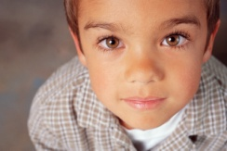



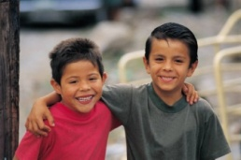

She´s got a hamster.
Tvoř podobné věty ke každému obrázku.

Slide 10
She´s got a hamster.
She´s got a cat.
He´s got a mouse.
They´ve got a dog.
They´ve got a lizard.
He´s got a guinea pig.
He´s got a spider.
She´s got a rabbit.
She´s got a fish.
He´s got a tortoise.
They´ve got a snake.
They´ve got a parrot.

Slide 11
To have got -
qustions + answers
Have I got a tortoise?
Yes, I have. x No, I haven´t.
Have you got a lizard?
Yes, you have. x No, you haven´t.
Has he got a hamster?
Yes, he has. x No, he hasn´t.
Has she got a guinea pig?
Yes, she has. x No, she hasn´t.
Has it got a big ears?
Yes, it has. x No, it hasn´t.
Have we got a parrot?
Yes, we have. x No, we haven´t.
Have they got a snake?
Yes, they have. x No, they haven´t.

Slide 12

!
!
Don´t
forget !
Have you got a dog?
Have you got a dog?
Yes, I have.
No, I haven´t.

Slide 13
Doplň odpovědi na otázky
kontrola kliknutím
Have you got a lizard?
Have you got a dog?
Yes, I have.
No, I haven´t.
Have you got a tortoise?
Have you got a rabbit?
Yes, I have.
No, I haven´t.

Slide 14
Have you got a guinea pig?
Have you got a spider
No, we haven´t.
No, I haven´t.
Have you got a fish?
Have you got a rabbit?
Yes, I have.
Yes, I have.

Slide 15

Doplň do vět have nebo has.
Kontrola kliknutím.
He ________ got a guinea pig.
I _________ got a mouse.
We _________ got a dog.
Julia _________ got a hamster.
Peter and Paul ________ got a cat.
has
have
have
has
have

Slide 16
Doplň do vět have nebo has.
Kontrola kliknutím.
_______ you got a rabbit?
_______ she got a lizard?
_______ they got a tortoise?
_______ Jack got a snake?
_______ John and Ken got a parrot?
Have
Has
Have
Has
Have

Slide 17
Doplň do vět have/has nebo haven´t/hasn´t .
Yes, I ______.
No, we ________ .
No, she _________ .
Yes, they _______ .
Yes, he ______ .
have
haven´t
hasn´t
have
has

Slide 18
obrázky jsou z webové galerie: http://office.microsoft.com/cs-cz/images/?CTT=6&ver=14&app=powerpnt.exe

