Slide 1

NÁZEV: VY_32_INOVACE_19_Present simple
NÁZEV ŠKOLY: Základní škola Hnátnice, okres Ústí nad Orlicí
AUTOR: Jana Hofrichterová
TÉMA SADY: Anglický jazyk II
ČÍSLO PROJEKTU: CZ.1.07/1.4.00/21.1871
DATUM: 29. 5. 2012
ROČNÍK: 5.

Slide 2
Anotace
materiál je určen k prezentaci a procvičení přítomného prostého času a frekvenčních příslovcí
na snímcích 4 – 5 si žáci opakují slovesa, která se často vyskytují v přítomném prostém čase
po výukové části (snímky 6, 7 a 10) si žáci učivo procvičují podle instrukcí na jednotlivých snímcích

Slide 3
Present simple

Slide 4
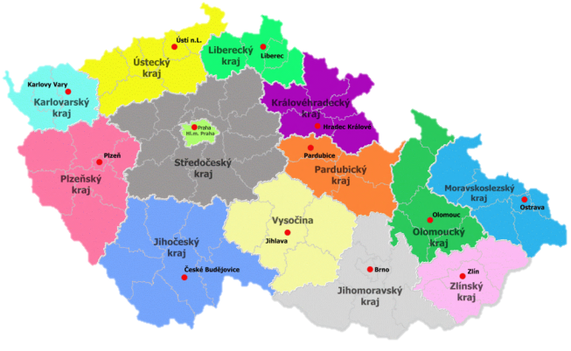
WORK
LIVE
SPEAK
hhh
dae
LISTEN
EAT
WATCH

Slide 5
GET UP
PLAY
RIDE A BIKE
SKATE
SWIM
READ

Slide 6




Present simple tense – přítomný prostý čas
(používá se k vyjádření děje, který probíhá opakovaně)
I read
you read
he reads
she reads
it reads
we read
you read
they read
!
ve 3. osobě čísla jednotného nezapomeň přidat – s
nebo – es u sloves končících na -o , -s, -sh, -ch:
goes, does, wishes, watches

Slide 7
Frequency adverbs
 | always /every day | often | sometimes | never
MO | P | P | P | x
TUE | P | x | x | x
WE | P | P | P | x
THU | P | P | x | x
FR | P | P | x | x
SA | P | x | P | x
SU | P | P | x | x

Slide 8
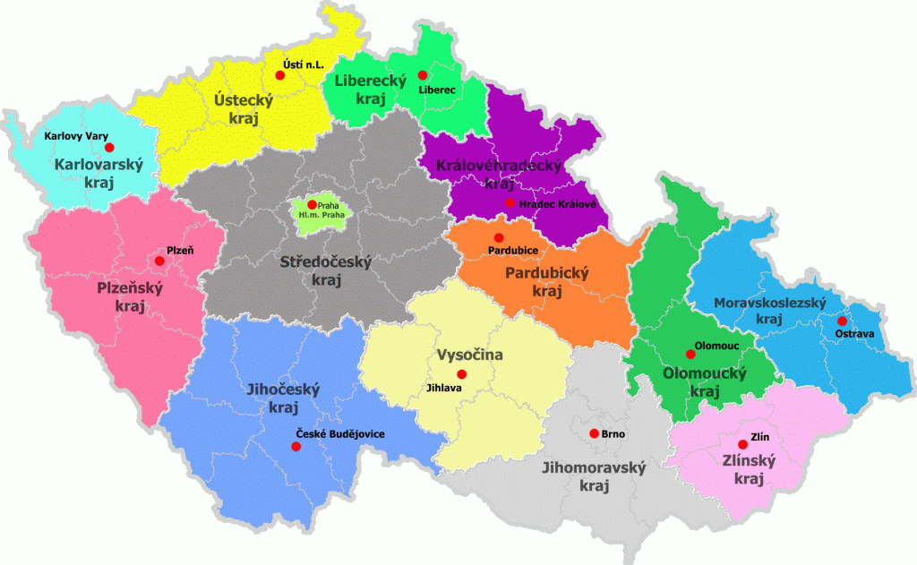
Doplň do vět správná slovesa ve správném tvaru
KONTROLA
hhhdae
She ______ as a
waitress.
Do you _______ English?
I _____ in Prague.
works
live
speak
He ______ to music every day.
They sometimes ________ TV .
_______ at it!
Look
listens
watch

Slide 9
Doplň do vět správná slovesa ve správném tvaru
KONTROLA
She always ______ ___ at 9 o´clock.
My sister _______ tennis every day.
He sometimes _________a bike.
gets up
plays
rides
I go __________ on Saturdays.
She often ______ books.
I never _______.
skate
swimming
reads

Slide 10

Present simple tense - questions and answers
tvoří se pomocí slovesa DO/DOES
Do I read every day?
Do you read every day?
Does he read every day?
Does she read every day?
Do you read every day?
Do they read every day?
Yes, I do.
Yes, you do.
Yes, he does.
Yes, she does.
Yes, you do.
Yes, they do.
No, I don´t (do not).
No, you don´t (do not).
No, he doesn´t (does not).
No, she doesn´t (does not).
No, you don´t (do not).
No, they don´t (do not).
Do you read every day?
Yes, I do.
No, I don´t.
POZOR!!!

Slide 11
Doplň do vět Do nebo Does
(klikni na správnou kartičku)
Do
Does
_______ you often go shopping?
Do
Does
______ she sometimes skate?
Do
Does
______ they play football every Thursday?
Do
Does
______ he work as a policeman?
Do
Does
______ we ride a bike every weekend?
Do
Does
______ you go fishing every day?
Do
Does
______ he often play computer games?

Slide 12
Odpověz na otázky podle skutečnosti
Do you get up at 7 o´clock? Yes, __________________ .
Do they live in the USA? Yes, __________________ .
Does he sometimes ride a bike? No, __________________ .
Do you often listen to music? Yes, __________________ .
Does she eat pizza for lunch? No, __________________ .
Do we go swimming on Fridays? Yes, __________________ .
Does he watch Tv every day? Yes, __________________ .
Do you speak German? No, __________________ .

Slide 13
Přečti si text a potom odpověz na otázky
Hello, I am Cindy. I´m thirty - two. I live in London. I work as a doctor. I speak English , French and German. I usually get up at 8 o´clock. Every day I listen to music and read books. Sometimes I ride a bike. On Mondays I play tennis. On Fridays I go swimming. I go shopping on weekends. I never watch Tv.
KONTROLA
Does she speak Czech?
Does she get up at 9 on Saturdays?
Does she sometimes go shopping?
Does she work as a doctor?
Does she play tennis every day?
Does she go swimming on Fridays?
Does she read books on Mondays?
Does she often watch Tv?
Does she live in England?
No, she doesn´t.
No, she doesn´t.
Yes, she does.
Yes, she does.
No, she doesn´t.
Yes, she does.
Yes, she does.
No, she doesn´t.
Yes, she does.

Slide 14
obrázky jsou z webové galerie: http://office.microsoft.com/cs-cz/images/?CTT=6&ver=14&app=powerpnt.exe

