Slide 1

Název školy: ZŠ Varnsdorf, Edisonova 2821, okres Děčín, příspěvková organizace
Jazyk a jazyková komunikace, Anglický jazyk, Austrálie
Autor: Michaela Galbavá, DiS.
Název materiálu: VY_22_INOVACE_25/I.SADA
Anotace: Prezentace je určena pro žáky II.stupně ZŠ, slouží k výkladu a opakování učiva Austrálie
Období: září – prosinec 2011

Slide 2
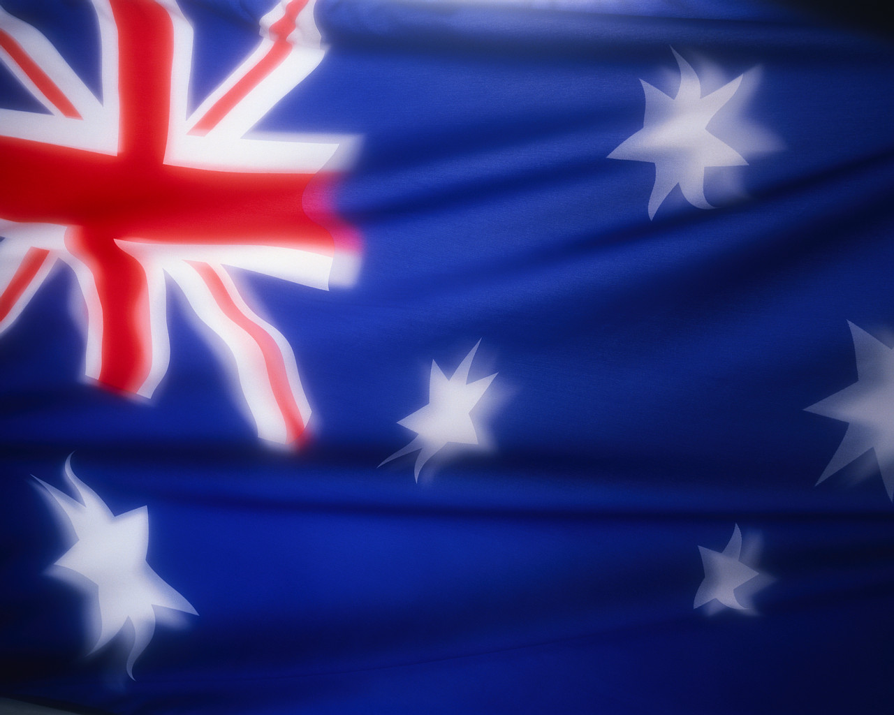
Australia
The Australian flag consists of a small Union Jack in the top left corner on a blue background and the Southern Cross Constellation. There is a seven-pointed star (six points represent the six states, and one point is for the territories.)

Slide 3
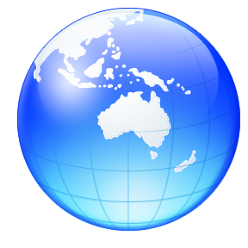
Australia
Australia is a member of British Commonwealth of Nations.
Australia is the smallest continent in the world.
It is situated between the Pacific and the Indian Oceans in the southern hemisphere.
To Australia belongs the island
of Tasmania and many smaller islands
in the Pacific and Indian Oceans.

Slide 4
6 States
Western Australia
New South Wales
2 Territories
Northern Territory
Australian Capital Territory
Australia is divided into:
Queensland
Victoria
South Australia
Tasmania

Slide 5
Basic facts
The Capital: Canberra
Official Language: None
Anthem: God save the Queen
Population: 22,745,103
Spoken Language: English
Cities: Melbourne, Perth, Adelaide, Brisbane
The largest city: Sydney

Slide 6
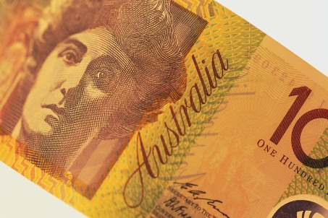
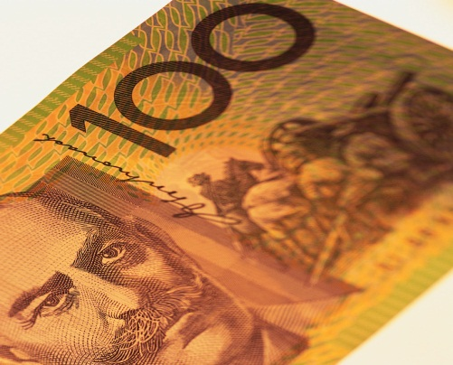
Basic facts
Head of the state: Queen Elizabeth II., she is represented by Governor General
Currency: Australian Dollar
Rivers: The Darling River, The Murray River
The highest mountain: Mount Kosciusko (2,228m)
Deserts: The Great Victoria Desert, The Great Sandy Desert
Lakes: Lake Eyre, Lake Torrens, Lake Gairdner

Slide 7
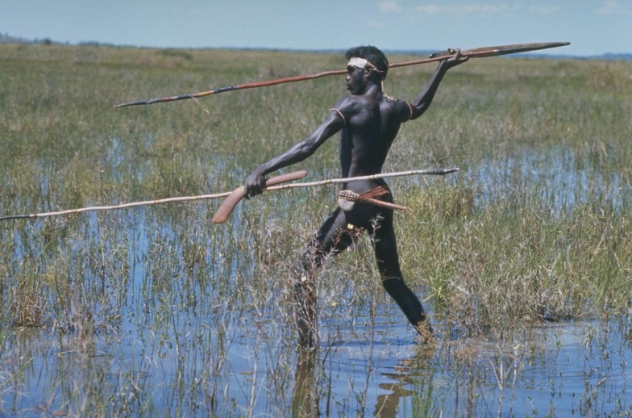
History
The island was discovered by Captain
James Cook in 1770.
Tasmania was discovered by the Dutch seaman Abel Tasman.
The first European settlers were mostly convicts.
Australia was British colony.

Slide 8
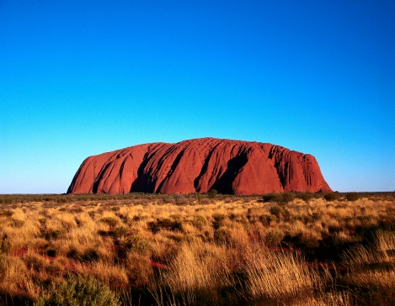
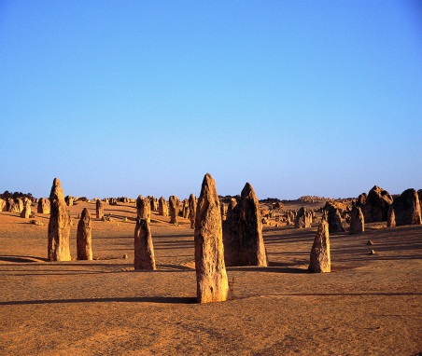
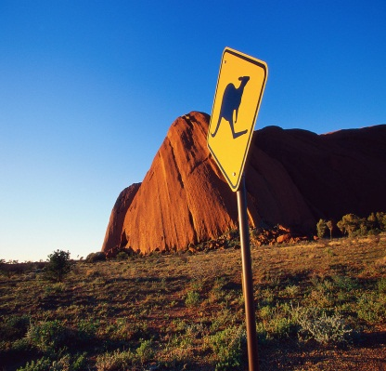
Geograpy
Australia is mostly plain.
Great part of the surface is desert.
Australia has the Australian Alps, the Great Diving Range.
Very famous are Ayers Rock (Uluru) – it has a special meaning for the Aborigines.
    It I the largest piece of rock in the world.
Other mysterious mountains are MacDonell Ranges and Flinders Ranges.

Slide 9
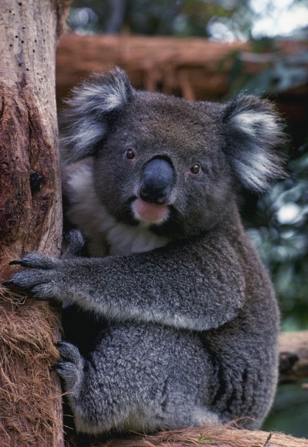
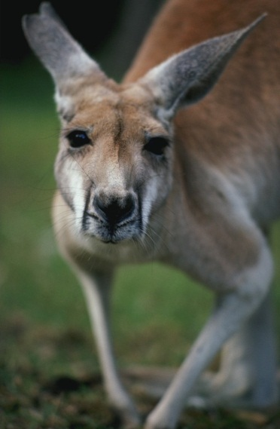
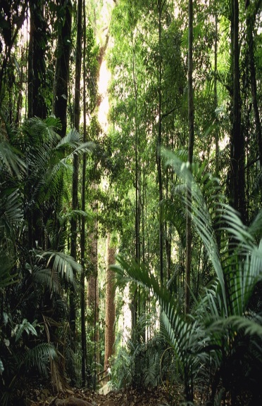
Flora and Fauna
Australia has a lot of unique:
  Animals like kangaroo, koala, emu, kiwi, echidna, cockatoo, dingo, wombat, platypus etc.
  Plants like eucalyptus, wattle (it is the national flower)

Slide 10
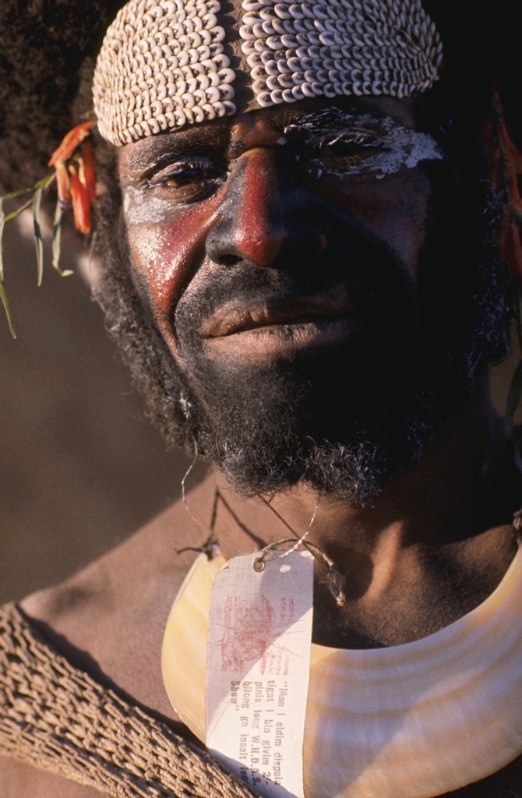
The Aborigines
The Aborigines are the original inhabitants.
They arrived from Asia about 40,000 years ago.
The used boomerangs for hunting.
1869-1969 – Stolen Generations (Stolen children) – aboriginal children were removed from their families by government to assimilate among the whites.

Slide 11
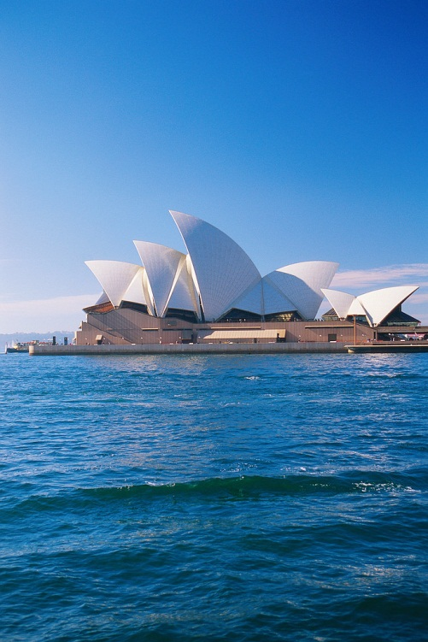
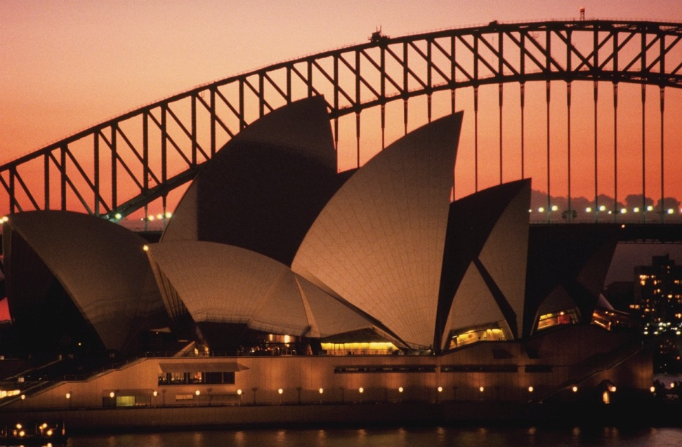
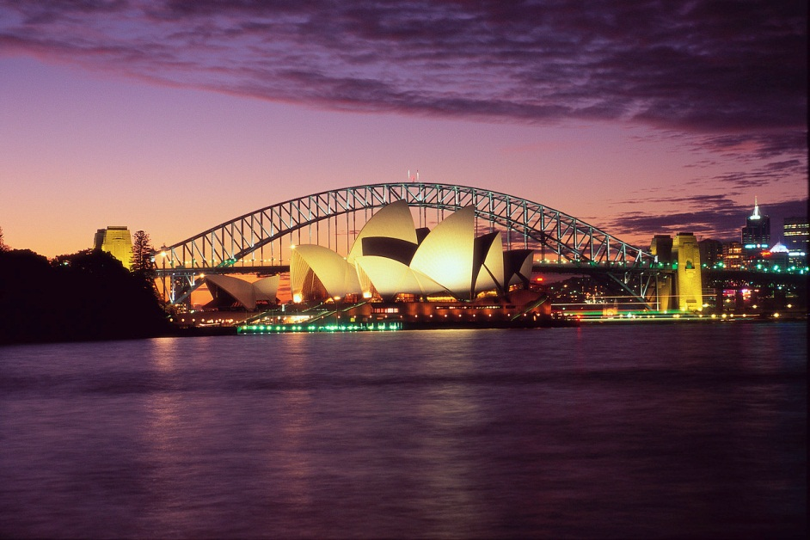
Sydney
Is the most populous city in Australia
The most well/known attractions include
  The Sydney Opera House
  The Sydney Harbour Bridge

Slide 12
Review
What is the Capital?
What are the symbols of Sydney?
Do you know about its history?
What are the typical Australian animals and plants?
Can you name four Australia cities?
How is Australia divided?
Who were the original inhabitants?
Who is the head of the country?
Do you remember the flag and national anthem?
Would you like to visit Australia? Why?
What is the official language?
Do you know the name of the Australia Currency?

Slide 13
Použité zdroje
Všechny obrázky prezentace byly použity z galerie Office.microsoft.com, citováno 28.10.2011

