Slide 1

Základní škola a Mateřská škola Choustník, okres Tábor
VY_32_Inovace_03A_holidays II

Slide 2
HOLIDAYS II
Talking about past actions
MORE 2 / UNIT 3

Slide 3
Talk about your holidays :
WHERE DID YOU GO LAST HOLIDAYS?
WHO DID YOU GO WITH?
HOW DID YOU GO THERE?
HOW LONG DID YOU STAY THERE?
WHAT DID YOU DO THERE?

Slide 4
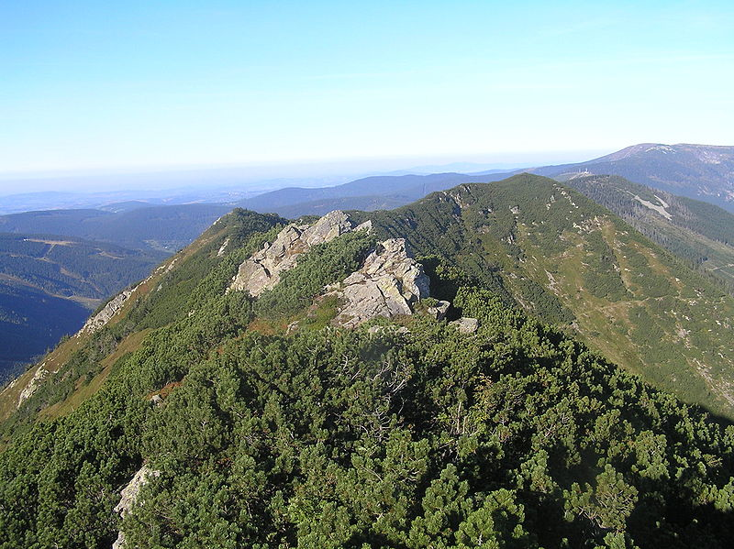
Krkonoše
to go by car there
to visit Pec pod Sněžkou
to live in a mountain cottage Šohajka
to climb up the highest Czech mount Sněžka 1602 metres high

Slide 5
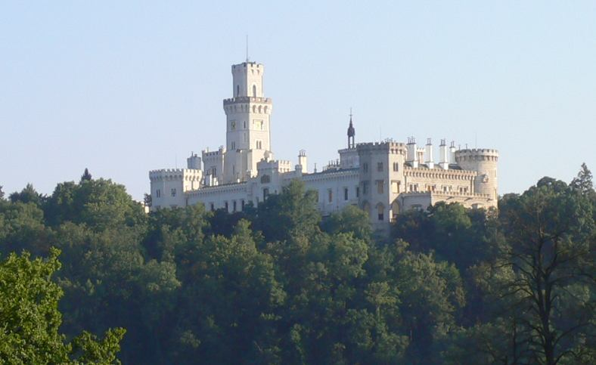
Hluboká nad Vltavou
to visit the Hluboká Castle
to go with parents
to go to the ALEŠ South Bohemian Gallery
to see Gothic paintings and statues

Slide 6
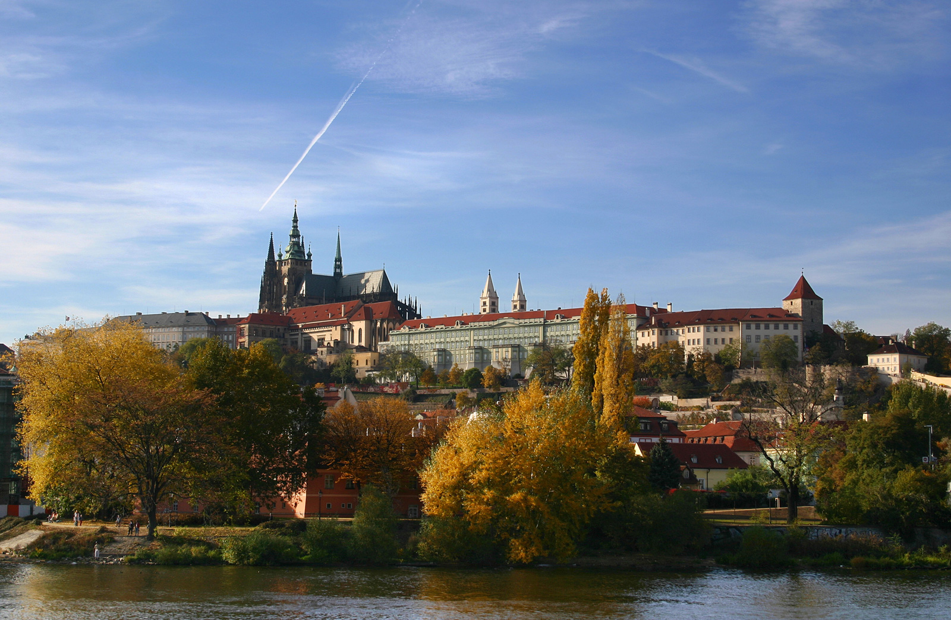
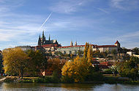
Praha
to go by train to Prague
to take photos of the Castle on the Hradčany
to eat in a restaurant
to see an Astronomical clock in the Old Town Square
to send picture postcards
to our grandparents

Slide 7
[Cit. 2011-01-06] dostupný pod licencí Creative Commons na WWW:
http://cs.wikipedia.org/wiki/Soubor:Koz%C3%AD_h%C5%99bety2.JPG
http://cs.wikipedia.org/wiki/Soubor:Schloss_Frauenberg.jpg
http://upload.wikimedia.7val.com/img/wikipedia/commons/d/d4/Hradschin_Prag.jpg

