Slide 1


Střední hotelová škola, s.r.o.
Floriánské náměstí 350, 272 01 Kladno
Digitální učební materiál
Číslo projektu | CZ.1.07/1.5.00/34.0112
Název projektu | Moderní škola
Název školy | Střední hotelová škola, s.r.o., Floriánské nám. 350, Kladno
Předmět | Anglický jazyk
Tematický okruh | Specifika národních kuchyní
Téma | English Eating Habits
Ročník | 2. a 3.
Jméno autora | Mgr. Dalibor Bartoš
Datum tvorby | 5. 1. 2013
Anotace | Student se seznámí se základními stravovacími návyky ve Velké Británii

Slide 2
English eating habits
Basic vocabulary

Slide 3
There is no expression in English for „dobrou chuť“, which perhaps reflects the English attitude to food

Slide 4
Breakfast
Traditional: fried or grilled bacon and eggs, sausages; grilled tomatoes; spicy beans; buttered toast; marmelade (citrus fruits)
Modern: a bowl of cereal followed by toast and marmelade. Coffee and tea

Slide 5
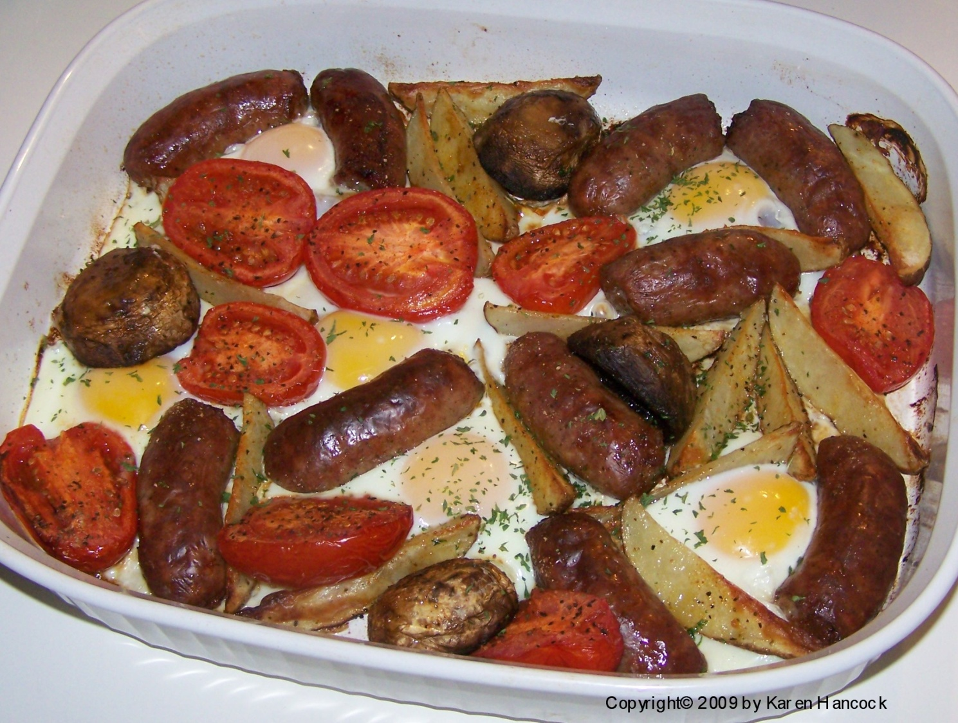
Traditional British Breakfast

Slide 6
Elevenses
In the middle of the morning
A cup of coffee and biscuits

Slide 7
Brunch
A combination meal which is eaten for breakfast and lunch
When they get up later

Slide 8
Lunch
Light
Soup (beef, vegetable, chicken, tomato, mushroom, celery, cauliflower)
A salad
Ham and cheese sandwiches
Pizza
Hamburgers
A dessert

Slide 9
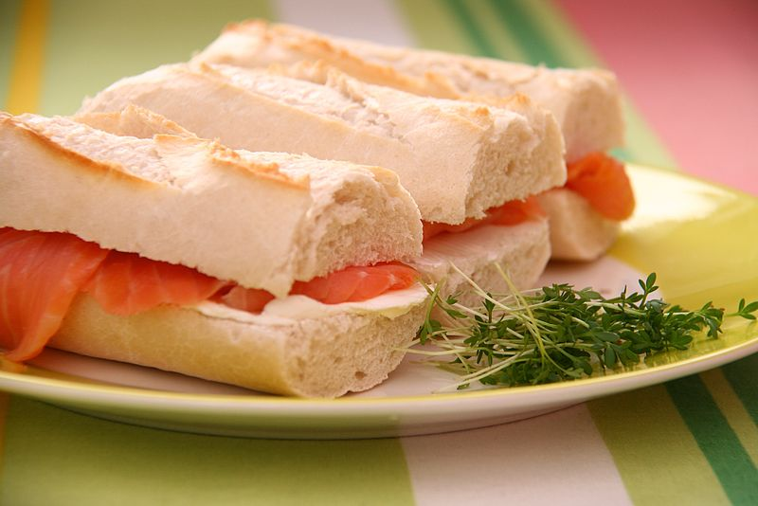
English lunch

Slide 10
Teatime
Tea or coffee with milk
Slice of white or brown bread and butter with cheese, fish or ham
Cakes, fruit pies, biscuits
Jam (made of other kinds of fruit than citruses

Slide 11
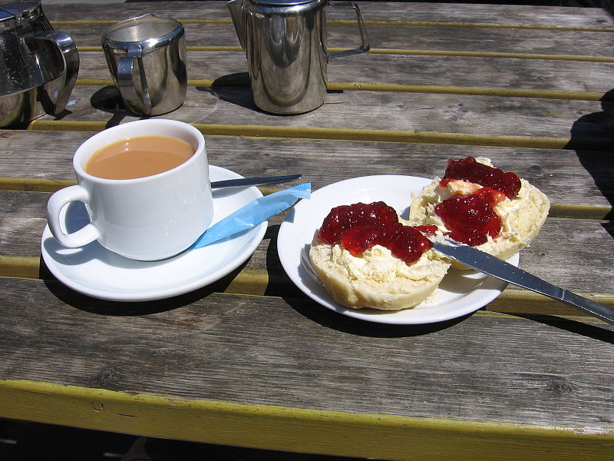
Teatime

Slide 12
Dinner
Served around 7 o´clock
Three or four courses
Soup (fish, meat)
Main course (a stew, chops, a meat pie, a roast joint, fish with potatoes and other vegetables
Dessert (fruit, fruit pie, fruit cake, pudding with custard, jelly with cream, ice cream)

Slide 13
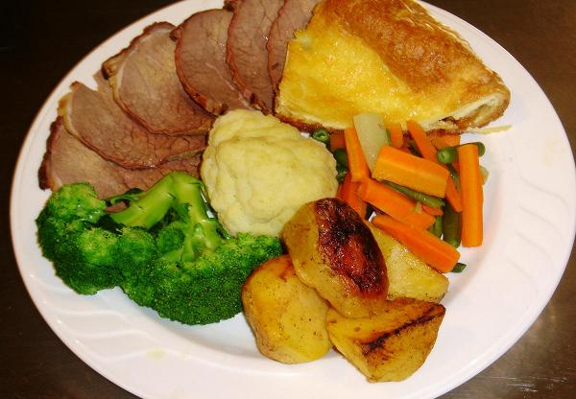
English dinner

Slide 14
Použité zdroje
HANCOCK, Karen. English Breakfast Bake Recipe [online]. [cit. 10.1.2013]. Dostupný na WWW: http://www.bellaonline.com/articles/art61640.asp
MORENZ, Katrin. Wikipedia [online]. [cit. 10.1.2013]. Dostupný na WWW: http://en.wikipedia.org/wiki/File:Salmon_Cream_Cheese_Sandwiches.jpg
MANSKE, Magnus. Wikipedia [online]. [cit. 10.1.2013]. Dostupný na WWW: http://en.wikipedia.org/wiki/File:Cornish_cream_tea_2.jpg
JAMES, Susan. Susan James Meals [online]. [cit. 10.1.2013]. Dostupný na WWW: http://susanjamesmeals.com/page009.html

