Slide 1

Název školy: Základní škola a mateřská škola Domažlice , Msgre B. Staška 232, příspěvková organizace
Autor: Mgr. Jindřiška Šmídová
Název : VY_32_INOVACE_02_Fingers 1
Téma: Fingers 1
Číslo projektu: CZ.1.07/1.4.00/21.1437
Sada: Angličtina 8. ročník

Slide 2
Anotace
Ročník | 8. ročník
Druh materiálu | Prezentace pro interaktivní tabuli
Pomůcky | Sešit, psací potřeby
Cíl (inovace) | Procvičení a rozšíření slovní zásoby
Metodické pokyny | Žáci si opíší text do sešitu. Dobrovolný úkol – žáci se naučí text zpaměti.

Slide 3

FINGERS

Slide 4
Two fat gentlemen met in a lane,
Bowed most politely, bowed once again.
How do you do, how do you do,
And how do you do again?

Slide 5
Two thin ladies met in a lane,
Bowed most politely, bowed once again.
How do you do, how do you do,
And how do you do again?

Slide 6
Two tall policeman met in a lane,
Bowed most politely, bowed once again.
How do you do, how do you do,
And how do you do again?

Slide 7
Two little schoolboys met in a lane,
Bowed most politely, bowed once again.
How do you do, how do you do,
And how do you do again?

Slide 8
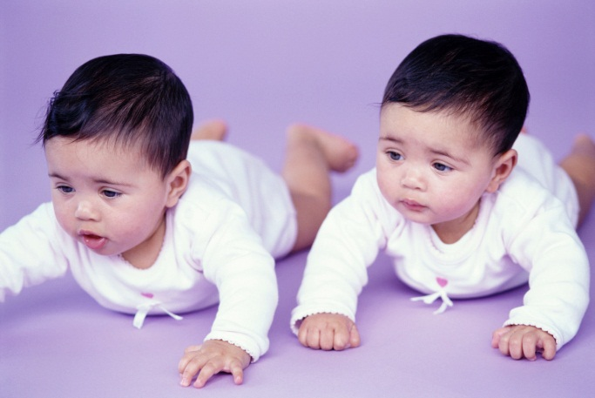
Two little babies met in a lane,
Bowed most politely, bowed once again.
How do you do, how do you do,
And how do you do again?

Slide 9
Two fat _______ met in a lane,
Bowed most ________, bowed once again.
How do you do, ______ you do,
And how do you do _______?

Slide 10
Two thin _______ met in a lane,
Bowed most politely, bowed once _______.
How ________, how do you do,
And how do you do _______?

Slide 11
Two tall _________ met in a lane,
Bowed most ________, bowed _______ again
How do you do, ______ do you do,
And how ______ you do again?

Slide 12
Two little _________ met in a lane,
Bowed ____ politely, bowed once again.
How do you do, ___ do you do,
And how do you do again?

Slide 13
Two little ______ met in a lane,
Bowed most politely, _____ once again.
How do you do, _____________,
And how do you do again?

Slide 14
And that‘s all ………

Slide 15
Citace
1.Ilustrace : www. office. microsoft.com

