Slide 1
History
Mgr. Zuzana Hnátová

Slide 2
Anotace
Kód Dumu : VY_32_INOVACE_1.AJ.04
Číslo projektu: CZ.1.07/1.5.00/34.0114
Vytvořeno: říjen 2012
Ročník: 3. ročník a 4. ročník - čtyřleté gymnázium (RVP-G)
Septima a Oktáva - osmileté gymnázium (RVP-G)
Vzdělávací oblast : Jazyk a jazyková komunikace
Vzdělávací obor: Anglický jazyk
Tematický okruh: The Czech Republic – History
Anotace:
Tento materiál byl vytvořen jako téma pro maturitní okruh: Česká republika na Gymnáziu a
JŠ Svitavy přibližně na jednu, popřípadě více vyučovacích hodin (pro výklad i opakování –
shrnutí učiva). Obsahuje jednak přehled faktografických údajů, tak i anglickou ustálenou
terminologii, doplněné o interaktivní cvičení: kvíz, otázky, rozhovory, videa, poslech….
Je primárně zaměřen na dva poslední ročníky gymnázia, i přesto se dá využít i v nižších ročnících
osmiletého i čtyřletého studia vcelku nebo jeho jednotlivé části
Pomůcky: interaktivní tabule, učebnice, handout

Slide 3
Contents
Tribes
Samo – Slavic state, Great Moravia
The Přemyslids, the Luxembourgh
John Huss
The Habsburgs, Rudolph II.
The Thirty Years War
The Czech National Revival
The Czechoslovak Republic, T.G. Masaryk

Slide 4
Contents
The Munich Agreement, the Protectorate of Bohemia and Moravia
Heydrich, Lidice
May Uprising
The rule of Communist Party
Prague Spring
Charter 77
The Velvet Revolution, Václav Havel
Split of Czechoslovakia
NATO, the EU

Slide 5
Tribes, Samo
Tribes
Samo
The 4th century BC – the Celtic tribes, the Boii – Bohemia
German and Slavic tribes
7th century
Frankish merchant
Samo's Empire in 623
The ruler of the Slavic state in Moravia – importance and further development – 833 Great Moravia established

Slide 6
The Přemyslids
1212 hereditary title of kings
Unified the Czech state
10-14th century – Václav I., Otakar I. .. Died by the sword 1306
Charles IV. – the Luxembourg Dynasty – the Holy Roman Emperor, highly-educated man, several languages, , culture-lover, Prague – the royal seat, the largest European centre of architecture, arts, education (+ son Wenceslas IV.) = the Golden Age
Charles Bridge, Karlštejn Castle, Charles University (1348)

Slide 7
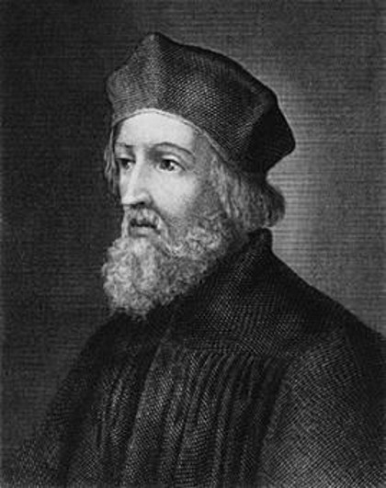
John Huss
1.
The religious leader, professor, dean and rector of Charles University
Burnt to death at stake as a heretic in Konstanz, Germany 1415
The Hussite Wars followed in the 15th century, the First Prague Defenestration

Slide 8
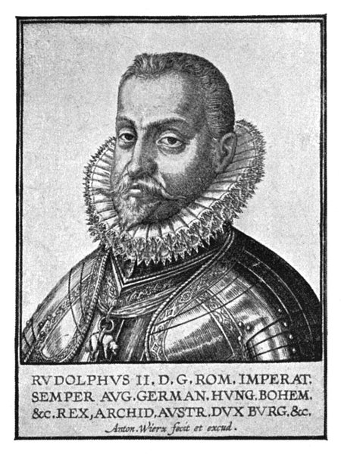
The Habsburgs
2.
1526 gained the throne
The Czech lands - part of the Austro-Hungarian Empire
Rudolph II. (1576-1612) – Prague the capital and cultural centre of Europe, place of mysticism and magic

Slide 9
The Thirty Years War
1618-1648, started by the Second Prague Defenestration, a revolt by protestants against Catholics
1620 – the Battle on the White Mountain, protestants defeated
Devastating effect on the country – persecution of non-Catholics, strong Germanisation of the Habsburgs
The Czech language driven away from schools, business, administration, not used by upper classes

Slide 10
The Czech National Revival
Stopped Germanisation
During 18-19th centuries revived the Czech language, national identity and culture
Mainly Czech national consciousness

Slide 11
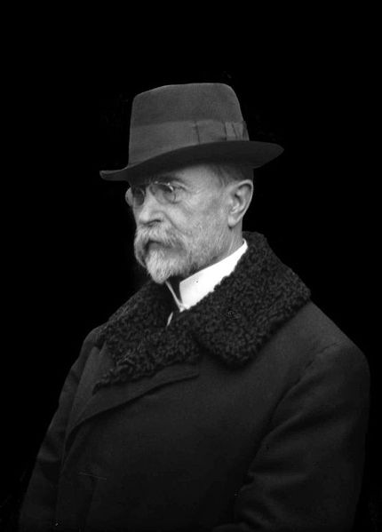
The Czechoslovak Republic, T.G.M.
3.
Created after the collapse of the Austro-Hungarian Emperor at the end of WWI in 1918, Czechs and Slovaks unified
T.G. Masaryk elected the first president

Slide 12
The Munich Agreement, the Protectorate
1938 a pact among Germany, Italy, Great Britain and France
1939 - the Sudetenland part of the Third Reich (Germany)
The Protectorate of Bohemia and Moravia, Slovakia independent

Slide 13
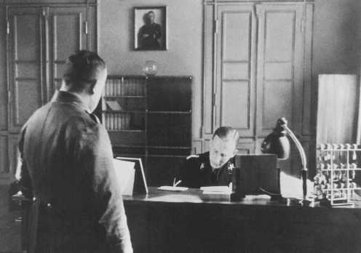
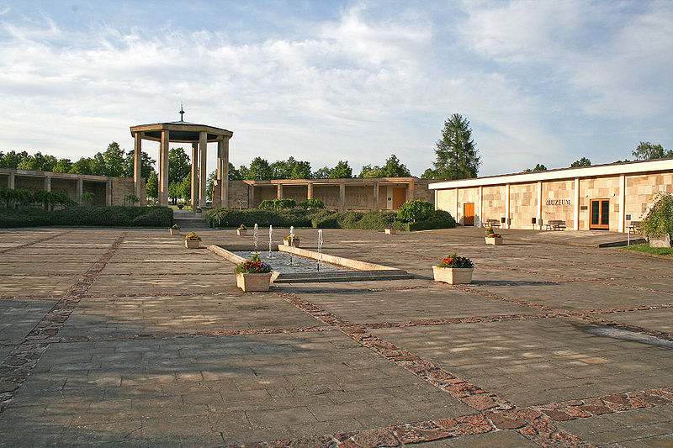
Heydrich, Lidice 1942
Deputy Reich Protector Heydrich assassinated in Prague
Lidice burnt down in revenge
4.
5.

Slide 14
May Uprising, the Communists
May Uprising 1945, the end of WWII
3 million Sudeten Germans driven away
The Communists
1946 – won the general election
1948 – came to power
1960 – new name of the country – the Czechoslovak Socialist Republic

Slide 15
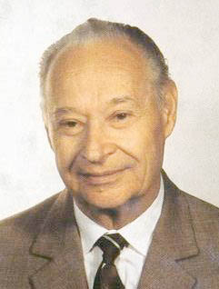
Prague Spring
6.
1968
Alexander Dubček – a process of democratisation
Opressed by the Soviets, the Armies of Warsaw Pact occupied country
Normalization followed for about 20 years

Slide 16
Charter 77
1977
An informal movement in Communist Czechoslovakia
Named after the document (from 1977)
Founders: Václav Havel, Zdeněk Mlynář, Jiří Hájek, Pavel Kohout
Criticized the government

Slide 17
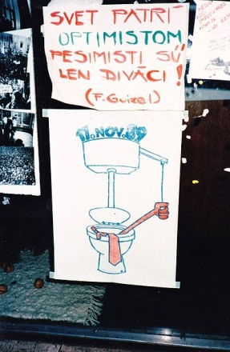
The Velvet Revolution
7.
1989
Freedom gained through a peaceful revolution
The end of communism
The Civic Forum founded
Václav Havel became president of democratic Czechoslovakia

Slide 18
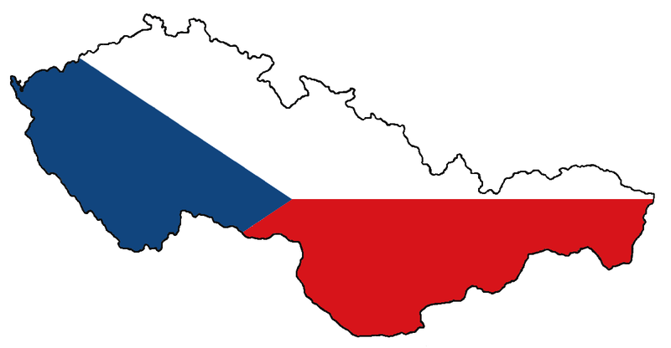
Split of Czechoslovakia
1993 – Czechoslovakia split into two independent countries: the Czech Republic and the Slovak Republic (Slovakia)
= the Velvet Divorce
8.

Slide 19
NATO, the EU
1999 – the CR joined NATO, also applied for a membership in the EU
2004 – the CR joined the EU
2007 – the CR a member of the Schengen Area
(NATO = the North Atlantic Treaty Organization,
The EU = the European Union)

Slide 20
Put the following historical events in the correct order
Split of Czechoslovakia
The Czech National Revival
The rule of Communist Party
NATO, the EU
Charter 77
Tribes
The Habsburgs, Rudolph II.
The Munich Agreement, the Protectorate of Bohemia and Moravia
The Přemyslids, the Luxembourgh
The Velvet Revolution, Václav Havel
The Thirty Years War
The Czechoslovak Republic, T.G. Masaryk
John Huss
Prague Spring
May Uprising
Samo – Slavic state, Great Moravia
Heydrich, Lidice

Slide 21
Zdroje a seznam použité literatury
Pictures
AUTOR NEUVEDEN. Commons.wikimedia.org [online]. [cit. 8.10.2012]. Dostupný na WWW: http://commons.wikimedia.org/wiki/File:Jan_hus_1.jpg.
WIERX ANTON. Commons.wikimedia.org [online]. [cit. 8.10.2012]. Dostupný na WWW: http://commons.wikimedia.org/wiki/File:Rudolf_II.imperator.png
ŠECHTL. Commons.wikimedia.org [online]. [cit. 8.10.2012]. Dostupný na WWW: http://commons.wikimedia.org/wiki/File:Tom%C3%A1%C5%A1_G_Masaryk1918.jpg .
AUTOR NEUVEDEN. Commons.wikimedia.org [online]. [cit. 8.10.2012]. Dostupný na WWW: http://commons.wikimedia.org/wiki/File:Heydrich_1934.jpeg
PS-2507 (PETER STEHLIK). Commons.wikimedia.org [online]. [cit. 8.10.2012]. Dostupný na WWW: < http://commons.wikimedia.org/wiki/File:Peter_Stehlik_2009.05.12_Lidice_004a.jpg >.
BODAJOZEF. Commons.wikimedia.org [online]. [cit. 8.10.2012]. Dostupný na WWW: < http://commons.wikimedia.org/wiki/File:Alexander_Dubcek.jpg >.
MD. commons.wikimedia.org [online]. [cit. 8.10.2012]. Dostupný na WWW: http://commons.wikimedia.org/wiki/File:Velvet_Revolution_Prague_Poster,_Nov._1989.jpg
JONESY 22. commons.wikimedia.org [online]. [cit. 8.10.2012]. Dostupný na WWW: http://commons.wikimedia.org/wiki/File:Czechoslovakia_color.png

Slide 22
Zdroje a seznam použité literatury
Books
AUTOR NEUVEDEN. The Czech Republic [online]. [cit. 22.10.2012]. Dostupný na WWW: <http://skola.amoskadan.cz/s_aj/ajhtm/at/at24.htm>.
SMITH-DLOUHÁ a kol. Angličtina – otázky a odpovědi .. Nejen k maturitě. Dubicko: INFOA, 2008, ISBN 978-80-7240-489-6.
AUTOR NEUVEDEN. Maturita Card 25: the Czech Republic [online]. [cit. 22.10.2012]. Dostupný na WWW: <http://www.bridge-online.cz/maturita/maturitni-karty>.
PERNICOVÁ Z.; LUHANOVÁ M.; PHILIPS P.. The Czech Republic [online]. [cit. 22.10.2012]. Dostupný na WWW: <http://www.bridge-online.cz/aitom/upload/maturita/temata/15_the_czech_personalities.pdf>.
AUTOR NEUVEDEN. Charter 77 [online]. [cit. 8.10.2012]. Dostupný na WWW: http://en.wikipedia.org/wiki/Charter_77

