Slide 1


Obchodní akademie a Jazyková škola
s právem státní jazykové zkoušky Jihlava
Šablona 32
VY_32_INOVACE_166.ANJ.12
Formal and informal letters - Elementary

Slide 2
Číslo projektu: CZ.1.07/1.5.00/34.0744
Šablona: VY_32_INOVACE
Číslo DUMU: 166.ANJ.12
Předmět: Anglický jazyk
Název materiálu: Formal and informal letters
Autor: Michaela Faltusová
Formát: Prezentace Microsoft Powerpoint
Velikost: 332 kB
Stupeň a typ vzdělávání: SŠ – odborné vzdělávání
Licence k obrazovému materiálu: CC BY, CC BY-SA
Datum vytvoření: 24. 1. 2013
Klíčová slova: formal letters, informal letters, vocabulary, phrases
Anotace: Základy psaní formálních a neformálních dopisů. Ukázka použitelných frází. Nácvik psaní dopisů.

Slide 3
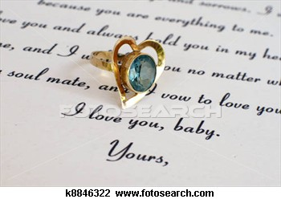
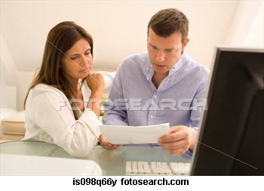
Formal and informal letters
Elementary

Slide 4
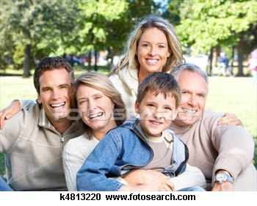
AN INFORMAL LETTER
– a letter to a friend or a member of a family

Slide 5
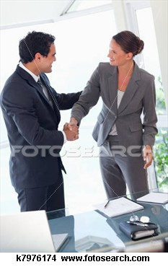
A FORMAL LETTER
- A letter to a business partner, college or any professionals

Slide 6
LAYOUT OF A LETTER
1. YOUR ADDRESS
2. THE NAME AND ADDRESS OF THE PERSON
TO WHOM YOU ARE WRITING
3. THE DATE
4. THE GREETING,
5. THE BODY OF THE LETTER (INTRODUCTION, MAIN PARTS, CONCLUSION)
6. THE ENDING
7. YOUR SIGNATURE

Slide 7
DO YOU KNOW HOW TO WRITE THE DATE?
WRITE THE DATE IN ENGLISH:
1.1.2013
6.4.2013
2.7.2013
23.10.2013

Slide 8
1st January January 1st
6th April April 6th
2nd July July 2nd
23rd December December 23rd

Slide 9
The greeting
Complete the chart. Which greetings belong to formal or to informal letters?
Dear John,
Dear Sir,
Dear Mr. Smith,
Dear Jane,
Dear Madam,
Dear Sir or Madam,
FORMAL LETTERS | INFORMAL LETTERS

Slide 10
The greeting
Complete the chart. Which greetings belong to formal or to informal letters?
FORMAL LETTERS | INFORMAL LETTERS
Dear Mr. Smith, | Dear John,
Dear Madam, | Dear Jane,
Dear Sir or Madam,
Dear Sir,

Slide 11
Phrases for an informal letter
Thanks for: - your letter
- your present
- your invitation.
I hope you are well.
It was good to see you last week.
Could you do something for me?

Slide 12
Phrases for a formal letter
I am writing to - inform you….
- to confirm our
I would like to
Could you possibly ….
I would be grateful if you could
I look forward to hearing from you.

Slide 13
The ending
Complete the chart. Which endings are suitable for formal or informal letters?
Love, Peter
Yours sincerely,
Best wishes,
Kind regards,
Yours faithfully,
Yours Jane,
FORMAL LETTERS | INFORMAL LETTERS

Slide 14
The ending
Complete the chart. Which endings are suitable for formal or informal letters?
,
FORMAL LETTERS | INFORMAL LETTERS
Yours sincerely | Love, Peter
Yours faithfully, | Best wishes,
 | Yours Jane,
 | Kind regards,

Slide 15
Yours sincerely x Yours faithfully
Yours faithfully,
If you don't know the name of the person you're writing to
Yours sincerely,
If you know the name of the person you're writing to

Slide 16
Use ideas on the next page to complete this letter.

Slide 17
Thanks for the invitation to your party on Friday.
Love,
It was so nice to see you last week.
I´ll be there at 8 o´clock.
Dear Petr,
I´ll bring some good red wine.
See you soon!

Slide 18
Use ideas on the next page to complete this letter.
Your address
Name and address of someone who you are writing to
Date
Dear Peter,
It was so nice to see you last week.
Thanks for the invitation to your party on Friday. I´ll be there at 8 o´clock. I´ll bring some good red wine. See you soon!
Love,
Your name

