Slide 1
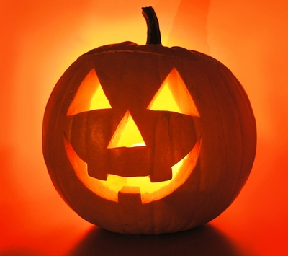

VY_22_INOVACE_AJ.5.3-4
HALLOWEEN
Obr.1

Slide 2
Complete the crossword:
1. čepice
2. netopýr
3. kostlivec
4. lucerna
5. strašidelný
6. čarodějnice
7. pavouk
8. sladkost
9. dýně
_ _ _ _ _ _ _ _ _

Slide 3
1.
2.
3.
4.
5.
6.
7.
8.
9.
H A L L O W E E N
 |  |  |  |  |  | H | A | T
 |  |  |  |  | B | A | T
 |  |  | S | K | E | L | E | T | O | N
 |  |  |  |  |  | L | A | N | T | E |  | R | N
 |  |  | S | P | O | O | K | Y
 |  |  |  |  |  | W | I | T | CH
 |  | S | P | I | D | E | R
 |  |  | S | W | E | E | T
P | U | M | P | K | I | N

Slide 4
Odkazy
Obr.1:http://www.google.cz/imgres?q=halloween&hl=cs&biw=1366&bih=576&gbv=2&tbm=isch&tbnid=p3eA5oKFxkNiVM:&imgrefurl=http://www.wellnessnoviny.cz/clanek/halloween-ve-vlnach/&docid=Z8_jMXTCVtyn4M&imgurl=http://www.wellnessnoviny.cz/image/2328/halloween-ve-vlnach.jpg&w=400&h=355&ei=5c9TT8SAOcLR4QTW-NjuDQ&zoom=1&iact=hc&vpx=508&vpy=190&dur=1612&hovh=211&hovw=238&tx=124&ty=106&sig=113371749014034453918&page=1&tbnh=165&tbnw=179&start=0&ndsp=11&ved=1t:429,r:2,s:0

