Slide 1

VY_32_INOVACE_23A_AJ – WHAT DO SEE IN THE PICTURE
Základní škola a Mateřská škola Choustník, okres Tábor

Slide 2
Procvičování známých slovíček
Otázka – co vidíš na obrázku

Slide 3

What do you see in the picture?
I see a hat in the picture.

Slide 4

What do you see in the picture?
I see ……… in the picture.

Slide 5
What do you see in the picture?
I see a horse in the picture.

Slide 6

What do you see in the picture?
I see………… in the picture.

Slide 7
What do you see in the picture?
I see a house in the picture.

Slide 8

What do you see in the picture?
I see ……… in the picture.

Slide 9
What do you see in the picture?
I see a chair in the picture.

Slide 10

What do you see in the picture?
I see a lamp in the picture.

Slide 11
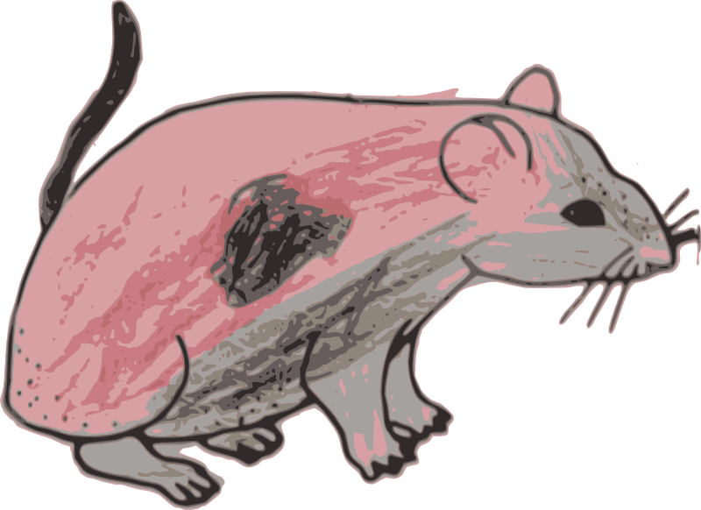
What do you see in the picture?
…………………….in the picture.

Slide 12
What do you see in the picture?
I see a mouse in the picture.

Slide 13
What do you see in the picture?
………………… in the picture.

Slide 14

What do you see in the picture?
……………… in the picture.

Slide 15
What do you see in the picture?
I see a pencil in the picture.

Slide 16

What do you see in the picture?
………………………………………………

Slide 17
What do you see in the picture?
I see a pig in the picture.

Slide 18

What do you see in the picture?
………………………………………………

Slide 19
What do you see in the picture?
I see a plum in the picture.

Slide 20

What do you see in the picture?
……………………………………………….

Slide 21
What do you see in the picture?
I see a pot in the picture.

Slide 22

What do you see in the picture?
……………………………………………….

Slide 23
What do you see in the picture?
I see the sun in the picture.

Slide 24

What do you see in the picture?
……………………………………………..

Slide 25
What do you see in the picture?
I see a tree in the picture.

Slide 26
Zdroj obrázků: Archiv autora

