Slide 2
MY FAMILY
Moje rodina

Slide 3
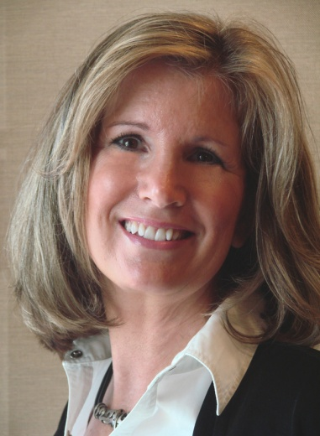
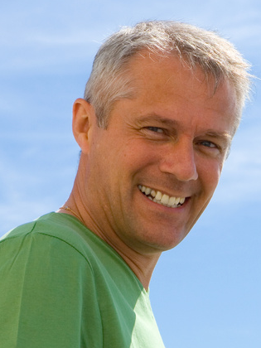
Who´s this?
thorem
fthare
This is my mother.
This is my father.

Slide 4
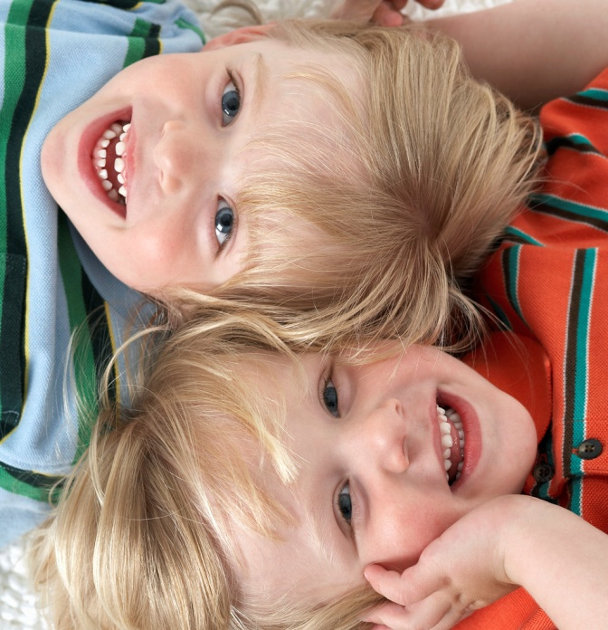
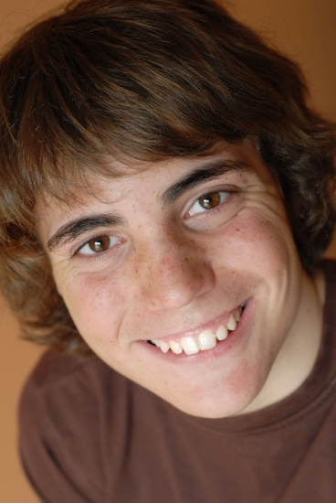
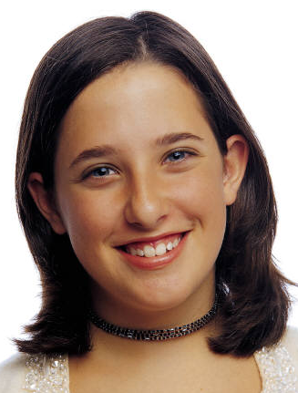
tresis
rebroth
Caroline
This is my sister Jane.
This is my brother Paul.
It´s me.

Slide 5
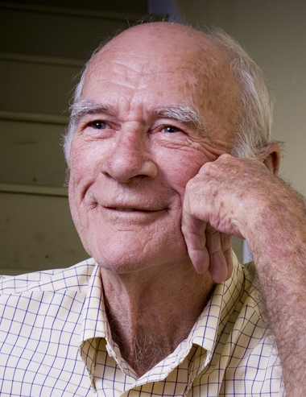
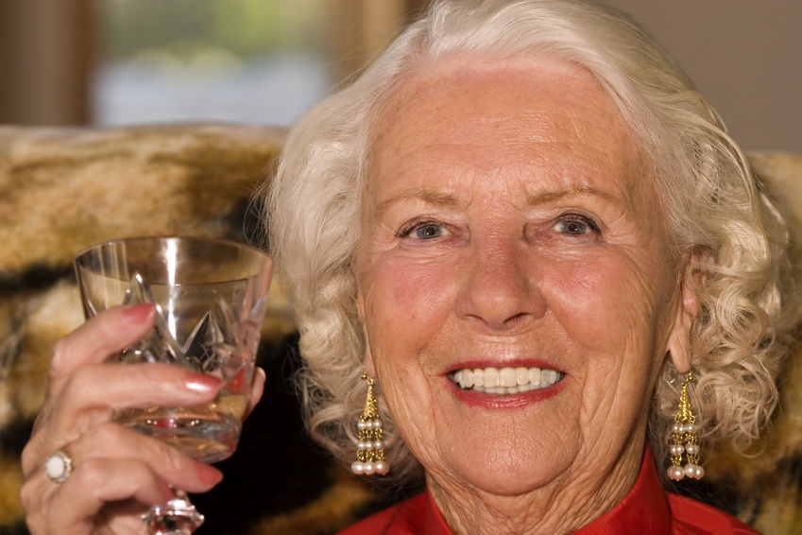
This is my grandparents
dagrnad
namgrad
This is my grandad.
This is my grandma.

Slide 6


Describe!
Jane
Paul
My sister is little.
She´s got blond hair
My brother Paul is older.
He´s got dark hair.

Slide 7
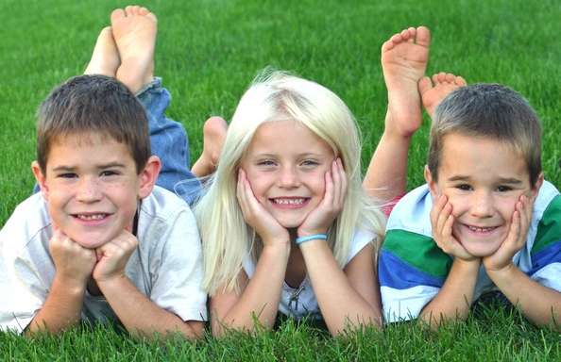
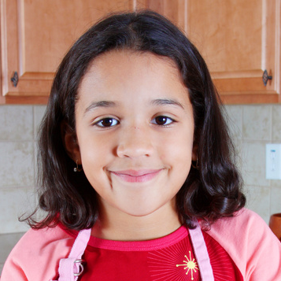
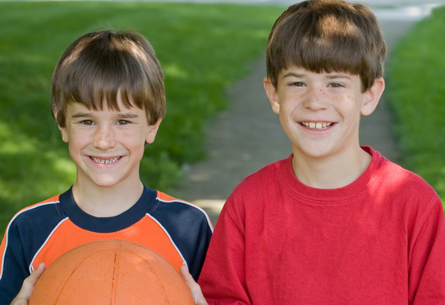
How many sisters and brothers have you got?
I have got one sister and two brothers.
I´ve got one sister.
I´ve got two brothers.

Slide 8
Zdroje:
Použité obrázky jsou z klipartů v programu PowerPoint

