Slide 1

EU peníze školám
Základní škola Čachovice a Mateřská škola Struhy, Komenského 96,
příspěvková organizace
Označení: VY_INOVACE_01_KvAj8
Předmět: Anglický jazyk
Ročník: 8.
Téma: Town
Název: Signs in a town
Autor: Vlasta Kouříková
Popis: Prezentace s přiřazováním nápisů

Slide 2
Metodika k materiálu
Žáci procházejí jednotlivými snímky (slidy) a vyhledávají správný nápis k obrázku, který kliknutím vyberou. Po kliknutí na správný nápis se nápis přesune vedle obrázku, jinak zůstane na svém místě.

Slide 3

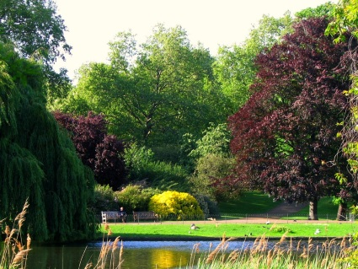
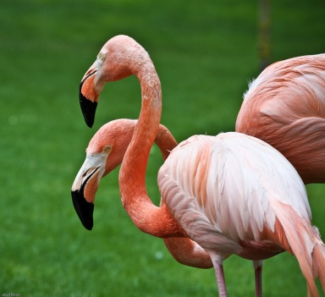
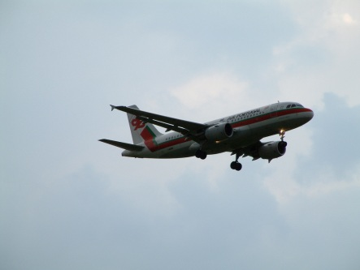
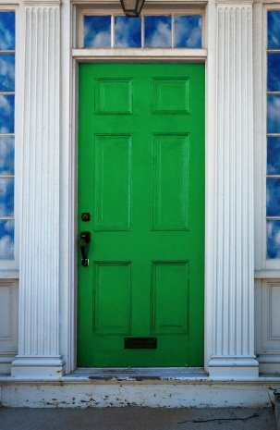
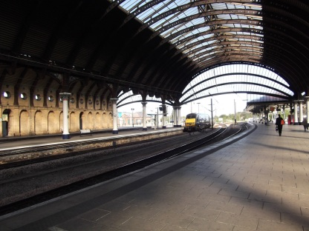
Signs in a town

Slide 4
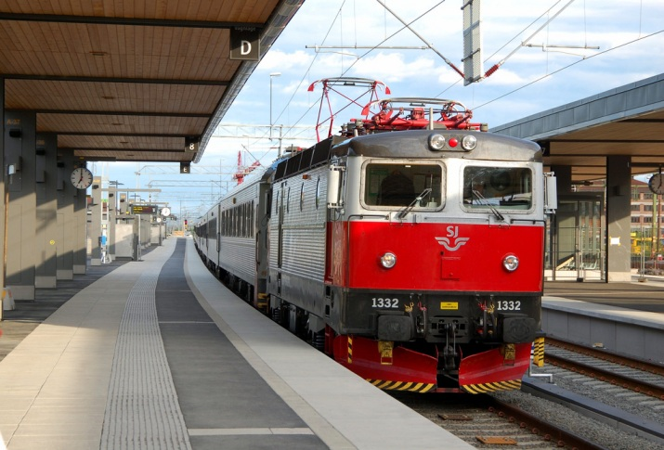
Do not lean out of the window
Do not walk on the grass
Please stand on the right
Do not lean out of the window
Please don’t feed the animals
No visitors
after 7 p.m.
Passengers must not cross the line
Fasten seat belts
Beware of the dog
PUSH
PULL
Queue this side

Slide 5

Please don’t feed the animals
Do not walk on the grass
Please stand on the right
Do not lean out of the window
Do not lean out of the window
Please don’t feed the animals
No visitors
after 7 p.m.
Passengers must not cross the line
Fasten seat belts
Beware of the dog
PUSH
PULL
Queue this side

Slide 6

Do not walk on the grass
Do not walk on the grass
Please stand on the right
Do not lean out of the window
Do not lean out of the window
Please don’t feed the animals
No visitors
after 7 p.m.
Passengers must not cross the line
Fasten seat belts
Beware of the dog
PUSH
PULL
Queue this side

Slide 7
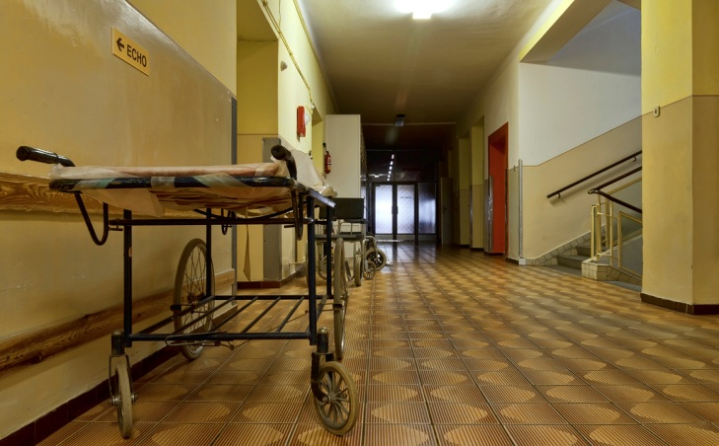
No visitors
after 7 p.m.
Do not walk on the grass
Please stand on the right
Do not lean out of the window
Do not lean out of the window
Please don’t feed the animals
No visitors
after 7 p.m.
Passengers must not cross the line
Fasten seat belts
Beware of the dog
PUSH
PULL
Queue this side

Slide 8
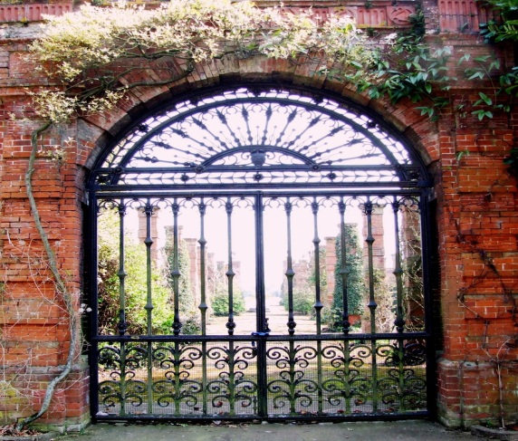
Beware of the dog
Do not walk on the grass
Please stand on the right
Do not lean out of the window
Do not lean out of the window
Please don’t feed the animals
No visitors
after 7 p.m.
Passengers must not cross the line
Fasten seat belts
Beware of the dog
PUSH
PULL
Queue this side

Slide 9
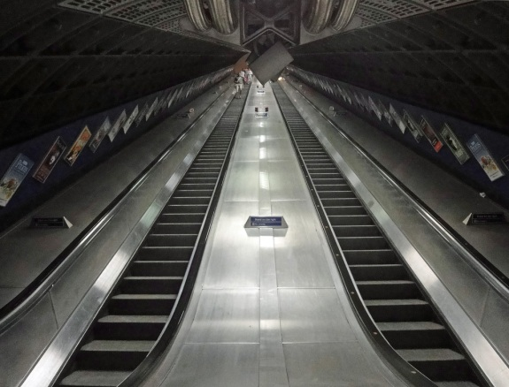
Please stand on the right
Do not walk on the grass
Please stand on the right
Do not lean out of the window
Do not lean out of the window
Please don’t feed the animals
No visitors
after 7 p.m.
Passengers must not cross the line
Fasten seat belts
Beware of the dog
PUSH
PULL
Queue this side

Slide 10

PUSH
PULL
Do not walk on the grass
Please stand on the right
Do not lean out of the window
Do not lean out of the window
Please don’t feed the animals
No visitors
after 7 p.m.
Passengers must not cross the line
Fasten seat belts
Beware of the dog
PUSH
PULL
Queue this side

Slide 11

Fasten seat belts
Do not walk on the grass
Please stand on the right
Do not lean out of the window
Do not lean out of the window
Please don’t feed the animals
No visitors
after 7 p.m.
Passengers must not cross the line
Fasten seat belts
Beware of the dog
PUSH
PULL
Queue this side

Slide 12
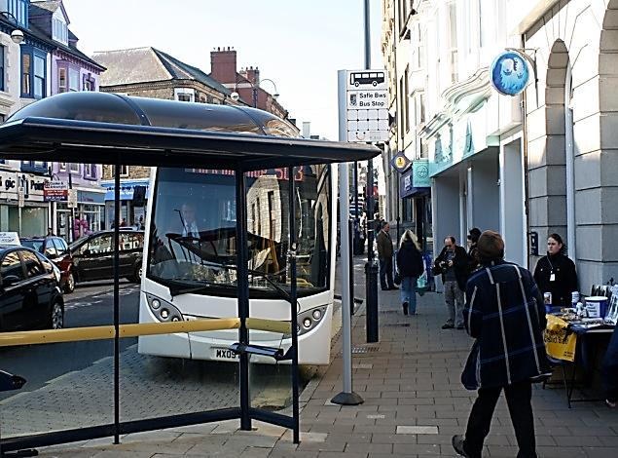
Queue this side
Do not walk on the grass
Please stand on the right
Do not lean out of the window
Do not lean out of the window
Please don’t feed the animals
No visitors
after 7 p.m.
Passengers must not cross the line
Fasten seat belts
Beware of the dog
PUSH
PULL
Queue this side

Slide 13

Passengers must not cross the line
Do not walk on the grass
Please stand on the right
Do not lean out of the window
Do not lean out of the window
Please don’t feed the animals
No visitors
after 7 p.m.
Passengers must not cross the line
Fasten seat belts
Beware of the dog
PUSH
PULL
Queue this side

Slide 14
Zdroj obrázků:
Všechny uveřejněné odkazy [cit. 2012-01-11]. Dostupné pod licencí Public Domain na WWW:
http://www.flickr.com/photos/abaransk/3673325713/sizes/l/in/photostream/
http://www.flickr.com/photos/ugardener/3292581624/
http://www.flickr.com/photos/kelehen/5593711738/
http://www.flickr.com/photos/77506989@N00/471287779/sizes/l/in/photostream/
http://www.flickr.com/photos/jb_1984/5920386022/
http://www.flickr.com/photos/brentdanley/2359749660/
http://www.flickr.com/photos/yahya/132962285/
http://www.flickr.com/photos/loudclaw/6282726935/
http://www.flickr.com/photos/timpers/6202892149/
http://www.flickr.com/photos/j3sus/4758162721/sizes/l/in/photostream/

