Slide 1

NÁZEV: VY_32_INOVACE_06_AJ_11
NÁZEV ŠKOLY: Základní škola, Uherský Ostroh, okres Uherské Hradiště, příspěvková organizace
AUTOR: Mgr. Ilona Jurčeková
TÉMA: AJ-9.A – London
ČÍSLO PROJEKTU: CZ.1.07/1.4.00/21.1616

Slide 2
ANOTACE
Tyto obrázky posloužily jako zábavné opakování tématu London.
Za každou kvízovou otázkou hned následuje další slide se správnou odpovědí.
Na závěr si můžete vytisknout kvíz.

Slide 3
Sightseeing in London
Následující obrázky znáte ze slavných filmů, reportáží či cestopisů.
Dokážete vybrat správnou odpověď z nabízených možností?

Slide 4
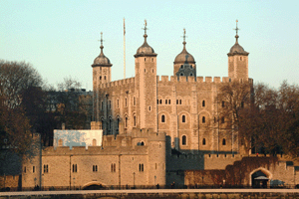
obr.1
1. What can you see in this picture?
a)Madame Tusseaud's
b)The Houses of Parliament
c)The Tower of London
d)Westminster Abbey

Slide 5
c)The Tower of London

Slide 6
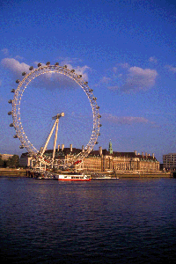
Obr.2
2.What can you see in this picture?
a)Greenwich
b)Hyde Park
c)Millenium Dome
d)The London Eye

Slide 7
d)The London Eye

Slide 8
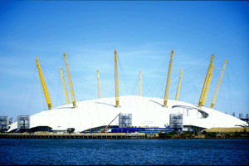
Obr.3
3. What's in this picture?
a)Hyde Park
b)London Eye
c)Millenium Dome
d)Wembley Stadium

Slide 9
c)Millenium Dome

Slide 10
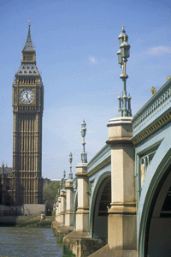
Obr.4
4. What's in this photo?
a)Big Ben
b)Greenwich Observatory
c)Tower Bridge
d)Westminster Abbey

Slide 11
a)Big Ben

Slide 12
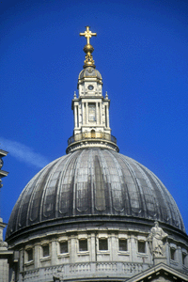
Obr.5
5. Do you recognize this?
a)Big Ben
b)Buckingham Palace
c)St. Pauls Cathedral
d)Westminster Abbey

Slide 13
c)St. Pauls Cathedral

Slide 14
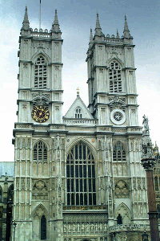
Obr.6
6. What's the name of this building?
a)Greenwich Observatory
b)The Houses of Parliament
c)The Tower of London
d)Westminster Abbey

Slide 15
d)Westminster Abbey

Slide 16
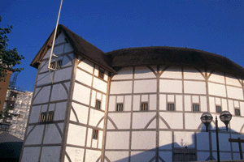
Obr.7
7. What's this?
a)Greenwich Observatory
b)The Globe Theatre
c)The National Theatre
d)The Tower of London

Slide 17
b)The Globe Theatre

Slide 18
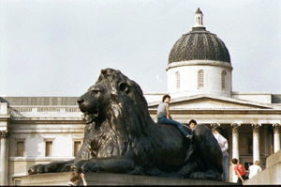
Obr.8
8. Where can you see this lion?
a)Hyde Park
b)Picadilly Circus
c)The Tower of London
d)Trafalgar Square

Slide 19
d)Trafalgar Square

Slide 20
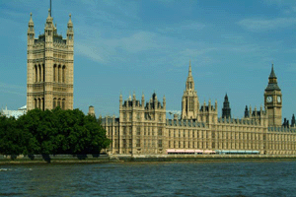
Obr.9
9. What does this picture show?
a)Buckingham Palace
b)The Houses of Parliament
c)The Tower of London
d)Westminster Abbey

Slide 21
b)The Houses of Parliament

Slide 22
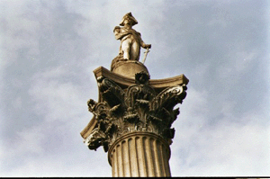
Obr.10
10. Where is this statue?
a)Buckingham Palace
b)Hyde Park
c)The Tower
d)Tralfalgar Square

Slide 23
d)Tralfalgar Square

Slide 24
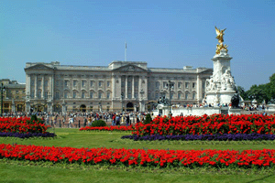
Obr.11
11. What's in this photo?
a)Buckingham Palace
b)Picadilly Circus
c)St. James Park
d)Westminster Abbey

Slide 25
a)Buckingham Palace

Slide 26
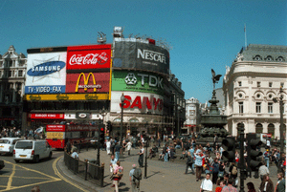
Obr.12
12. Where was this picture taken?
a)Leicester Square
b)Oxford Street
c)Picadilly Circus
d)The Square Mile

Slide 27
c)Picadilly Circus

Slide 28
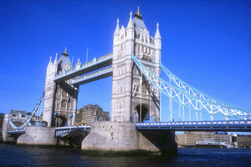
Obr.13
13. What's the name of this bridge?
a)Hungerford Bridge
b)Millenium Bridge
c)Tower Bridge
d)Westminster Bridge

Slide 29
c)Tower Bridge

Slide 30
Quiz – pracovní list
1) London has about _________ inhabitants.
10 million
15 million
20 million
4 million
2) In 1666, most of the city was destroyed by _________.
a storm
an earthquake
barbarians
fire
3) The architect who constructed a large number of buildings in London was _________.
Guy Fawkes
Henry Hudson
Pierre L'Enfant
Sir Christopher Wren
4) The construction of the Tower of London started in _________ century.
11th
13th
15th
9th

Slide 31
5) Waterloo is one of the largest _________ in London.
airports
bus stations
ports
railway stations
6) The Houses of Parliament can be found in the _________.
Buckingham Palace
The Mall
Trafalgar Square
Westminster Palace
7) Big Ben is actually the name of _________.
a bell
a clock
a palace
a tower
8) Trafalgar Square was named after a famous _________.
admiral
battle
explorer
king

Slide 32
Řešení
1 – a
2 – d
3 – d
4 – a
5 – d
6 – d
7 – a
8 - b

Slide 33
CITACE
Text: Marek Vít, http://www.helpforenglish.cz/realie/united-kingdom/london/. (11.12. 2011)
Quiz:<a href="../../../../../../../../../realie/united-kingdom/london/c2007091203-quiz--london.html" class="clanek"> <img src="image/topic/rea.gif" alt="">Quiz: London</a> 16. 09. 2007
Obrázky:
Obr. 1-13://www.helpforenglish.cz/realie/united-kingdom/london/image/layout/top.gif 25. 04. 2006

