Slide 1

Název školy: ZŠ Bor, okres Tachov, příspěvková organizace
Autor: Mgr. Irena Šeneková
Vytvořeno dne: 13.5.2013
Název: VY_32_INOVACE_1C_AJ8_11_Enough
Číslo projektu: CZ.1.07/1.4.00/21.3534
Vzdělávací oblast: Angličtina
Téma: Adjectives and adverbs
Ročník: 8. ročník
Klíčová slova: enough, adjectives, nouns

Slide 2
Anotace
Enough – použití s přídavným jménem
s podstatným jménem
samostatně
Věty na procvičení

Slide 3

TICKETS
3
enough + noun
I’ve got £ 2.50 but I need £ 3.
He hasn’t got enough money.

Slide 4
Enough normally goes before nouns.
Is there enough sugar in your coffee?
We wanted play football but we didn’t have enough players.
Complete the sentences:
He can’t buy the book. He hasn’t got _____________.
I can’t run very far. I haven’t got ________________.
We had to sit on the floor because ther weren’t
______________ .
money
enough
enough
energy
enough
chairs

Slide 5
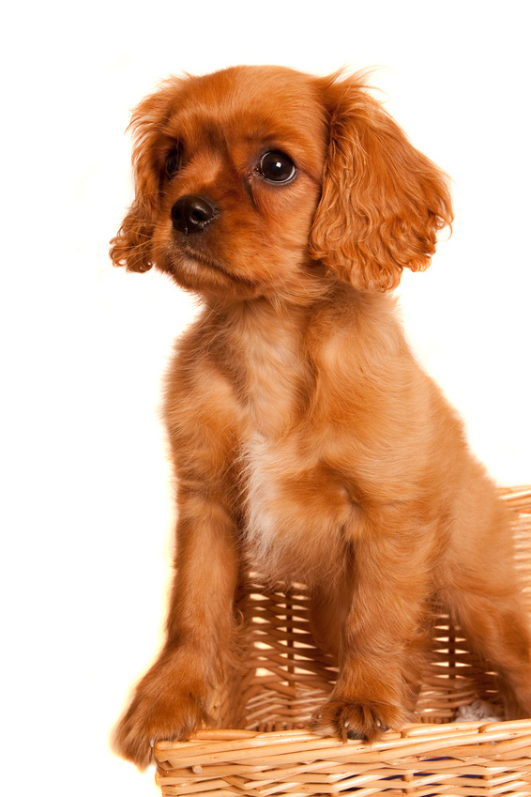

adjectives + enough
The kennel isn’t big enough.

Slide 6
Enough goes after adjectives and adverbs.
I can’t run very far. I’m not fit enough.
Let’s go . We’ve waited long enough.
Complete the sentences:
warm
enough
Shall we sit outside? – No, it isn’t _______________ .
2. Can you hear the radio? Is it _________________ for you?
enough
loud

Slide 7
We can use enough alone ( without the noun ).
We don’t need any more money. We’ve got enough.
Would you like some more to eat? No, thanks. I ’ve had enough.

Slide 8
We say:
enough for ( sb/sth)
This skirt isn’t big enough for a car.
enough to ( do sth )
I haven’t got enough money to buy a car.
enough for ( sb/sth) to (do sth)
There aren’t enough chairs for everybody to sit down.

Slide 9
Complete the sentences. Use enough with the words in brackets .
Why don’t you buy a car? – You’ve got ________ .
Don’t buy that the coat. It’s nice but it isn’t __________
Tina is very thin. She doesn’t __________ .
This house isn’t ________ for a large family.
Is there _________ in your coffee?
He isn’t a very good tennis player because he doesn’t _____.
You don’t eat ________.
I don’t want to go to bed. I’m not_________ .
I don’t have __________ .
This knife isn’t _______________ tomatoes..
Have we got____________ sandwiches?
We played well but not _________________ the game.
(money)
(long)
(eat)
(big)
(sugar)
(practise)
(fruit)
(tired)
(time )
(sharp/cut)
(bread/make)
(well/win)
KEY

Slide 10
KEY
Why don’t you buy a car? – You’ve got enough money.
Don’t buy that the coat. It’s nice but it isn’t long enough.
Tina is very thin. She doesn’t eat enough.
This house isn’t big enough for a large family.
Is there enough sugar in your coffee?
He isn’t a very good tennis player because he doesn’t practise enough.
You don’t eat enough fruit.
I don’t want to go to bed. I’m not tired enough.
I don’t have enough time.
This knife isn’t sharp enough to cut tomatoes.
Have we got enough bread to make sandwiches?
We played well but not well enough to win.

Slide 11
Použité zdroje
MURPHY, Raymond. English Grammar in Use. Singapore: Cambridge University Press, 2004, ISBN 978 0521 755481.
PETERS, Sarah; GRÁF, Tomáš. Nová cvičebnice anglické gramatiky. Praha: Polyglot, 2007, ISBN 80-86195-00-7.
Obrázky : Galerie Microsoft Office – klipart

