Slide 1
Název školy: Základní škola Městec Králové
Autor: Mgr. Marcela Kloučková
Název: VY_32_INOVACE_05_Aj6
Číslo projektu: CZ.1.07/1.4.00/21.2313
Téma: Zájmena
Anotace: Tato prezentace nabízí základní přehled osobních a přivlastňovacích zájmen. Obsahuje řadu cvičení
na upevnění nové nebo již známé látky.
Datum: 21. 10. 2012

Slide 2
Pronouns (Personal Pronous, Possessive Adjectives)
(Zájmena – osobní, přivlastňovací)

Slide 3
 |  | OSOBNÍ |  | PŘIVLASTŇOVACÍ
 |  | podmětné (subject) | předmětné(object)
j. č. | 1 | I | me | my
 | 2 | you | you | your
 | 3 | he | him | his
 |  | she | her | her
 |  | it | it | its
mn. č. | 1 | we | us | our
 | 2 | you | you | your
 | 3 | they | them | their

Slide 4
Choose the correct pronouns to complete the sentences.
1. _____ in the garden. (we‘re/we/us/our)
2. _____ my pencil case. (it‘s/it/its)
3. _____ has got a pet at home. (he‘s/he/him/his)
4. Can you take _____ to the zoo? (we‘re/we/us/our)
5. _____ favourite animal is an elephant. (I‘m/I/me/my)
6. _____ is my friend. (she‘s/she/her)
7. I don‘t like _____. (they‘re/they/them/their)
8. Can I help _____?(you‘re/you/your)
We‘re
It‘s
He
us
My
She
them
you

Slide 5
Change the underlined words to a pronoun. Rewrite the sentences.
1. Tom and Lisa are the same age.
They are the same age.
2. What does your father do? My father is a dentist.
What does your father do? He is a dentist.
3. Is this Tom‘s car?
Is this his car?
4. I don‘t like tomatoes.
I don‘t like them.
5. They can see a house.
They can see it.

Slide 6
Correct the mistakes.
1. Do you know she?
2. Its raining.
3. His doesn‘t like coffeee.
4. This is you bag.
5. Me computer is slow.
her
It‘s
He
your
My

Slide 7
Fill in the correct pronouns.
1. _____ (she) gets up at six o‘clock every day.
2. Jack likes books. This book is for _____. (he)
3. He is _____ (you) brother.
4. Look at _____. (they).
5. Give _____ (I) a textbook.
6. Is Peter doing _____ (he) homework?
7. We‘ve got two rabbits. _____ (I) must feed _____. (they)
8. _____ (she) name is Jane.
She
him
your
them
me
his
I
them
Her

Slide 8
Translate.
1. Je to jejich pes?
Is it their dog?
2. Jana je má nejlepší kamarádka. Mám ji ráda.
Jane is my best friend. I like her.
3. Petr a jeho rodiče bydlí v Praze.
Peter and his parents live in Prague.
4. Tom je můj bratranec. Znáš ho?
Tom is my cousin. Do you know him?
5. Je to dobrý časopis. Cheš ho?
It‘s a good magazine. Do you want it?

Slide 9
Answer the questions.
1. What‘s your name?
My name is …
2. What‘s your best friend‘s name?
Her/his name is …
3. Where do you live?
I live in …
4. Where does your best friend live?
He/she lives in …
5. What are your hobbies?
My hobbies are …
6. What are your best friend‘s hobbies?
His/her hobbies are …

Slide 10
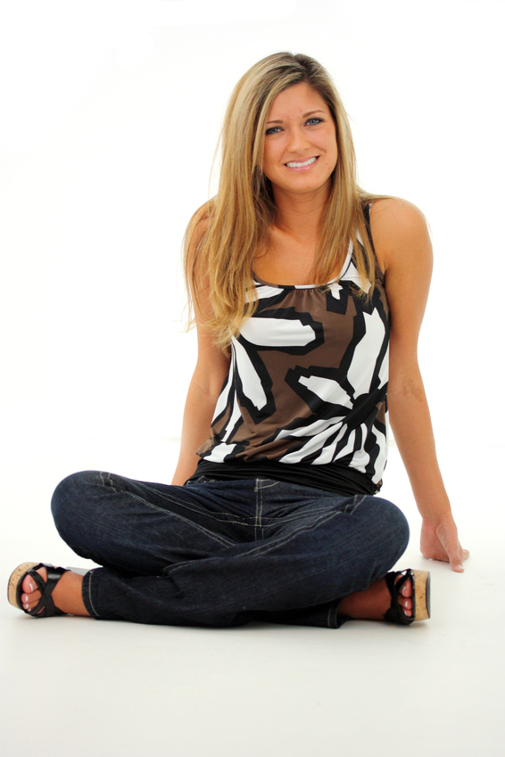
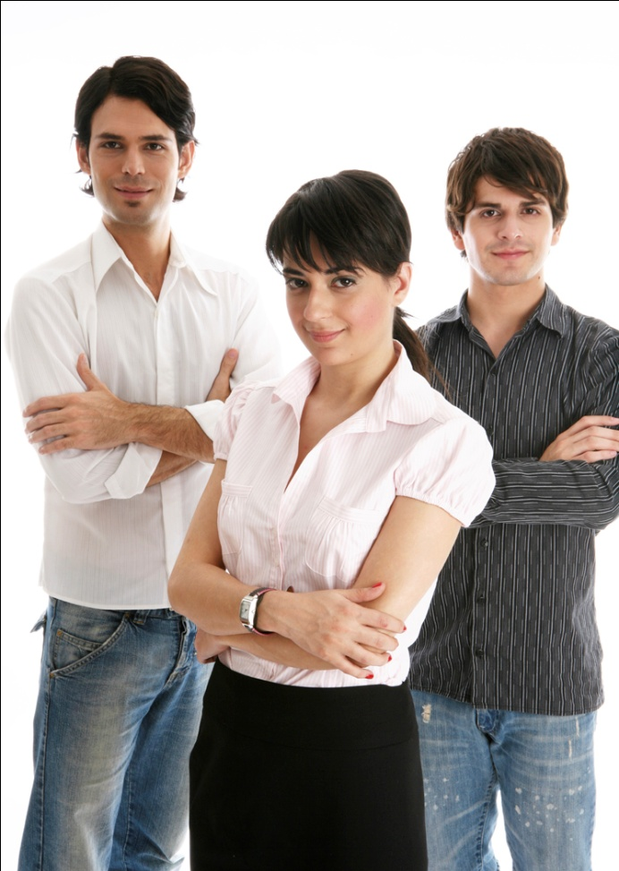
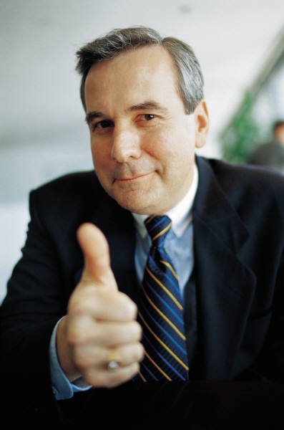
Complete the sentences with him, her, it or them. Use the pictures.
Look at her. Give it to him. It‘s for them.
[1]
[2]
[3]

Slide 11
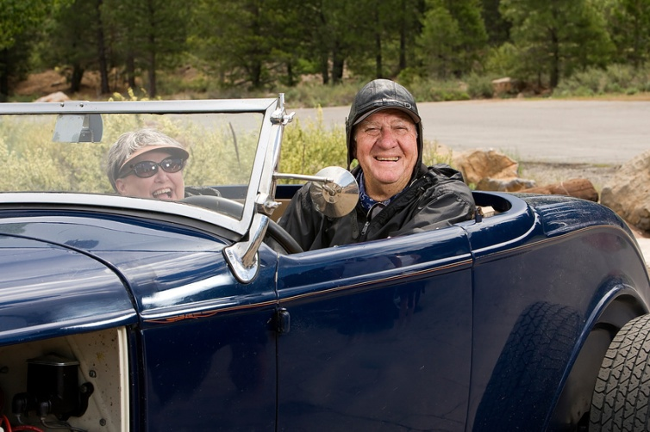
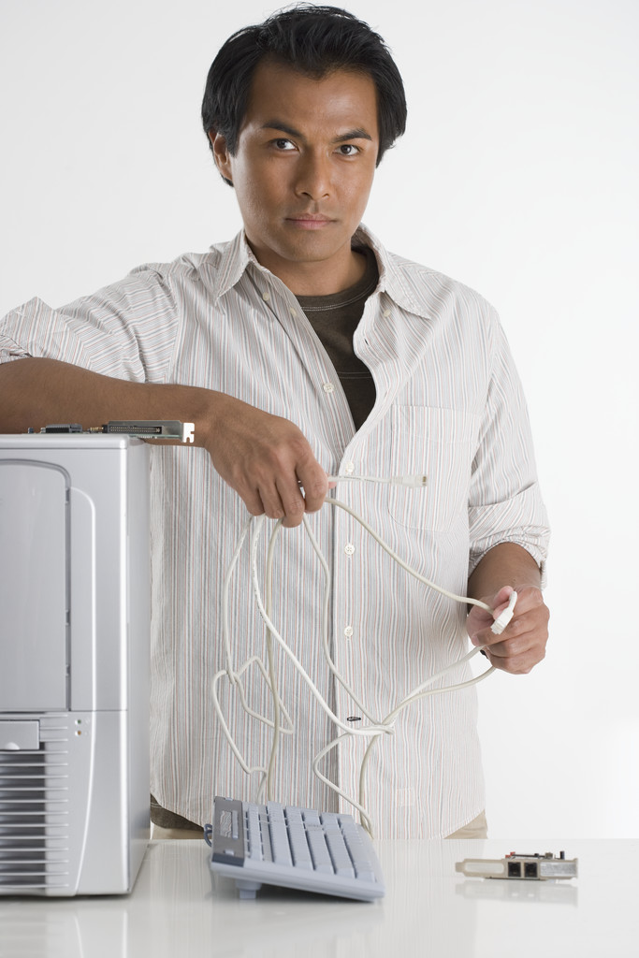
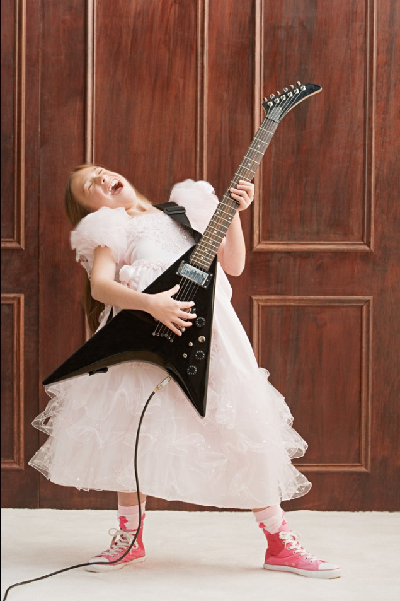
Complete the sentences with his, her or their.
Use the pictures.
[5]
Their car is old.
[4]
[6]
I like her dress.
It‘s his computer.

Slide 12
Zdroje
[1] Woman. Office.com [online]. 2012 [cit. 2012-10-26]. Dostupné z: http://office.microsoft.com/cs-cz/images/results.aspx?qu=woman&ex=1#ai:MP900448523|
[2] Man. Office.com [online]. 2012 [cit. 2012-10-26]. Dostupné z: http://office.microsoft.com/cs-cz/images/results.aspx?qu=man&ex=1#ai:MP900316822|
[3] People. Office.com [online]. 2012 [cit. 2012-10-26]. Dostupné z: http://office.microsoft.com/cs-cz/images/results.aspx?qu=people&ex=1#ai:MP900438373|
[4] Dress.Office.com [online]. 2012 [cit. 2012-10-26]. Dostupné z: http://office.microsoft.com/cs-cz/images/results.aspx?qu=dress&ex=1#ai:MP900431699|mt:2|
[5] Old car.Office.com [online]. 2012 [cit. 2012-10-26]. Dostupné z:
http://office.microsoft.com/cs-cz/images/results.aspx?qu=old+car&ex=1&origin=FX010132103#ai:MP900442259|
[6] Computer. Office.com [online]. 2012 [cit. 2012-10-26]. Dostupné z: http://office.microsoft.com/cs-cz/images/results.aspx?qu=computer&ex=1#ai:MP900422337|

