Slide 1
Název školy: Základní škola Městec Králové
Autor: Mgr. Marcela Kloučková
Název: VY_32_INOVACE_09_Aj6
Číslo projektu: CZ.1.07/1.4.00/21.2313
Téma: přítomné časy
Anotace: Druhá část prezentace je rovněž zaměřena na výklad a procvičení přítomného času prostého. Vysvětluje, jak tvořit otázky a krátké odpovědi. Zároveň představuje užití přítomného času prostého v anglickém jazyce. Může sloužit i k zopakování již probrané látky.
Datum: 28.8. 2012

Slide 2
Present Simple – Part 2
(přítomný čas prostý)

Slide 3
Questions (otázky)
(tázací výraz) + do/does + podmět + infinitiv bez
to (…) ?
I, you, we, they - do
he, she, it – does
Do they make the bed every day?
Where do you live?
Does he come from Canada?
When does he play football?
(When does he plays football?)
play - významové sloveso nemá
koncovku –s (je již ve tvaru does)

Slide 4
Short answers (krátké odpovědi)
Yes, I/you/we/they do.
Yes, he/she/it does.
No, I/you /we/they don‘t.
No, he/she/it doesn‘t.
Do you like music? Yes, I do.
Does he play computer games? Yes, he does.
Do they get up early at the weekend? No, they don‘t.
Does she teach English? No, she doesn‘t.

Slide 5
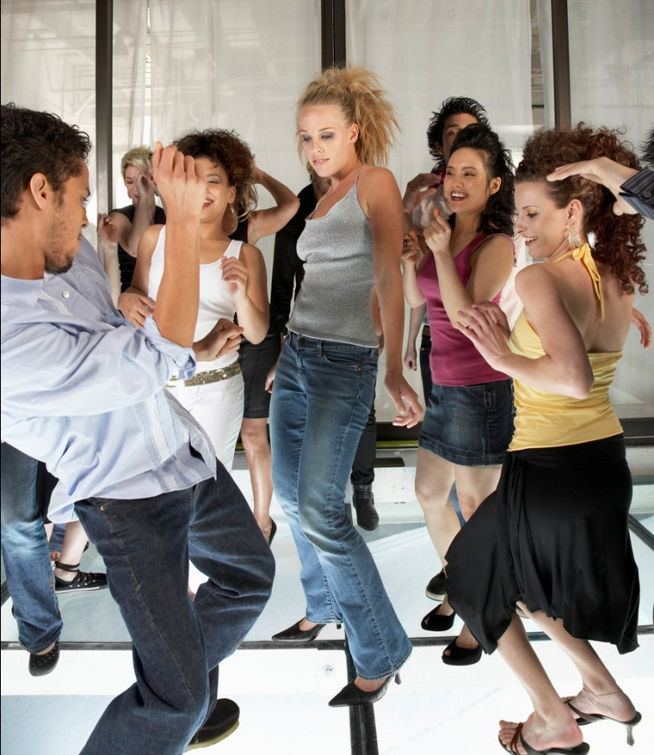
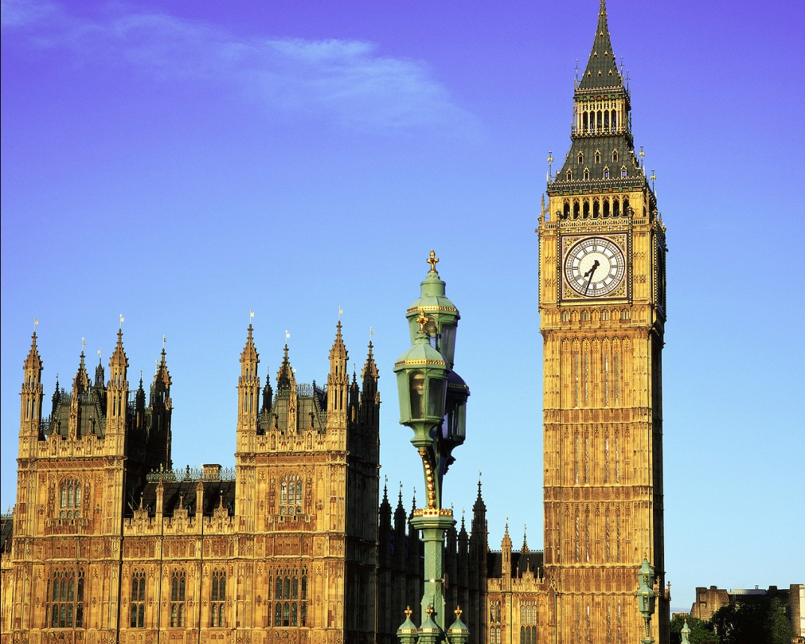
Answer the questions. Use the pictures.
Do they go to the disco Does she live in Prague?
at the weekend?
No, she doesn‘t.
Yes, they do.
She lives in London.
[1]
[2]

Slide 6
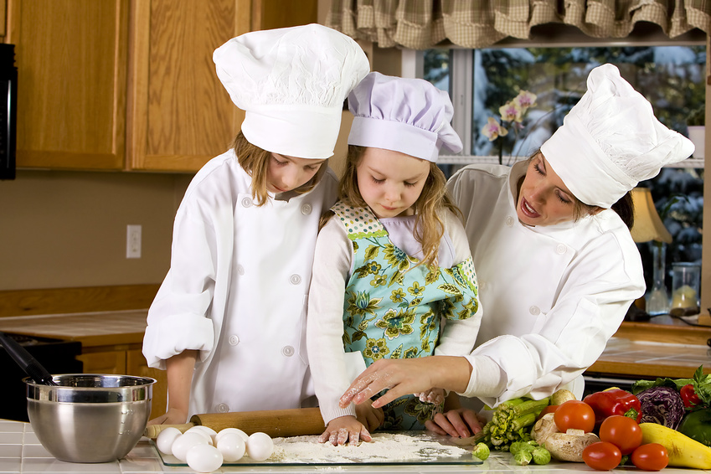
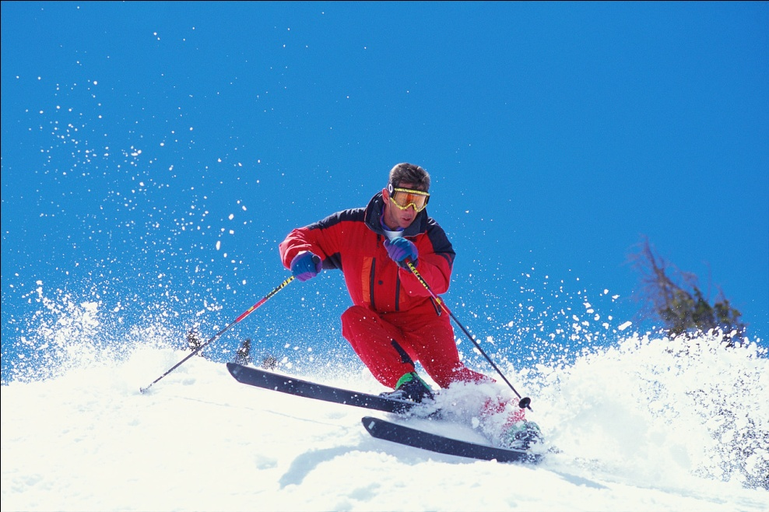
Answer the questions. Use the pictures.
Do they cut the grass Does he go sking in winter?
on Sundays?
Yes, he does.
No they don‘t.
They cook on Sundays.
[3]
[4]

Slide 7
Fill in the gaps with the correct form of the verbs.
Example:
Do you live in a city? (live)
1. Does he drink water? (drink) Yes, he does.
2. When do you do your homework? (do)
3. Does she set the table every day? (set)
No, she doesn‘t.
4. Do they have a birthday party every year? (have) No, they don‘t.
5. What does Jane do in her free time? (do)

Slide 8
Answer the questions.
1.Where do you live?
I live in…
2. When do you get up on weekdays?
I get up at … on weekdays.
3. Do you like English?
Yes, I do./No, I don‘t.
4. Does your mum work in a hospital?
Yes, she does./No, she doesn‘t.
5. What do you usually do at the weekend?
I usually … at the weekend.

Slide 9
Translate.
1. Kde pracuješ?
Where do you work?
2. Mají tví rodiče rádi psy? Ano, mají.
Do your parents like dogs? Yes, they do.
3. Kde bydlí tvůj nejlepší kamarád?
Where does your best friend live?
4. Do they use the computer every day? No, they don‘t.
Používají počítač každý den? Ne, nepoužívají.
5. Does the concert start at quarter to eight?
No, it doesn‘t. It starts at half past eight.
Začíná koncert v 7.45? Ne, nezačíná. Začíná v 8 hodin.

Slide 10
Make questions for theses answers.
Example:
How does Jane go to school?
Jane goes to school by bus.
1. ________________________________?
I study Maths every Monday morning.
2. ________________________________?
Harry gets up at half past six.
3. ________________________________?
No, I don‘t like tomatoes.
What do you study every Monday norning
When / What time does Harry get up
Do you like tomatoes

Slide 11
Use (použití)
opakovaný děj v přítomnosti
      typická spojení: every (day, week, year, morning…), often, always, usually, at the weekends, on Sundays,…
      I usually get up at 6 o‘clock.
      He goes skiing every winter.
všeobecně pravdivé skutečnosti
It snows in winter.
She comes from Spain.

Slide 12
Fill in the gaps with suitable words.
do plays farm doesn‘t play September does go
do go live goes start car does every
1. A: How _________ he _________ to work?
B: He _________ to work by _________ .
2. A: When _________ you _________ school?
B: We start school in _________ .
3. A: _________ he _________ the piano?
B: No, he _________. He _________ the guitar.
4. A: Where _________ your grandparents ________?
B: They live on a _________ in England.
5. They _________ to the cinema ________ month.
does
go
goes
car
do
start
September
Does
play
doesn‘t
plays
do
live
farm
go
every

Slide 13
Zdroje
[1] Diskotéka. Office.com [online]. 2012 [cit. 2012-11-25]. Dostupné z: http://office.microsoft.com/cs-cz/images/results.aspx?qu=diskot%C3%A9ka&ex=2#ai:MP900431161|
[2] Londýn. Office.com [online]. 2012 [cit. 2012-11-25]. Dostupné z: http://office.microsoft.com/cs-cz/images/results.aspx?qu=Lond%C3%BDn&ex=1#ai:MP900402161|mt:1,2|
[3] Vaření. Office.com [online]. 2012 [cit. 2012-11-25]. Dostupné z: http://office.microsoft.com/cs-cz/images/results.aspx?qu=Va%C5%99en%C3%AD&ex=1#ai:MP900442192|mt:2|
[4] Lyžování. Office.com [online]. 2012 [cit. 2012-11-25]. Dostupné z: http://office.microsoft.com/cs-cz/images/results.aspx?qu=ly%C5%BEov%C3%A1n%C3%AD&ex=2#ai:MP900400191|mt:2|

