Slide 1

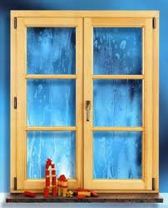
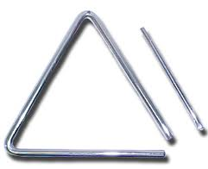
Název školy: ZŠ a MŠ Zvole
Autor: Mgr. Jana Němcová
Název: VY_32_INOVACE_11 V Tvary a předměty
Téma: Matematika a její aplikace
Číslo projektu: CZ.1.07/1.4.00/21.0305

Slide 2
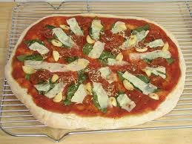


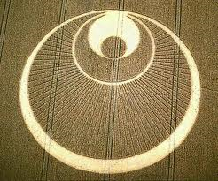

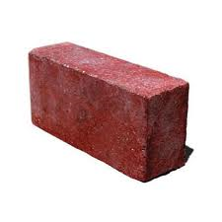
JAKÝ GEOMETRICKÝ TVAR PŘEDMĚTY PŘIPOMÍNAJÍ?

Slide 3
ODKAZY
http://images.google.com/imgres?imgurl=http://2.bp.blogspot.com/_Nw4pZg3f-xs/TPqOw8reAmI/AAAAAAAAEJI/T63J5vUseRY/s400/triangle-6-inch-quality.jpg&imgrefurl=http://twogoodears.blogspot.com/2010/12/bermuda-triangle-exit.html&usg=__dJ1IdGXZjkfA3O3iiLvMHa-sUEI=&h=245&w=302&sz=15&hl=cs&start=0&sig2=Iw_RoCXNH5gdPjx-IN1jXg&zoom=1&tbnid=LPhp1VlScoZv-M:&tbnh=119&tbnw=155&ei=ulj-Tc_7CIWSswaU5MzwDQ&prev=/images%3Fq%3Dtroj%25C3%25BAheln%25C3%25ADk%26hl%3Dcs%26biw%3D940%26bih%3D600%26tbs%3Diur:fmc%26tbm%3Disch&itbs=1&iact=rc&dur=143&page=1&ndsp=15&ved=1t:429,r:3,s:0&tx=90&ty=67&biw=940&bih=600
http://t3.gstatic.com/images?q=tbn:ANd9GcRO_g7kB5S-hIkWl3jEFxbcqwnejGkbudhk_fK73QeMW12CPlI1
http://t2.gstatic.com/images?q=tbn:ANd9GcS6yF2FX5H0iBB2j5mNu22TtH9GeYLCT0-qMPJGPYqjt06mWiLT
http://images.google.com/imgres?imgurl=http://www.savvysassymoms.com/blog/wp-content/uploads/2010/04/Icecreamscoop.gif&imgrefurl=http://www.savvysassymoms.com/child-hunger-ends-here-ice-cream-social/&usg=__V8p5L_ODPsNokH1GLnUzAaWY300=&h=738&w=750&sz=48&hl=cs&start=0&sig2=37bMVXP3fz2KbBcNjrYhyQ&zoom=1&tbnid=yQcvNh2McVmL5M:&tbnh=126&tbnw=128&ei=8Vv-Te7xIcnNswbOguDyDQ&prev=/images%3Fq%3DZMRZLINA%26hl%3Dcs%26sa%3DG%26biw%3D940%26bih%3D600%26tbs%3Diur:fmc%26tbm%3Disch&itbs=1&iact=rc&dur=277&page=1&ndsp=18&ved=1t:429,r:12,s:0&tx=51&ty=97&biw=940&bih=600
http://images.google.com/imgres?imgurl=http://farm1.static.flickr.com/126/352490914_49dbd5dfa3.jpg&imgrefurl=http://www.flickr.com/photos/lenore-m/352490914/&usg=__ThFaW8Q3to9B94Lw0Bk_PQ17au8=&h=375&w=500&sz=166&hl=cs&start=14&sig2=hBTPLTRgBbRmhROLw3n6Vg&zoom=1&tbnid=SncfOIc5pyd0UM:&tbnh=98&tbnw=130&ei=NVz-Tb2CCMzIsgbwzqTuDQ&prev=/images%3Fq%3DPIZZA%26hl%3Dcs%26sa%3DG%26biw%3D940%26bih%3D600%26tbs%3Diur:fmc%26tbm%3Disch&itbs=1&biw=940&bih=600
http://images.google.com/imgres?imgurl=http://earth911.com/wp-content/uploads/2008/11/single-brick.jpg&imgrefurl=http://earth911.com/recycling/construction/brick/&usg=__2hUcyKyARa9NKEm1WjTR60WrhF0=&h=300&w=300&sz=13&hl=cs&start=0&sig2=gC8halBYf3Ha-xphfrXZjg&zoom=1&tbnid=yjKD2Sr4VwU1FM:&tbnh=98&tbnw=98&ei=Zlz-TYuhOITKtAbGwYXvDQ&prev=/images%3Fq%3DCIHLA%26hl%3Dcs%26sa%3DG%26biw%3D940%26bih%3D600%26tbs%3Diur:fmc%26tbm%3Disch&itbs=1&iact=rc&dur=155&page=1&ndsp=14&ved=1t:429,r:0,s:0&tx=78&ty=53&biw=940&bih=600
http://t3.gstatic.com/images?q=tbn:ANd9GcRmINYj4KZAOp9kpAPNnbRQxSiDT0lgXn9ujFFpifPg_psiDZaqwg
http://images.google.com/imgres?imgurl=http://www.guschal-bauelemente.de/data/bilder/10_inhalt/leistungen_gross_fenster_07.jpg&imgrefurl=http://www.guschal-bauelemente.de/leistungen_gross.php%3Fid%3D100&usg=__Rj_K8rb6_2d6BJni_0rkhG2l9e4=&h=395&w=320&sz=32&hl=cs&start=49&sig2=T63E-p6jT_AkydKpeKfPMw&zoom=1&tbnid=0D7FACuWJsQZbM:&tbnh=134&tbnw=117&ei=mFz-TfWMLM7IsgbkuJzyDQ&prev=/search%3Fq%3DOKNO%26hl%3Dcs%26sa%3DG%26biw%3D940%26bih%3D600%26tbs%3Diur:fmc%26tbm%3Disch&itbs=1&iact=rc&dur=255&page=4&ndsp=15&ved=1t:429,r:5,s:49&tx=41&ty=92&biw=940&bih=600

