Slide 1
SEASONS OF THE YEAR
Mgr. Naďa Bisová

Slide 2
ANOTACE
Kód DUMu: VY_32_INOVACE_6.AJ.16
Číslo projektu: CZ.1.07/1.5.00/34.0114
Vytvořeno: prosinec 2012
Ročník: 3. ročník a 4. ročník – čtyřleté gymnázium (RVP-G)
Septima a Oktáva – osmileté gymnázium (RVP-G)
Anotace:
Tento materiál by vytvořen jako téma pro maturitní okruh: Science and Technology. Nature na Gymnáziu a JŠ Svitavy; přibližně na jednu, popřípadě více vyučovacích hodin (pro výklad i opakování – shrnutí učiva). Obsahuje jednak přehled faktografických údajů, tak i anglickou ustálenou terminologii, doplněné o interaktivní cvičení: otázky a fotografie pro nácvik popisu obrázků. Je primárně zaměřen na dva poslední ročníky gymnázia, i přesto se dá využít i v nižších ročnících osmiletého i čtyřletého studia vcelku nebo jeho jednotlivé části.
Pomůcky: interaktivní tabule
Vzdělávací oblast | Jazyk a jazyková komunikace
Vzdělávací obor | Anglický jazyk
Tematický okruh | Science and Technology. Nature

Slide 3
Seasons of the year
How many seasons are there in a year?
4 seasons
The four seasons are: spring, summer, autumn/fall and winter.

Slide 4
SPRING
When does spring begin? When does it end?
March – June
What is the weather like in spring?
changeable, unpredictable, cool wind, more sunshine, becomes warmer, the temperature rises, April showers, rainbow, days get longer, nights get shorter,…

Slide 5
SPRING
What is the spring nature like?
Landscape: the sun warms the earth, it starts to thaw, the snow
melts (flood), paths are full of mud and puddles
Animal babies: lamb, chicken, kitten, little rabbit / bunny
Birds: build nests, lay eggs, baby birds hatch from their eggs, some bird species come back from the south / their winter homes (storks, wild geese, ..)
Some animals such as bears waking up from hibernation.

Slide 6
SPRING
What is the spring nature like?
First spring flowers in bloom: snowdrops, snowflakes, tulips, dandelions, primroses, crocuses, daffodils
Trees: leafy trees – come into leaf, trees in blossom
Bright green meadows, gardens and parks, fields ploughed and planted with corn / potatoes, seeds sprouting, crops growing

Slide 7
SPRING
What do people do or like doing in spring?
start working in their gardens, do the spring cleaning, go for walks or ride their bikes again, prepare for Easter (decorated eggs, plaited willow rod, sweet pastries, cake in the shape of a lamb, sweet bread called “Mazanec”, ribbons, houses / flats and gardens
decorated),…
What do people wear in spring?
jackets, raincoats, jumpers, t-shirts, skirts, umbrellas, Wellington boots,..

Slide 8
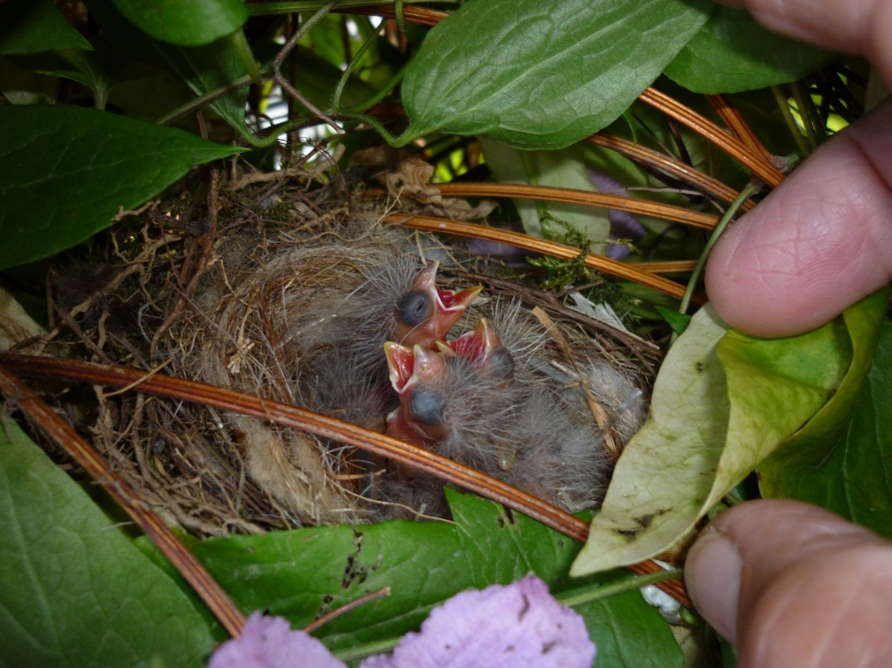
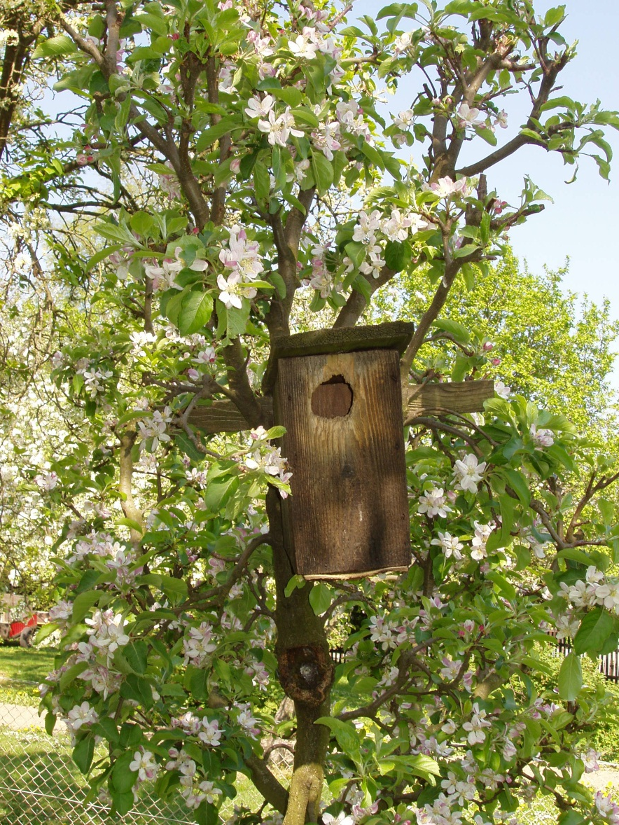
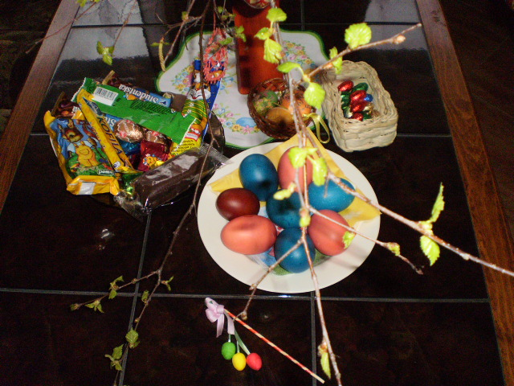
SPEAK ABOUT SPRING ON YOUR OWN
1.
2.
3.

Slide 9
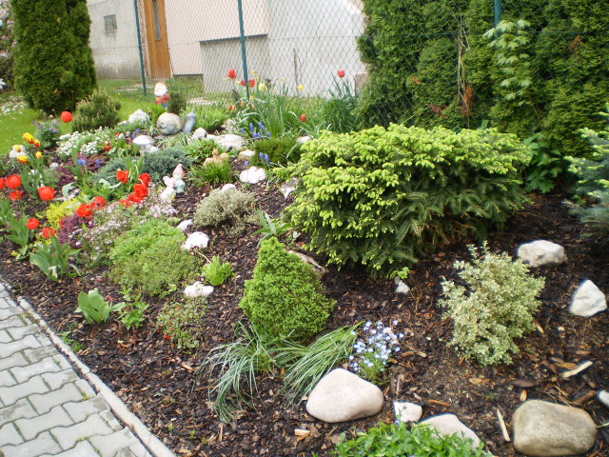
SPEAK ABOUT SPRING ON YOUR OWN
4.

Slide 10
SUMMER
When does summer begin? When does it end?
June – September
What is the weather like in summer?
bright and clear and hot days, early morning dew, summer storms (a crash of thunder, a flash of lightening, strong wind, rainfall, hail, mudslides, floods), the temperature rises again to 25° C, rainbow, dry seasons - drought

Slide 11
SUMMER
What is the summer nature like?
flowers in bloom (sunflowers, roses, red poppies)
fruit in the gardens (strawberries, gooseberries, blackberries, blueberries, apricots, peaches, cherries, currants, water melons)
vegetables (tomatoes, cucumbers, peas, lettuce
corn (wheat, barley, rye) harvested
moving grass, hay making, …
Animals bring up their babies.

Slide 12
SUMMER
What do people do or like doing in summer?
go on holidays (around the country or abroad), sunbathe, eat ice-cream (bars / cones), have a barbecue / picnic, have a rest, send picture postcards, buy souvenirs, do sports, work in the garden, attend open-air festivals (film, music, folklore), go sightseeing or spend time at outdoor swimming pools / aqua parks or centres or ZOOs,…
What do people wear in summer?
t-shirts, tops, shorts, skirts, light dresses, swimsuits, straw hats, sunglasses, sandals,…

Slide 13
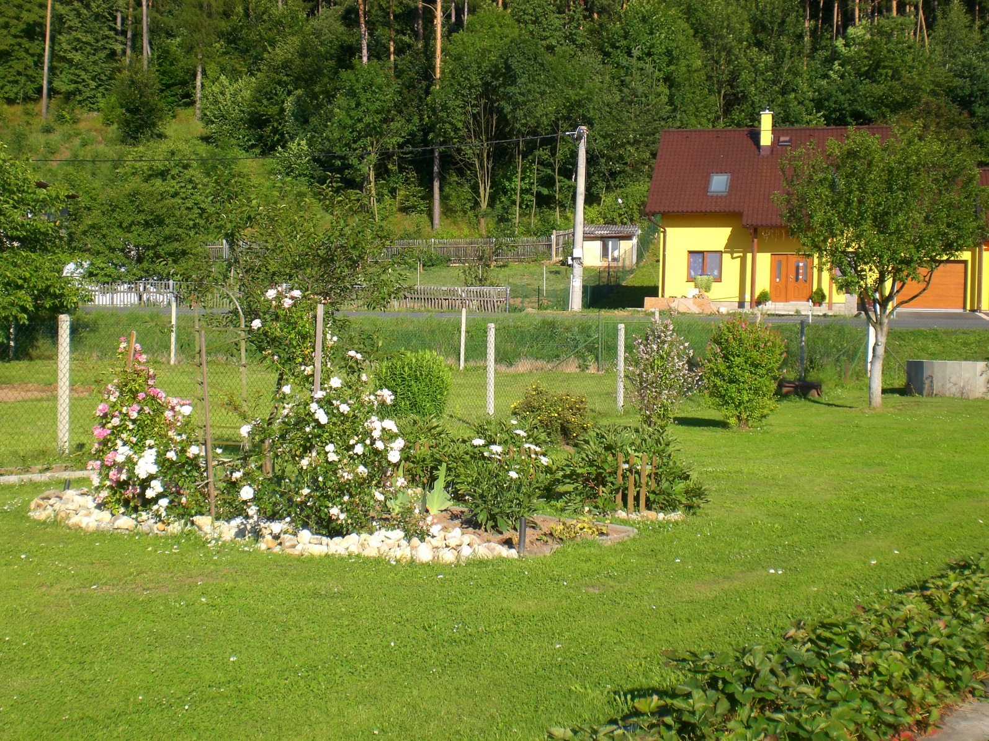
SPEAK ABOUT SUMMER ON YOUR OWN
5.

Slide 14
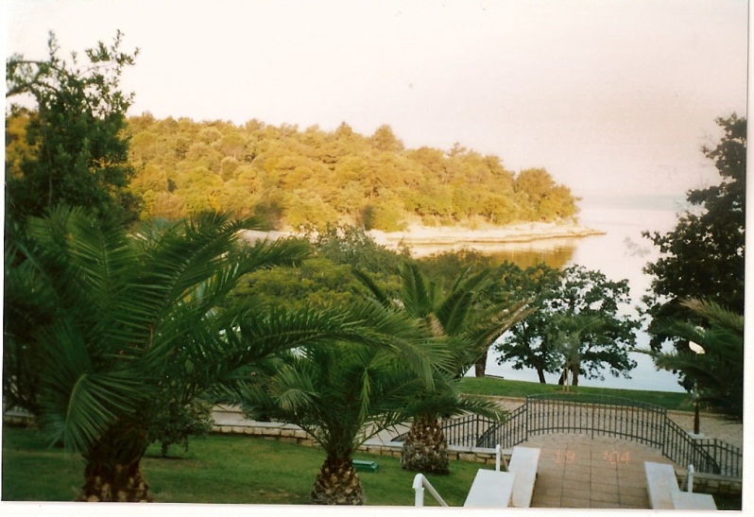
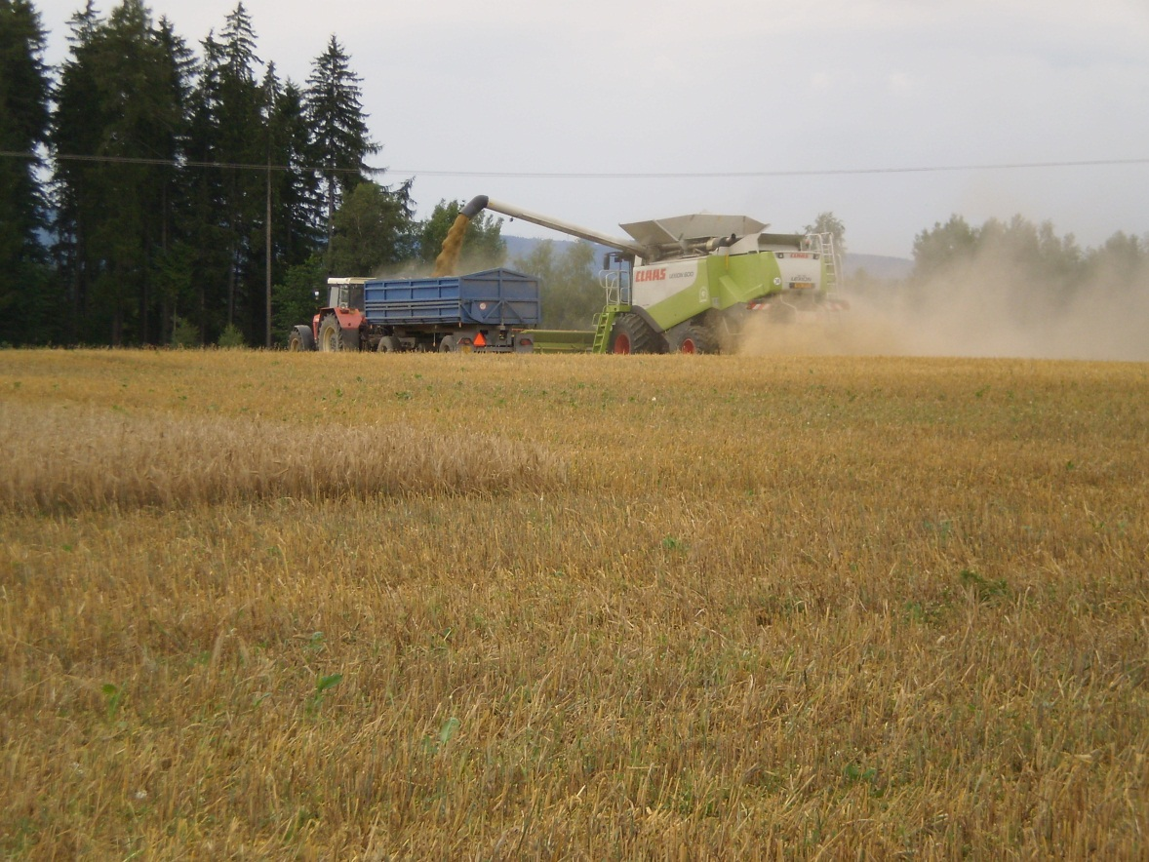
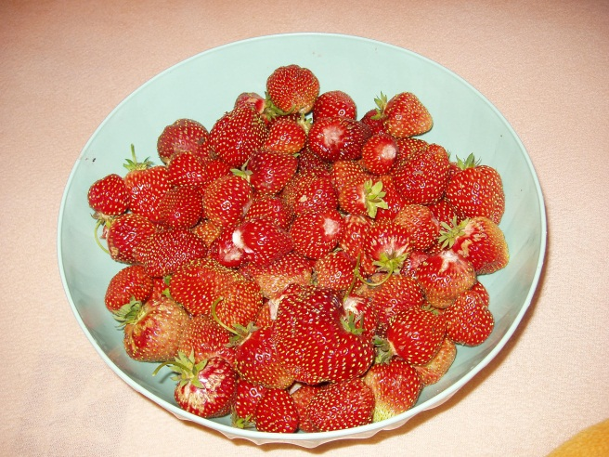
SPEAK ABOUT SUMMER ON YOUR OWN
6.
8.
7.

Slide 15
AUTUMN / FALL
When does autumn begin? When does it end?
September – December
What is the weather like in autumn?
sun sets earlier and rises later, days get shorter, nights get longer, unsettled weather, cloudy and overcast sky, dull and chilly mornings, the temperature continues to drop, it becomes damp, chilly, wet and rainy, it may drizzle, the Indian Summer,…

Slide 16
AUTUMN / FALL
What is the autumn nature like?
Landscape: the time of harvest (pumpkins, apples, pears, plums, sugar beet, potatoes, wine grapes, chestnuts, hazel nuts, mushrooms,…. )
Animals: hunting season begins, storing up food for coming winter, birds flock together, some set out on journey to the south
Trees: leafy trees change colour and shed their leaves
Grass: stops growing, goes dry

Slide 17
AUTUMN / FALL
What do people do or like doing in autumn?
prepare their gardens for coming winter, children love flying their kites, go for a walk and enjoy autumn landscape, attend autumn festivals /celebrations /gatherings /parties (harvest festivals, Halloween parties),…
What do people wear in autumn?
warm clothes, jackets, sweaters, boots, umbrellas, caps, gloves,…

Slide 18
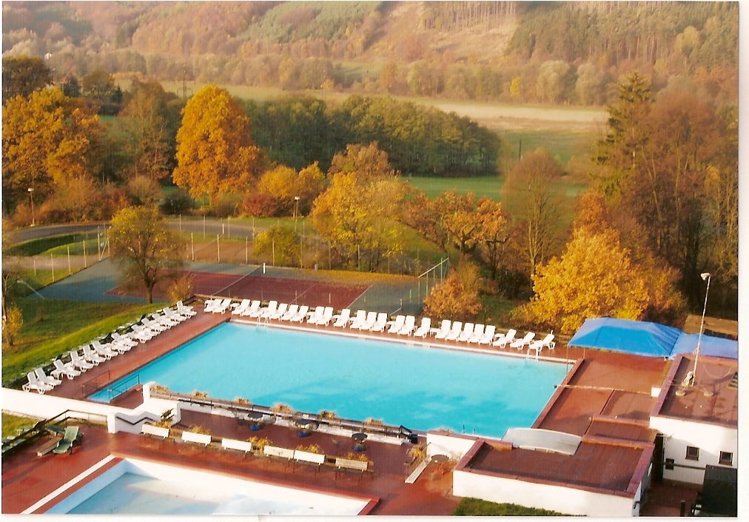
SPEAK ABOUT AUTUMN ON YOUR OWN
9.

Slide 19
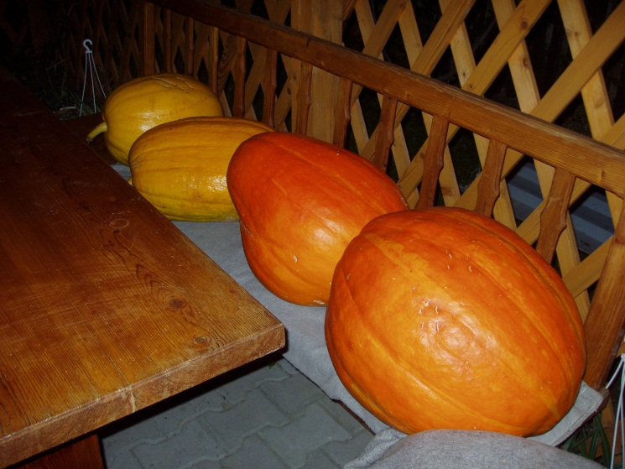
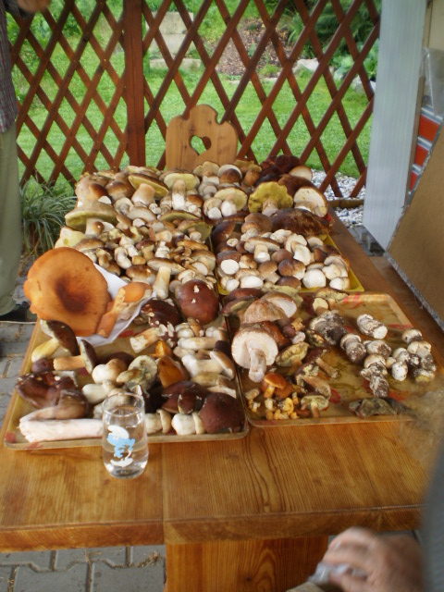
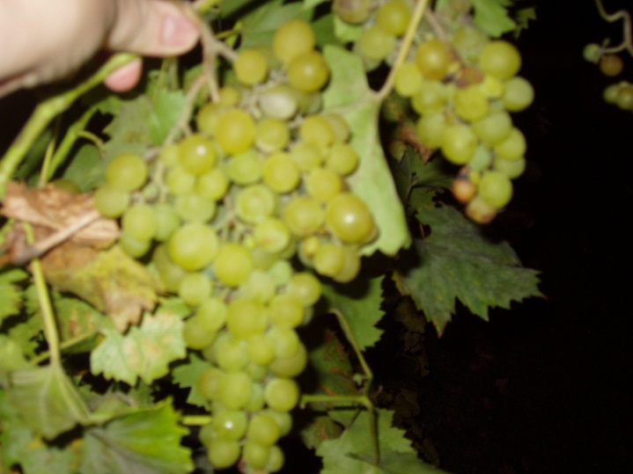
SPEAK ABOUT AUTUMN ON YOUR OWN
12.
10.
11.

Slide 20
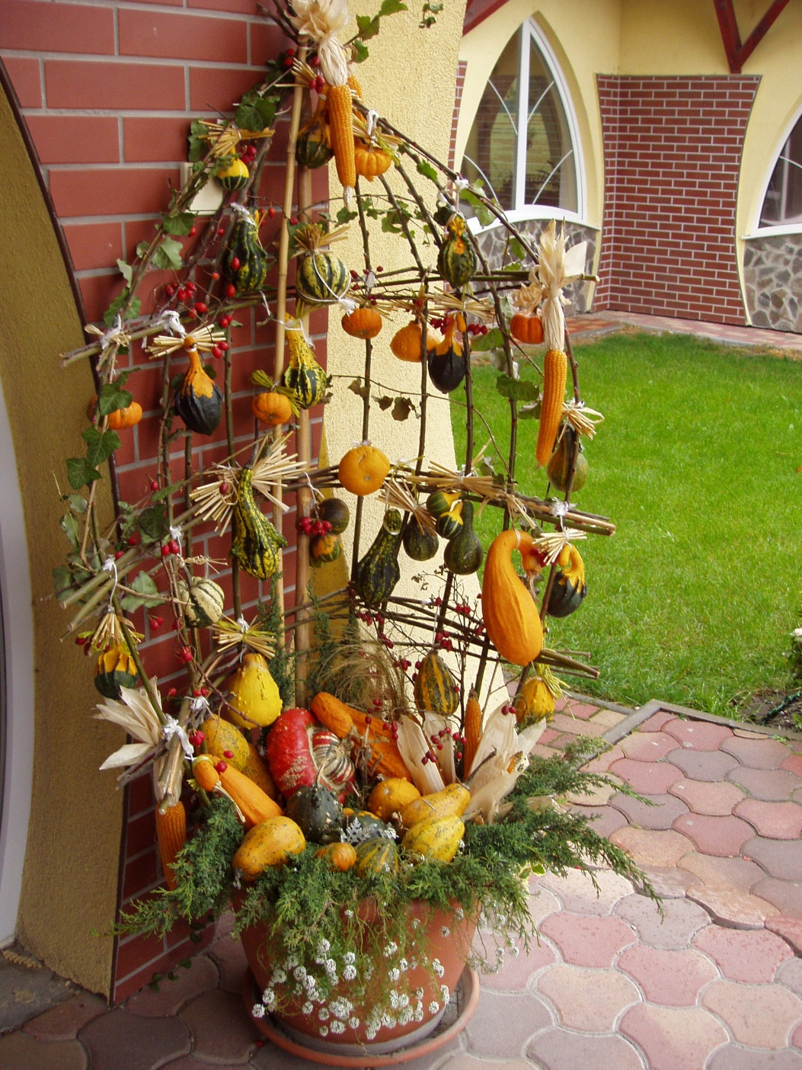
SPEAK ABOUT AUTUMN ON YOUR OWN
13.

Slide 21
WINTER
When does winter begin? When does it end?
December – March
What is the weather like in winter?
snowfall, icy wind, hard frosts, the temperature drops, some 20° C below zero, snowstorms, strong wind, the frost lets up and the snow melts, the coldest season of the year

Slide 22
WINTER
What is the winter nature like?
Landscape: snowdrifts along the roads, icy and slippery roads,
snowflakes falling down from the dull grey sky,
icicles hanging from roofs
Trees: evergreen trees (green) x decidious trees (bare)
Animals: hibernate x remain and stay active in winter (grow
new, thicker fur in the fall, spend the winter in their
winter shelter / dormant

Slide 23
WINTER
What do people do or like doing in winter?
throwing snow balls, building snowmen, sledging, sliding, skating on lakes and streams that are frozen over, downhill skiing and cross-country skiing, snowboarding, and enjoy Christmas time,…
What do people wear in winter?
mittens, gloves, scarves, caps, boots, warm winter jackets and coats, ski boots, ski suits, …

Slide 24
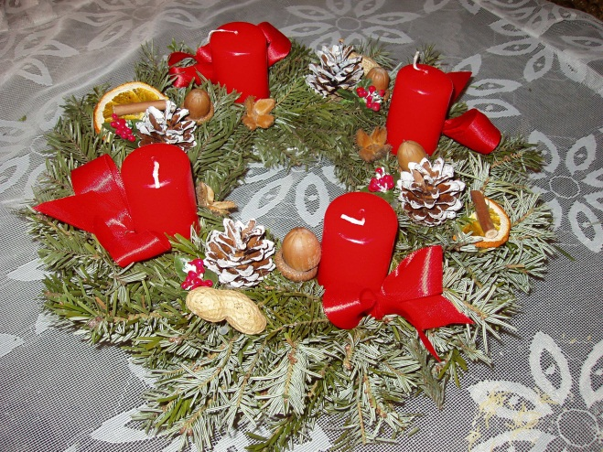
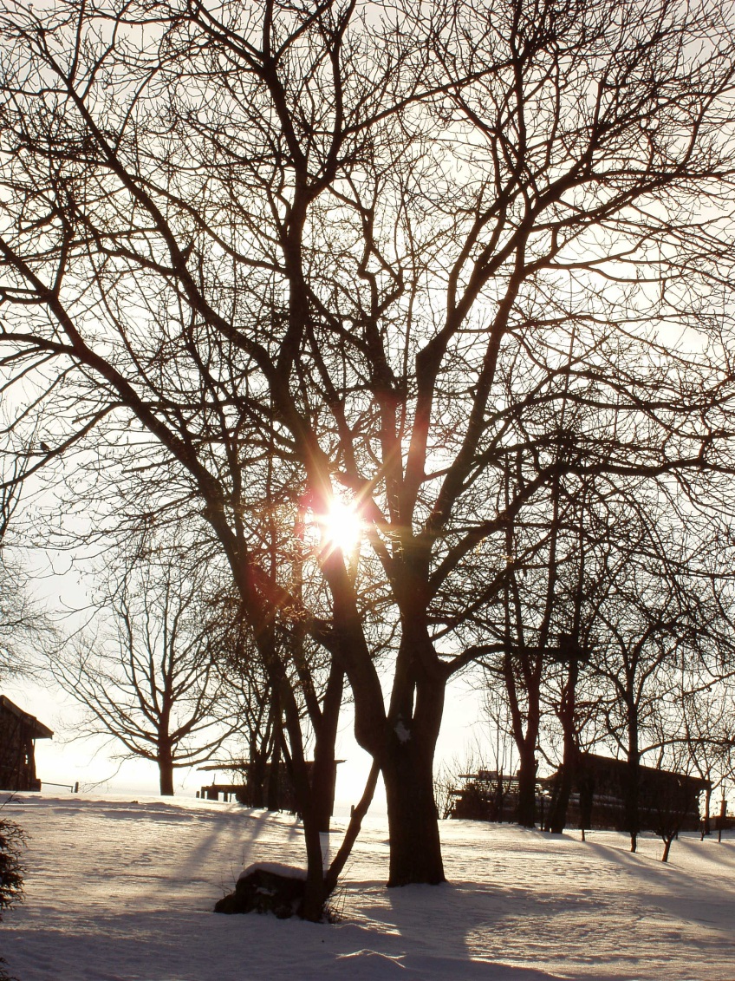
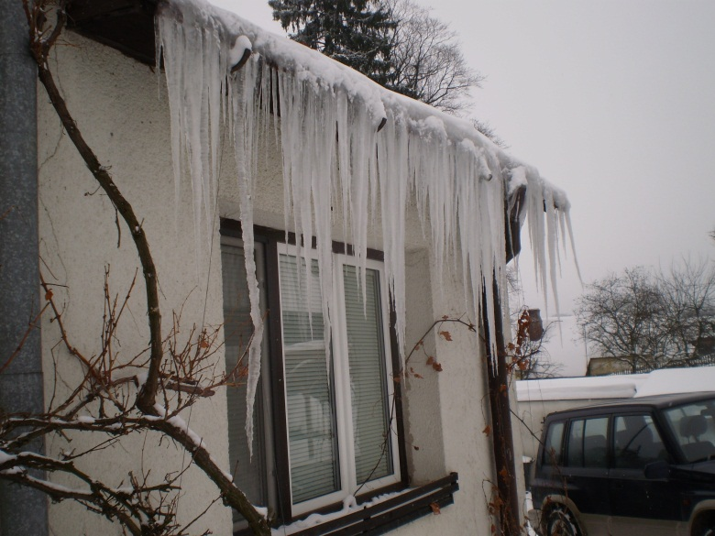
SPEAK ABOUT WINTER ON YOUR OWN
15.
14.
16.

Slide 25
Comprehension questions
What is the countryside like in spring?
What weather can I expect in your country in summer?
What do people like doing in autumn?
What do people wear in winter?
What else do you associate with each season of the year? (food, drinks, bank holidays, festivities, people, places, events, …)

Slide 26
FOTOGALERIE:
1.-5. Tomčíková Naděžda (se souhlasem autora)
6. Bisová Naďa (vlastní galerie autora)
7.-16. Tomčíková Naděžda (se souhlasem autora)

Slide 27
KNIŽNÍ ZDROJE:
1. SMITH-DLUHÁ, Gabrielle a kol. Angličtina, Otázky a odpovědi. Dubicko: INFOA, 2008, ISBN 978-80-7240-489-6.
2. ROBERTS, Rachel J.. Speak Up - The English-speaking World. Italy: Modern Languages, 2006, ISBN 88-493-0439.
3. TIERNEY, James. Carousel - the English-speaking world. Italy: Modern languages, 2006, ISBN 88-493-0355.
4. EL-HMOUDOVÁ, Dagmar. Angličtina - Maturitní témata. Český Těšín: Petra Velanová, Třebíč, 2006, ISBN 9788086873046.
5. CHUDÁ, Jana; CHUDÝ, Tomáš. Topics for English Conversation. Havlíčkův Brod: Fragment, 1996, ISBN 8072000519.

