Slide 1

Název školy: ZŠ Bor, okres Tachov, příspěvková organizace
Autor: Mgr. Irena Šeneková
Vytvořeno dne: 6.6.2013
Název: VY_32_INOVACE_1C_AJ8_18_ - ing clauses
Číslo projektu: CZ.1.07/1.4.00/21.3534
Vzdělávací oblast: Angličtina
Téma: There’s someone / something + ing
see / hear someone + ing
Ročník: 8. ročník
Klíčová slova: Relative clauses, - ing clauses

Slide 2
Anotace
There’s someone / something + ing
see / hear someone + ing
Exercises

Slide 3
Vztažné věty
(Relative clauses)
-ing clauses
We use – ing clauses to say what somebody (or something)
is (or was) doing at a particular time.

Slide 4
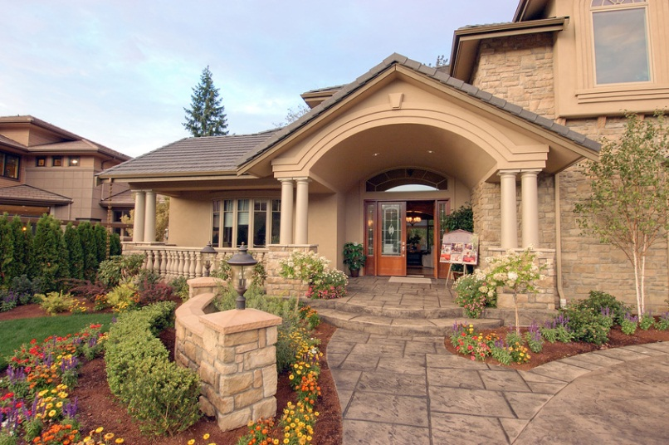
There‘s a car which is stopping by the gate.
There‘s a car.
It‘s stopping by the gate.
There‘s a car stopping by the gate.

Slide 5
I can see a woman who is drinking water.
I can see a woman. She‘s drinking water.
I can see a woman drinking water.

Slide 6
There’s someone / something + ing
There’s a car stopping by the gate.
There are two people looking at our house.
see / hear someone + ing
I can see him opening the window.
I can hear someone shouting.

Slide 7

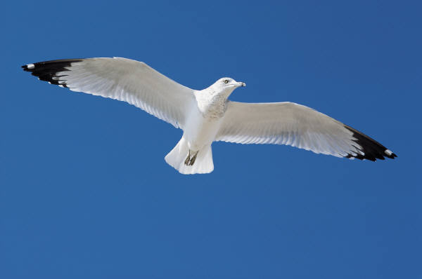
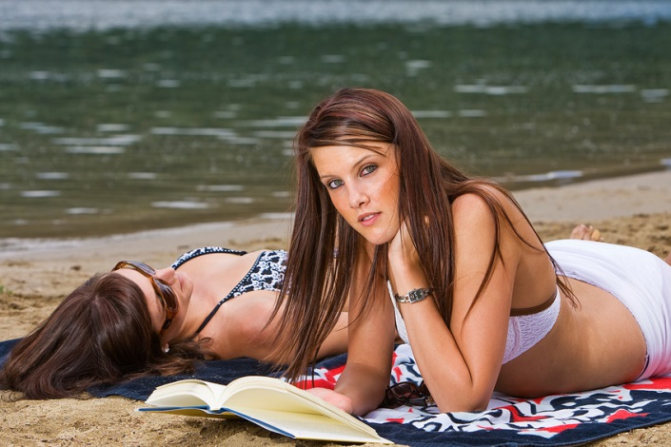
I can see a dog reading a book.
I can see a bird flying in the sky.
There are two women lying
on the beach.

Slide 8
Who were those people waiting outside?.

Slide 9
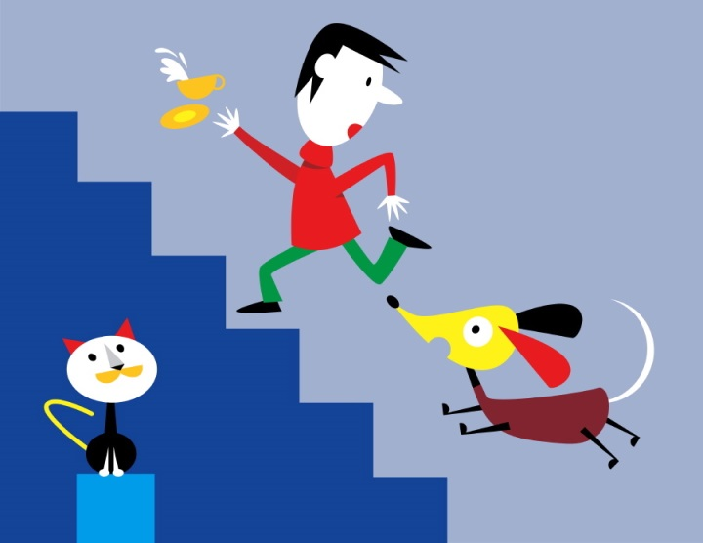
Say what you can see.
I can see a girl jumping rope.
I can see a boy playing with a ball.
I can see a dog chasing a man.
I can see two people planting a tree.

Slide 10

Use I can see…
walking.
skiing.
playing golf.
cycling.
sitting on a bench and reading a newspaper.
carrying an umbrella.
taking photographs.

Slide 11
Use There‘s / are
There‘s a man taking photographs.
There‘s someone standing at the door.
There‘s a man ringing the doorbell.
There are three children swimming in the pool.

Slide 12


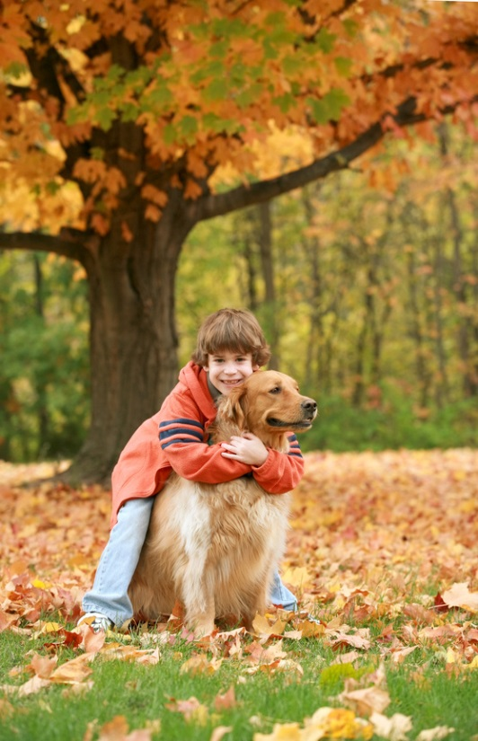
There‘s a woman standing by the car.
There‘s a boy hugging his dog under a tree.

Slide 13
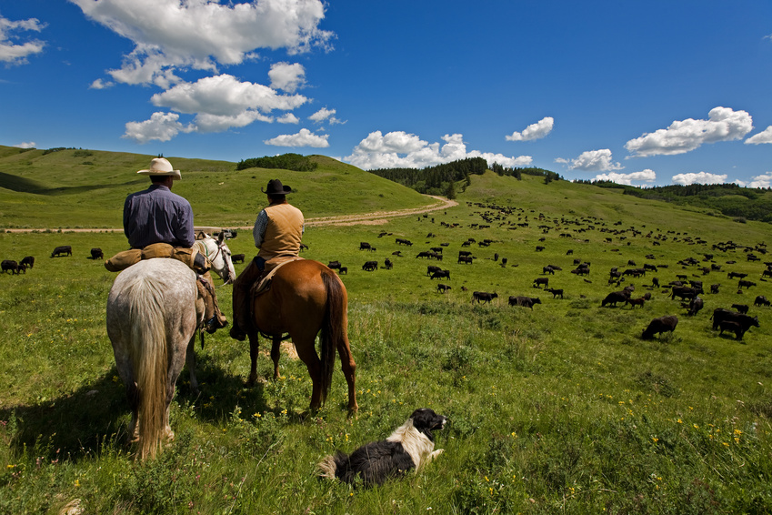
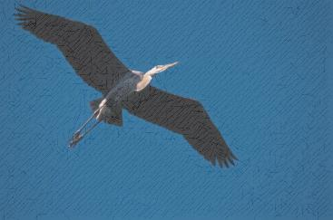
Say six sentences about the picture. Use There‘s / There are + ing

Slide 14
Possible answers:
There are two men sitting on their horses.
There is a dog lying in the grass.
There are white clouds floating in the sky.
There are some (a herd of ) cows grazing (eating grass) on the meadow.
There is a road winding among the hills.
There is a bird flying in the sky.

Slide 15
Použité zdroje
MURPHY, Raymond. English Grammar in Use. Singapore: Cambridge University Press, 2004, ISBN 978 0521 755481.
.HUTCHINSON, Tom. Project. Oxford: Oxford University Press, 2009, ISBN 978-0-19-476417-9.
Obrázky : Galerie Microsoft Office – klipart

