Slide 1

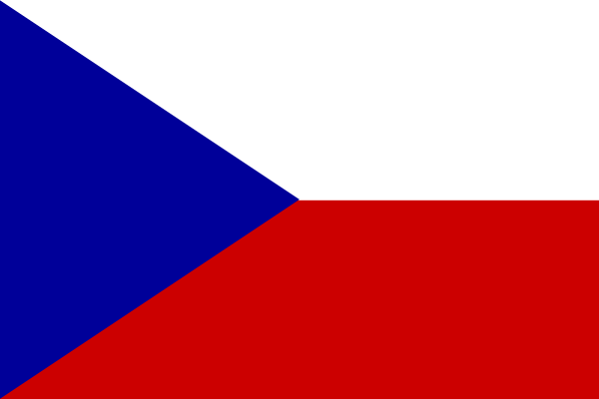

THE CZECH REPUBLIC
Anotace: Materiál je určen žákům 7. ročníku a slouží k výkladu základních fakt o ČR.
Název školy: ZŠ Štětí, Ostrovní 300
Autor: Lenka Pizúrová
Název materiálu: VY_32_INOVACE_AJ.7.A.+B.17_the:czech_republic
Název: The Czech Republic
Vzdělávací oblast: Jazyk a jazyková komunikace
Vzdělávací obor: Cizí jazyk – anglický jazyk
Téma: Česká republika
Ročník: 7.
Školní rok: 2012/2013
Datum: 16.05. 2013
Číslo operačního programu:CZ.1.07/1.4.00/21.1693

Slide 2
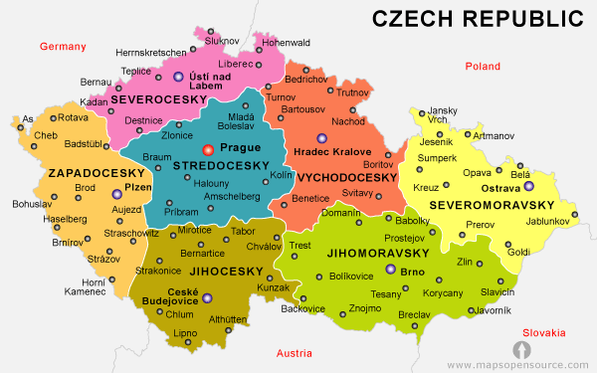
This is the Czech Republic. The Czech Republic is divided into 3 parts –
Bohemia, Moravia and Silesia. The Czech Republic is a small country
in the middle of Europe. There live about 10 million people in CZ.

Slide 3
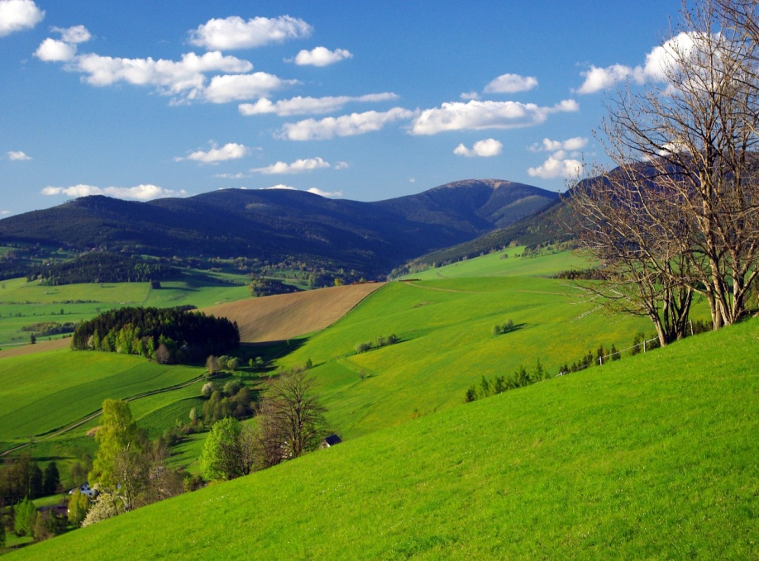
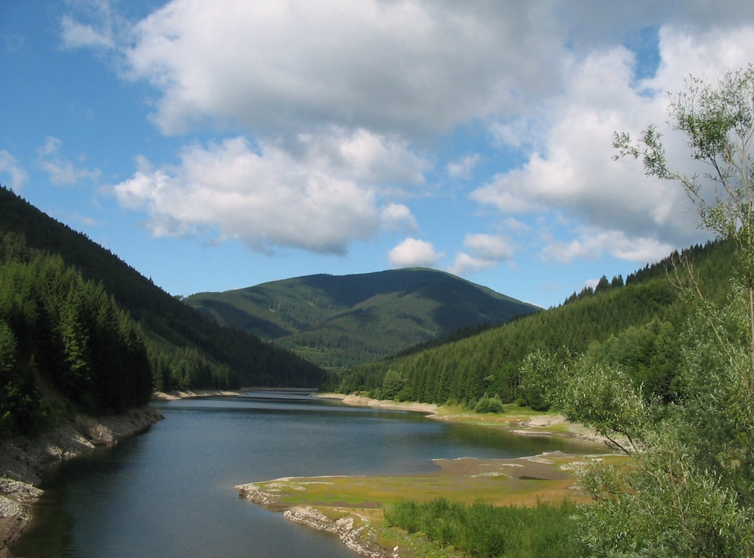
GEOGRAPHY
The Czech landscape is quite varied. There are
mountains on the borders, there are many
hilly parts all over the republic. The south-east
of Moravia is flat. The most important rivers
are Vltava and Elbe.

Slide 4
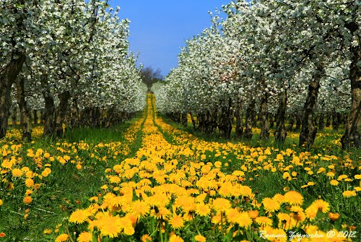
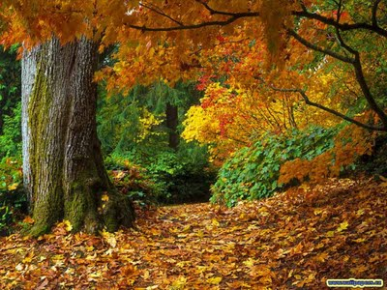
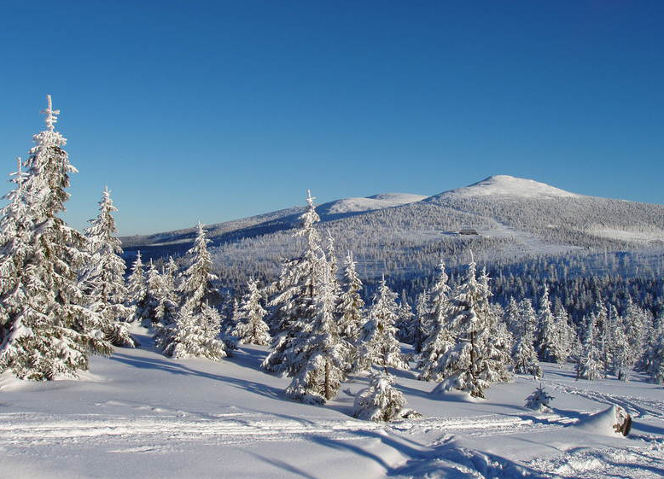
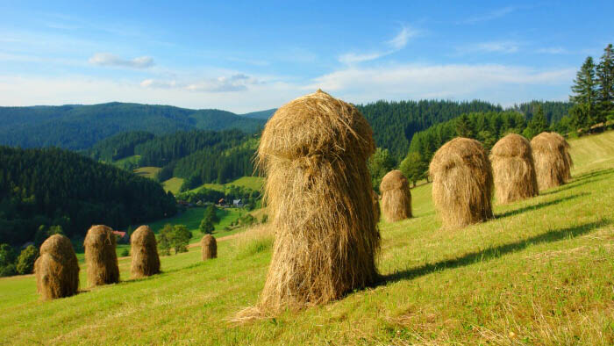
The Czech Republic has continental climate. The summers are quite hot, winters are
cold and cloudy. It usually snows in winter, so many people go skiing.

Slide 5
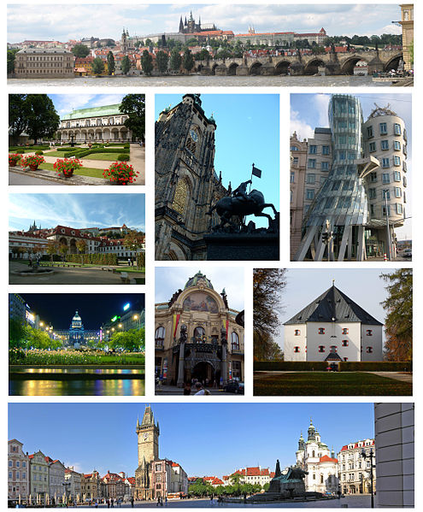
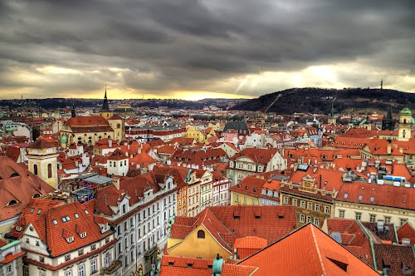
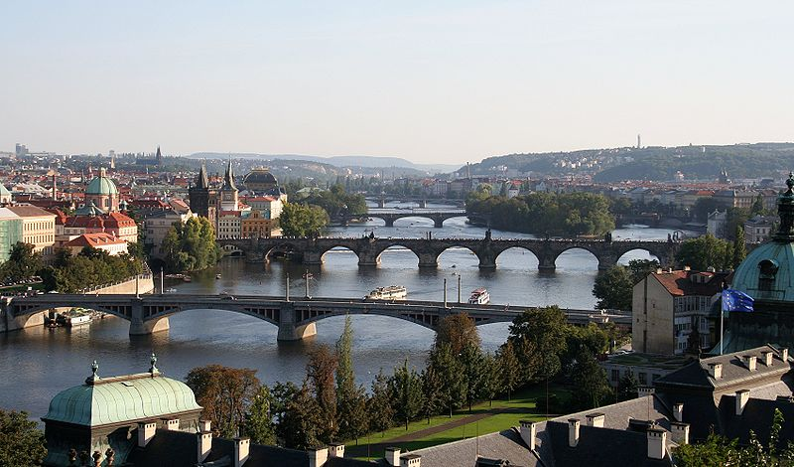
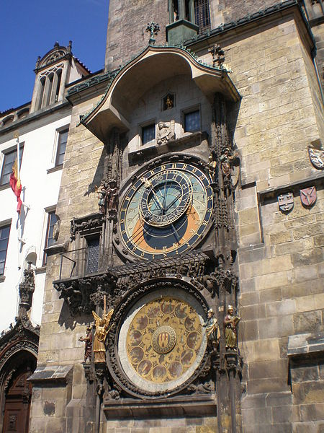
Prague is the capital and the biggest city in the Czech Republic. About 1 million
people live here. Many tourist from other countries visit Prague, because there are
many beautiful historic sights. The most famous and visited are the Prague Castle
and Charles Bridge.

Slide 6
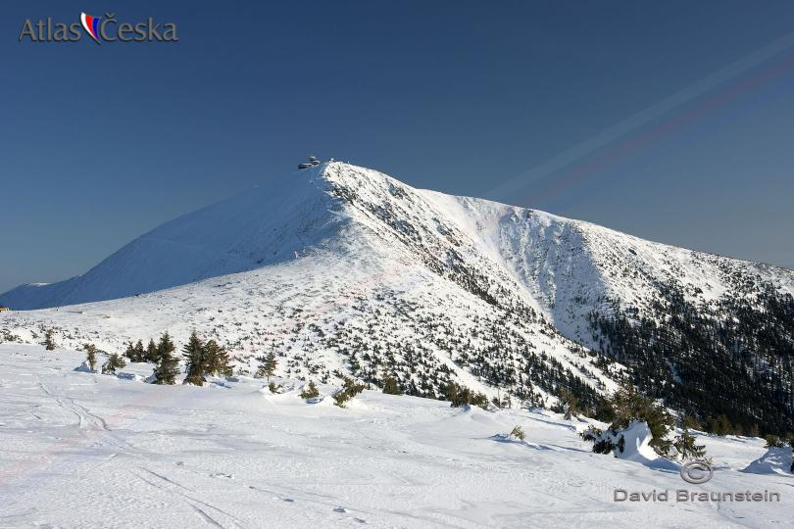
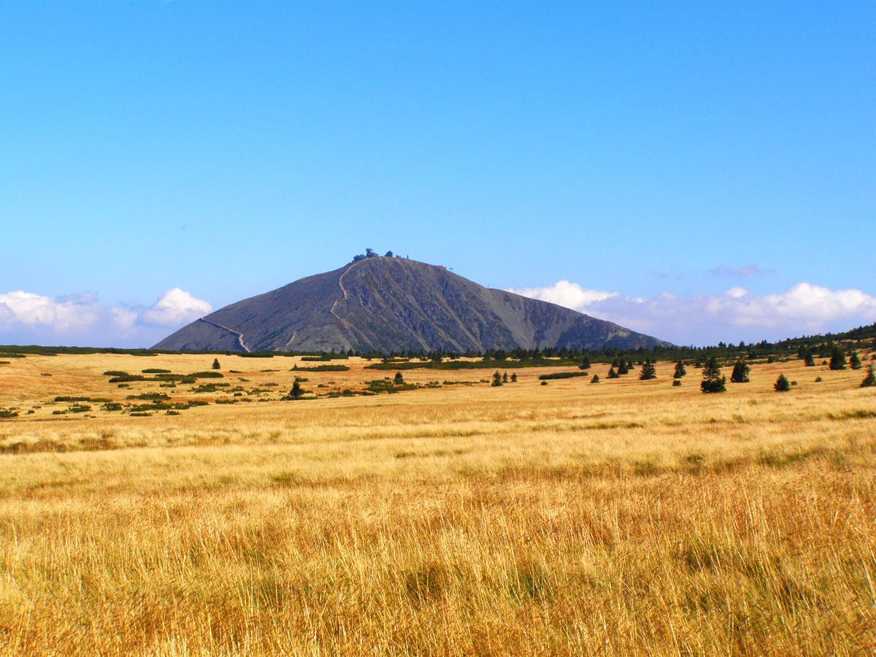
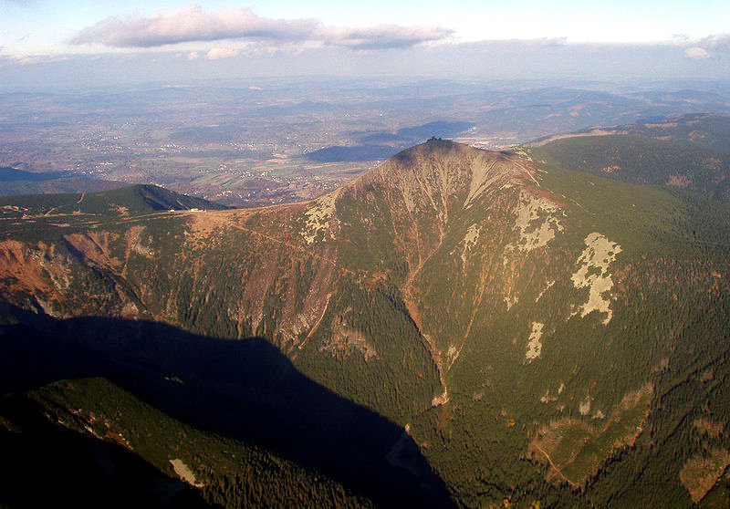
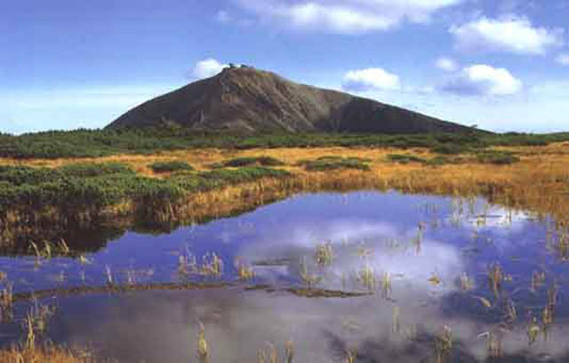
Sněžka is the highest peak in the Czech Republic. It lies in the Krkonoše mountains and
is 1602 m high. Many people also from foreign countries come to ski to the Krkonoše
mountains.

Slide 7
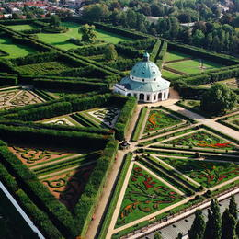
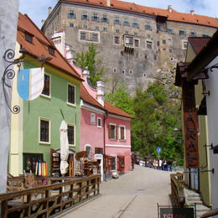
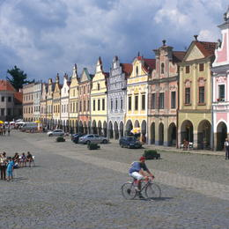
UNESCO sights
There are 12 places that belong to UNESCO – Gardens and Castle at Kroměříž, Historic
Centre od Český Krumlov, Historic Centre of Prague, Historic Centre of Telč, Holašovice
Historical Village Reservation, Holy Trinity Column in Olomouc, Jewish Quarter and
St Procopius Basilica in Třebíč, Kutná hora: Historical Town Centre with the Church
of St Barbara and the Cathedral of Our Lady at Sedlec, Lednice-Vlatice Cultural
Landscape, Litomyšl Castle, Pilgrimage Church of St John of Nepomuk at Zelená hora,
Tugendhat Villa in Brno

Slide 8
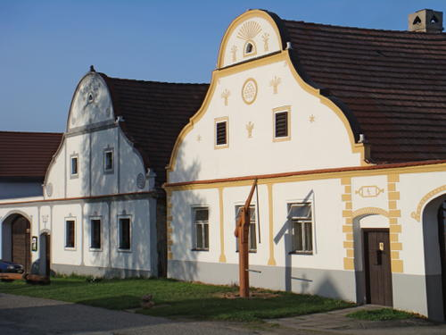
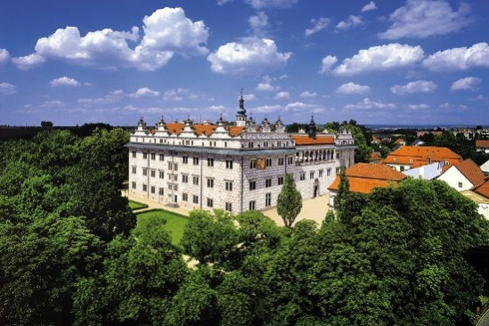
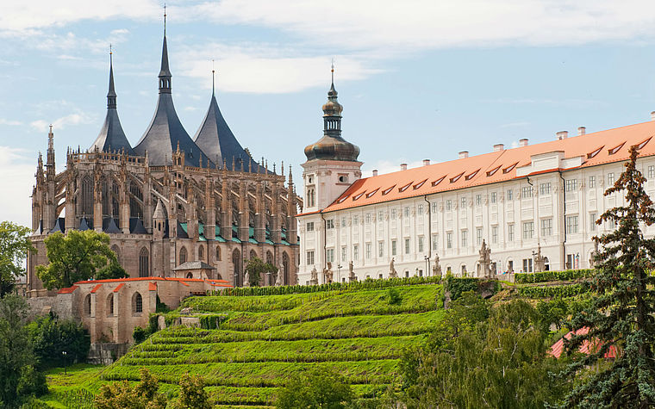
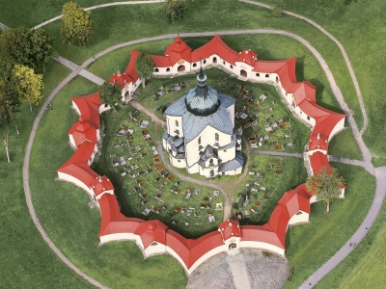

Slide 9
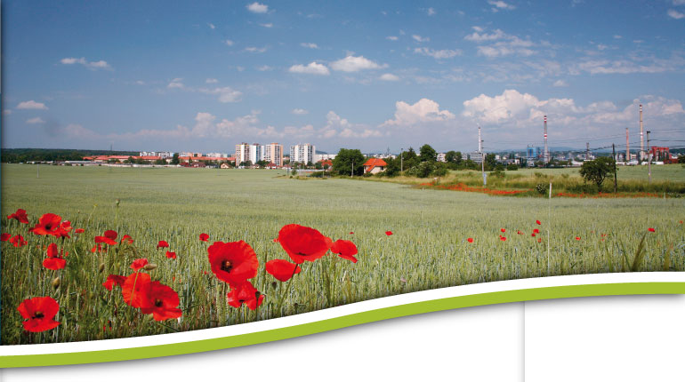
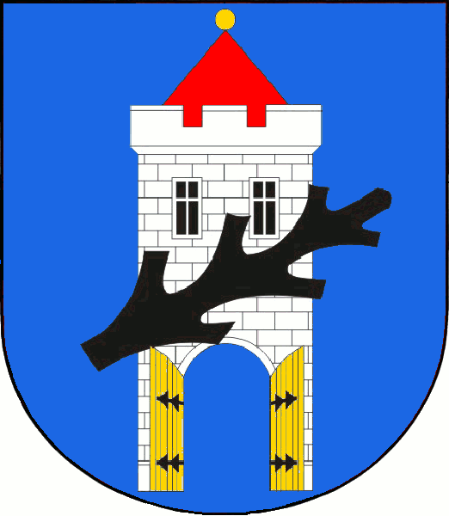
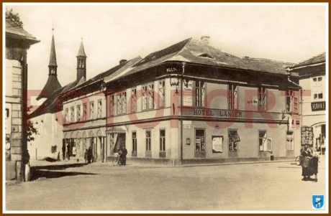
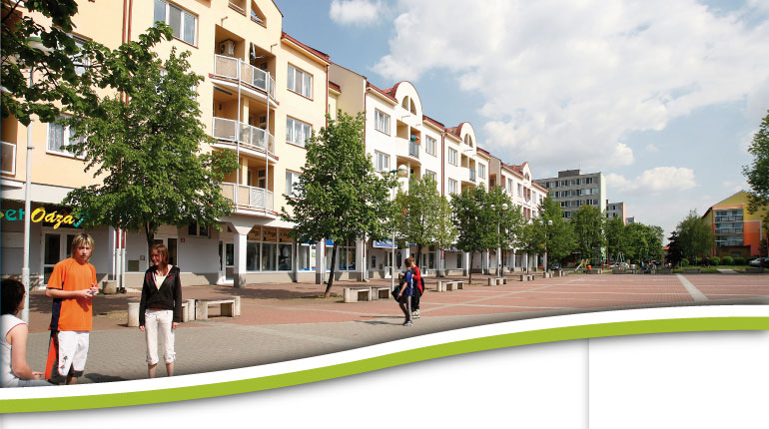
Štětí is a small town on the Labe river, in the north of Bohemia.
Štětí is famous for its paper mill, which is the biggest in central
Europe. There live about 9 thousand people in this town.

Slide 10
METODICKÝ NÁVOD
Na jednotlivých slidech jsou popsány základní fakta o ČR – slouží k výkladu

Slide 11
ODKAZY
Česká státní vlajka, [cit. 2013-02-13]. Dostupné z:
http://www.czechschoolofdallas.org/program/
Mapa ČR, [cit. 2013-02-13]. Dostupné z:
http://www.mapsopensource.com/czech-republic-political-map.html
Geography, [cit. 2013-02-13]. Dostupné z:
https://upload.wikimedia.org/wikipedia/commons/d/d7/Smrk_a_rameno_%C5%A0ance_1.jpg
https://upload.wikimedia.org/wikipedia/commons/c/c8/Kralicky-Sneznik-03.jpg
Roční období, [cit. 2013-02-13]. Dostupné z:
http://www.panoramio.com/photo/71208119
http://www.czechtourism.com/a/beskydy-valassko-summer/
http://davesfotoworld.blogspot.cz/2009/10/romantic-autumn.html#!/2009/10/romantic-autumn.html
http://www.livefortheoutdoors.com/Destinations/Search-Results/World/Europe/Czech-Republic/
Praha, [cit. 2013-02-13]. Dostupné z:
https://en.wikipedia.org/wiki/File:Prague_Montage.jpg
https://en.wikipedia.org/wiki/File:Praga_0003.JPG
https://en.wikipedia.org/wiki/File:Vltava_in_Prague.jpg
http://www.panoramio.com/photo/67912795

Slide 12
ODKAZY
Sněžka, [cit. 2013-02-13]. Dostupné z:
http://www.atlasceska.cz/kralovehradecky-kraj/snezka/
http://www.ok1vei.com/jo70ur.htm
http://ekolist.cz/cz/zpravodajstvi/zpravy/anketu-sedm-divu-krkonos-vyhral-obri-dul-snezka-propadla
http://horn.rajce.idnes.cz/cesta_na_Snezku_23.9.2009
Památky UNESCO, [cit. 2013-02-13]. Dostupné z:
http://www.vi-hotels.com/cz/angelo-prague/poloha/ceska-republika/
http://www.zdarns.cz/o-meste/zelena-hora.asp

