Slide 1

Název školy: Základní škola a mateřská škola,
Hlušice
Autor: PaedDr. Vaňková Marcela
Číslo projektu: CZ.1.07/1.4.00/21.3235
Název: VY_32_INOVACE_3C_14_Present simple - questions
Téma: Anglická gramatika v 6. a 9. ročníku ZŠ

Slide 2
ANOTACE:
1) Materiál je určen pro žáky 2. stupně ZŠ. Dle úvodní tabulky učitel připomene žákům strukturu a tvorbu otázky – Present simple.
2) Následuje procvičení tvorby otázek dle předchozí věty. Kontrola správnosti v závěru materiálu.
3) Písemné procvičení otázek, rozdělení žáků na dvě skupiny: A), B). Kontrola správnosti.
4) Dialogy, konverzace ve dvojicích dle obrázků: What do you...? How often do you...? Where do you...? Why do you...? ap.
5) Zařazení materiálu k procvičení Present simple - questions.

Slide 3
PRESENT SIMPLE - questions
 |  | SUBJECT | INFINITIVE | … every day?
What Where |  | I | work help like | in a factory? my Mum? her sister? chess? English? a game? this toy? to Paris? the film? a horrible dream?
When Why How | Do | he, she, it | play study stop want
What time How many How much |  | we you they | go see have

Slide 4
PRESENT SIMPLE - questions
Make questions: A)
________ ____ ______ ________ __________________? We have breakfast at six.
________ ____ ________ ____ ____ ______? They go to bed at ten o'clock.
________ ____ ______ ______ ______ ______ ____? They get up at eight o'clock.
________ ____ ______ ________ __ ________? We have a rest at four o'clock.
Make questions: B)
________ ____ ________ __________ school? They start at nine.
________ ____ ______ ______________? I collect stamps.
________ ____ ______ ________? I play the piano.
________ ____ ______ ________? I draw horses.

Slide 5
PRESENT SIMPLE - questions
Make questions: A)
________ ____ ______ ________? I read books.
________ ____ ______ __________? I write letters.
____ ______ ________ volleyball? Yes, I do.
____ ______ ________ in a bank? Yes, I do.
Make questions: B)
____ ______ __________ sports? Yes, I do.
________ ________ ______ ________ __________________? Ben has breakfast at six.
____ ______ ________ computer games? Yes, I do.
________ ________ ______ ____ ____ ______? She goes to bed at ten o'clock.

Slide 6
PRESENT SIMPLE - questions
1) your best friend/ go to the gym/ twice a week?
____________________
____________________
2) their brother/ often/ go skateboarding?
____________________
____________________
3) you and your teacher/ meet/ every day?
____________________
____________________
4) What time/ your family/ have supper/ at the weekend?
__________________________________________
5) How often/ Jennifer/ play live concerts?
__________________________________________
6) Where/ Czech people/ usually/ spend their summer holidays?
______________________________________________

Slide 7

PRESENT SIMPLE - questions
Correct:
When do you have breakfast? We have breakfast at six.
When do they go to bed? They go to bed at ten o'clock.
When do Tom and Bob get up? They get up at eight o'clock.
When do you have a rest? We have a rest at four o'clock.
When do they start school? They start at nine.
What do you collect? I collect stamps.
What do you play? I play the piano.
What do you draw? I draw horses.
What do you read? I read books.
What do you write? I write letters.
Do you play volleyball? Yes, I do.
Do you work in a bank? Yes, I do.
Do you watch sports? Yes, I do.
When does Ben have breakfast? Ben has breakfast at six.
Do you play computer games? Yes, I do.
When does she go to bed? She goes to bed at ten o'clock.

Slide 8
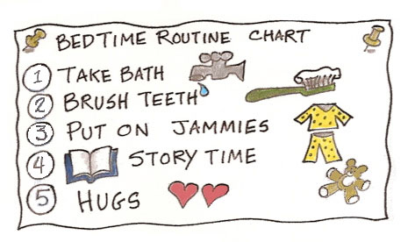

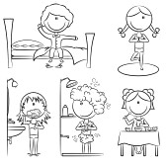
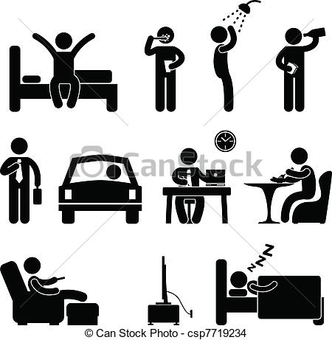
PRESENT SIMPLE - dialogues

Slide 9
CITACE:
http://images.google.com/imgres?q=routines+clipart&biw=1161&bih=506&tbm=isch&tbnid=3OBjcumZAwVUDM:&imgrefurl=http://blog.positivediscipline.com/2012/02/routines.html&docid=OcEVRukA3qcaIM&imgurl=http://2.bp.blogspot.com/-fTZtJGz3lvE/Ty8HMkiganI/AAAAAAAAFM4/XNbfDLK_DyQ/s1600/routine-chart.jpg&w=473&h=276&ei=gLCvUf61BoPUtQbnmIGQBQ&zoom=1&iact=rc&dur=141&page=1&tbnh=137&tbnw=257&start=0&ndsp=22&ved=1t:429,r:9,s:0,i:108&tx=182&ty=35
http://images.google.com/imgres?q=routines+clipart&biw=1161&bih=506&tbm=isch&tbnid=Lgelbb7n6wbfiM:&imgrefurl=http://www.123rf.com/clipart-vector/routine.html&docid=zRT3zWVIH-pBeM&imgurl=http://us.cdn3.123rf.com/168nwm/dobric/dobric1101/dobric110100002/8626737-daily-life-including-wake-up-yoga-teeth-cleaning-shower-and-breakfast.jpg&w=168&h=168&ei=gLCvUf61BoPUtQbnmIGQBQ&zoom=1&iact=rc&dur=125&page=1&tbnh=134&tbnw=133&start=0&ndsp=22&ved=1t:429,r:6,s:0,i:99&tx=95&ty=94
http://images.google.com/imgres?q=routines+clipart&biw=1161&bih=506&tbm=isch&tbnid=d12dP2oY6-FqmM:&imgrefurl=http://welcometoerinsworld.wordpress.com/2011/11/13/had-a-good-weekend-long-and-rambly/&docid=4_bs76Y5tpwevM&imgurl=http://bp0.blogger.com/_ihXPOFm-1cg/R8KxVSXzGxI/AAAAAAAAAGY/uRw47e17uWk/s200/clipart-pencil-checklist.png&w=200&h=194&ei=gLCvUf61BoPUtQbnmIGQBQ&zoom=1&iact=hc&vpx=123&vpy=2&dur=234&hovh=155&hovw=160&tx=105&ty=103&page=3&tbnh=155&tbnw=160&start=44&ndsp=24&ved=1t:429,r:45,s:0,i:222
http://images.google.com/imgres?q=routines+clipart&start=118&biw=1161&bih=506&tbm=isch&tbnid=Sk94KsNOhbd1nM:&imgrefurl=http://www.canstockphoto.com/man-daily-routine-people-icon-sign-7719234.html&docid=esL5PsoO0eGZEM&imgurl=http://comps.canstockphoto.com/can-stock-photo_csp7719234.jpg&w=400&h=407&ei=k7KvUZf6K8XNtAaqzoDQBw&zoom=1&iact=hc&vpx=891&vpy=114&dur=1328&hovh=226&hovw=223&tx=171&ty=159&page=6&tbnh=144&tbnw=142&ndsp=23&ved=1t:429,r:40,s:100,i:124
http://images.google.com/imgres?q=routines+clipart&start=90&biw=1161&bih=506&tbm=isch&tbnid=rzmZIlAVdZ8SkM:&imgrefurl=http://cheerleading.lovetoknow.com/School_Mascot_Clipart&docid=L0l1kaCcnfJmtM&imgurl=http://cf.ltkcdn.net/cheerleading/images/std/51234-367x327-SchoolMascotClipart.jpg&w=367&h=327&ei=AbavUau_IZHMswaiwICwDQ&zoom=1&iact=hc&vpx=90&vpy=2&dur=938&hovh=212&hovw=238&tx=138&ty=125&page=5&tbnh=136&tbnw=153&ndsp=28&ved=1t:429,r:12,s:100,i:40
Project English 3, Oxford, Tom Hutchinson, Grammar summary
Angličtina, Školní kurz gramatiky, Maria Birkenmajer, E. Maňko, Infoa 2008
The Good Grammar Book, Michael Swan, Catherine Walter, Oxford University Press
Essential Grammar in Use, Raymond Murphy, Cambridge University Press
Spark, Virginia Evans_Jenny Dooley, Teacher´s book, Express Publishing
Let´s study Grammar, Krajewska Milada, Infoa
Terasoft, TC Angličtina 2, 3, 4, PC program 2003

