Slide 1

NUMBERS

Slide 2
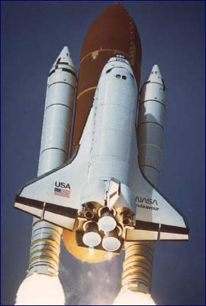
THE ROCKET IS READY!
START THE COUNTING!

Slide 3

TEN

Slide 4

NINE

Slide 5

EIGHT

Slide 6

SEVEN

Slide 7

SIX

Slide 8

FIVE

Slide 9

FOUR

Slide 10

THREE

Slide 11

TWO

Slide 12

ONE

Slide 13
START !

Slide 14
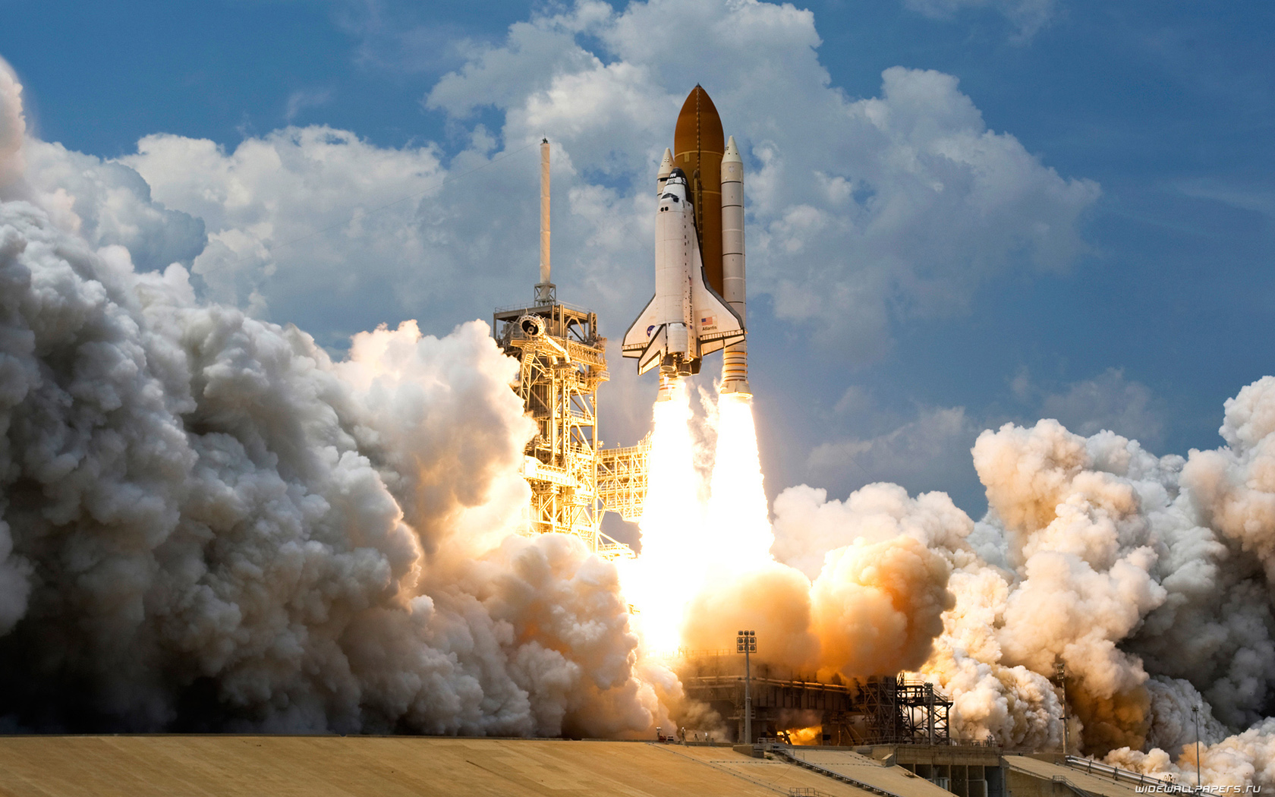

Slide 15
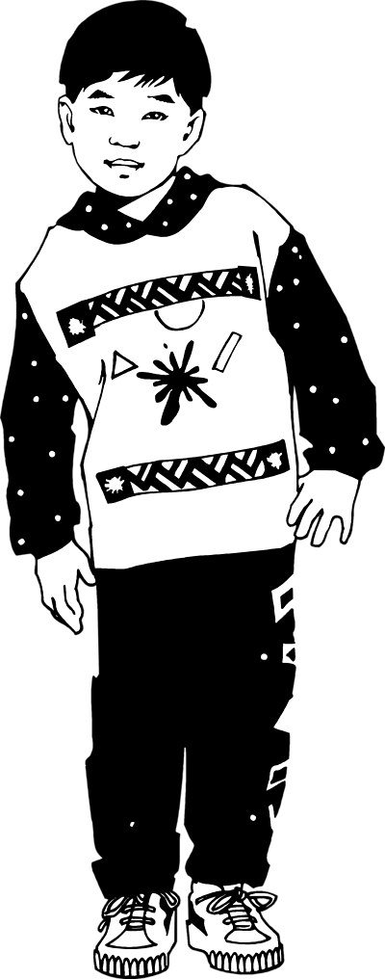
?

Slide 16
ONE BOY

Slide 17
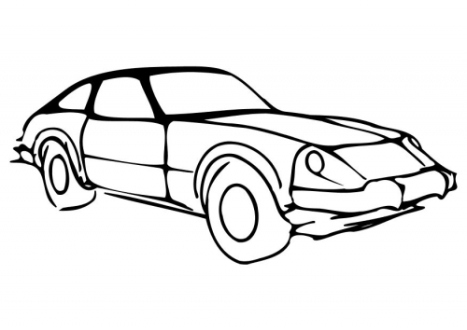
?

Slide 18
TWO CARS

Slide 19
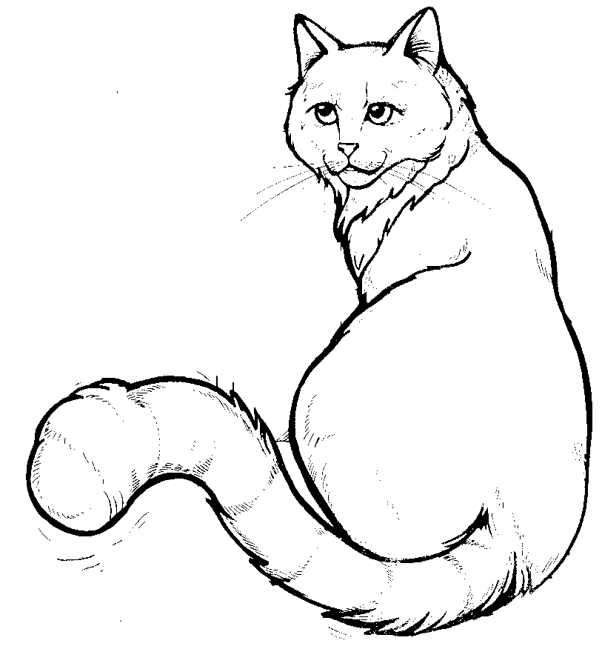
?

Slide 20
THREE CATS

Slide 21
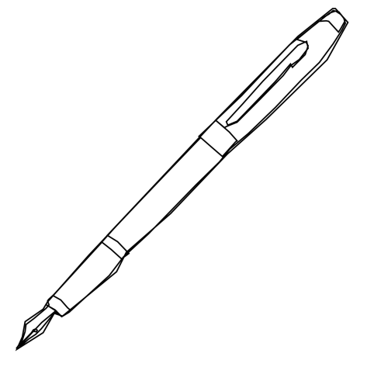
?

Slide 22
FOUR PENS

Slide 23
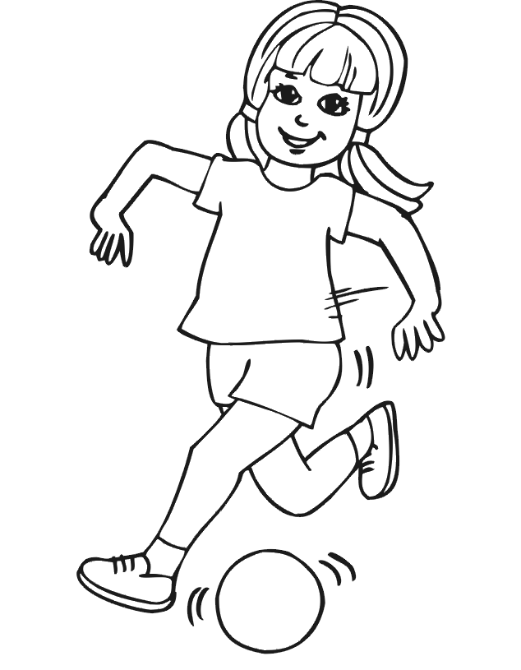
?

Slide 24
FIVE GIRLS

Slide 25
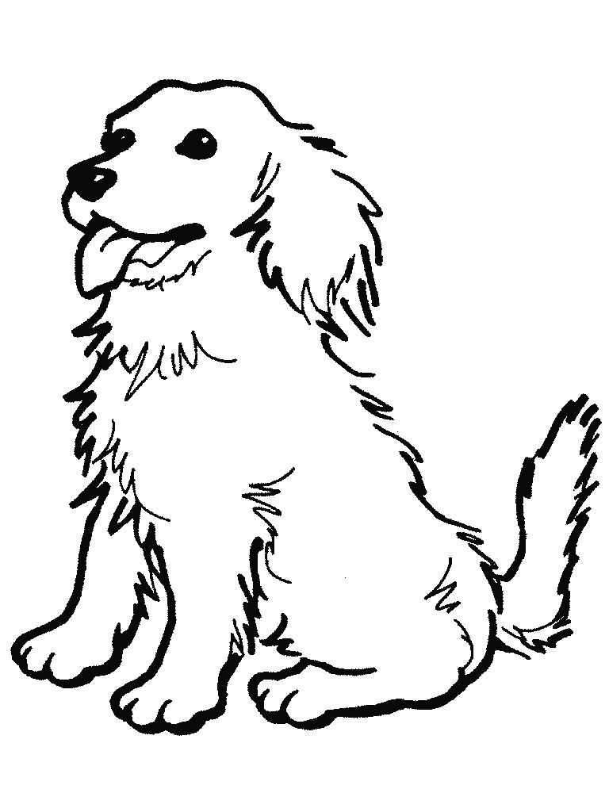
?

Slide 26
SIX DOGS

Slide 27
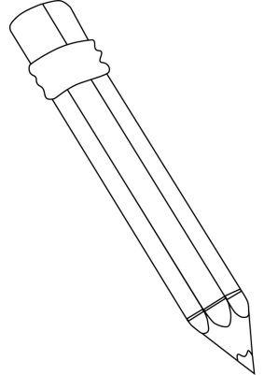
?

Slide 28
SEVEN PENCILS

Slide 29

?

Slide 30
EIGHT BUTTERFLIES

Slide 31

?

Slide 32
NINE FLOWERS

Slide 33
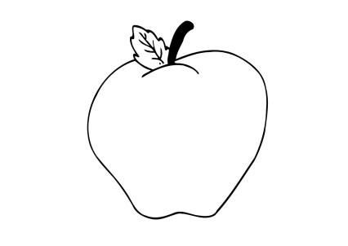
?

Slide 34
TEN APPLES

