Slide 1

NUMBERS

Slide 2
BIBLIOGRAFIE
Bibliografie: http://1.bp.blogspot.com/-107YXKeAXs/
UB6V49H9yuI/AAAAAAAACsY/69ceZJXaYZE/s1600/number-one-.png http://digimind.com/blog/wpcontent/
uploads/2012/02/number2c.png http://blog.scholarshippoints.com/wpcontent/
uploads/2010/11/number3.png http://blog.campaignasia.com/wpcontent/
uploads/2012/04/4NumberFourInCircle.png http://www.dirtyprettythangs.com/wpcontent/
uploads/2012/07/five.png http://coachdawnwrites.com/wp-content/uploads/2011/09/six.png
http://3.bp.blogspot.com/-rk4c3b-O0Zk/Txh8WXyxF8I/AAAAAAAADJE/6PbDF0ul_o8/s1600/seven.png
http://www.hickman.k12.ca.us/images/number%208.png
http://www.aerospaceguide.net/spacepictures/shuttle_endeavour.jpg http://www.edupics.com/car-t10259.jpg
http://www.meridianvitality.com/wp-content/uploads/2010/06/color-dog-2.gif
http://www.arthursclipart.org/pets/pets/cat.gif http://www.wpclipart.com/plants/rose_sketch.png
http://adaptstudio.ca/blog/uploaded_images/fountainpen-764306.png
http://www.benscoloringpages.com/coloringpages/pencil.jpg http://stuffpoint.com/art/image/37295-art-butterflymonarch.
jpg http://www.printactivities.com/ColoringPages/Soccer/Girl-Soccer-Player.gif
http://www.brideonline.co.nz/media/Styles/apple.gif

Slide 3
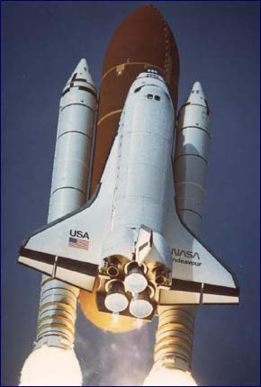
THE ROCKET IS READY!
START THE COUNTING!

Slide 4

TEN

Slide 5

NINE

Slide 6

EIGHT

Slide 7

SEVEN

Slide 8

SIX

Slide 9

FIVE

Slide 10

FOUR

Slide 11

THREE

Slide 12

TWO

Slide 13

ONE

Slide 14
START !

Slide 15
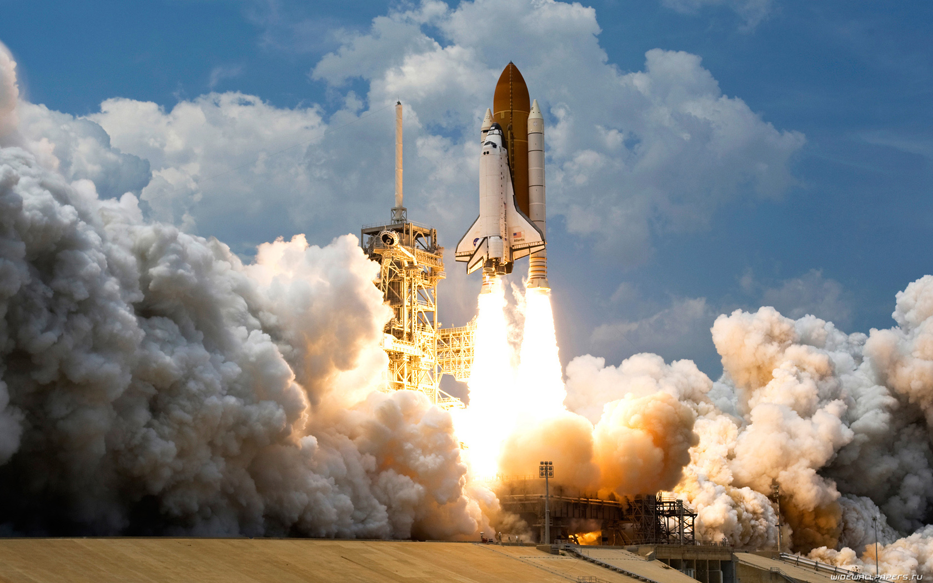

Slide 16
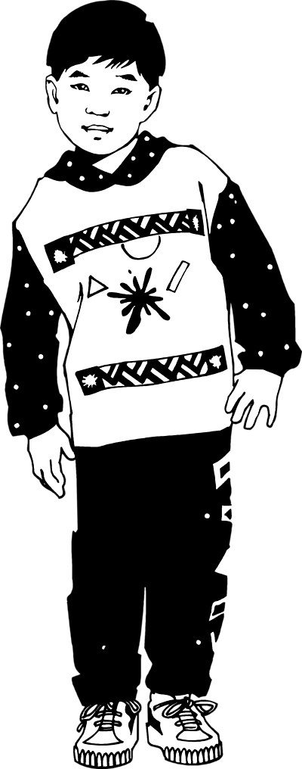
?

Slide 17
ONE BOY

Slide 18

?

Slide 19
TWO CARS

Slide 20
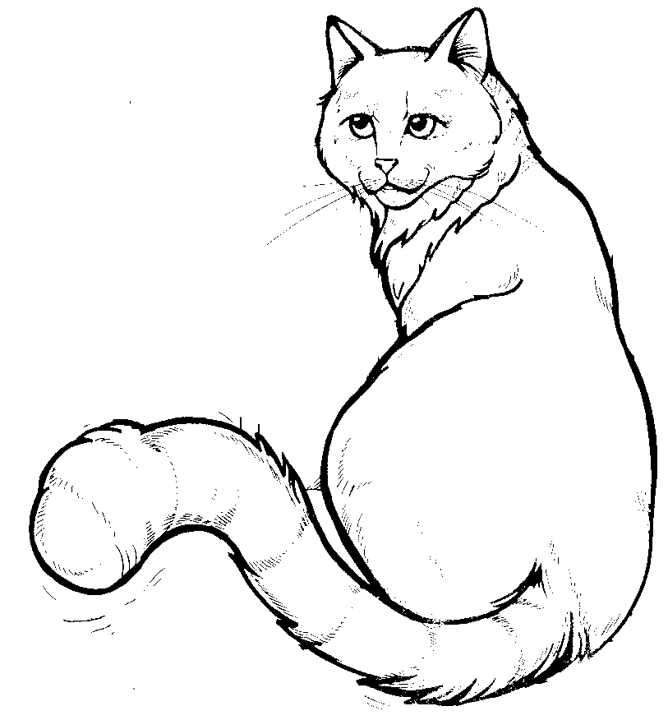
?

Slide 21
THREE CATS

Slide 22

?

Slide 23
FOUR PENS

Slide 24
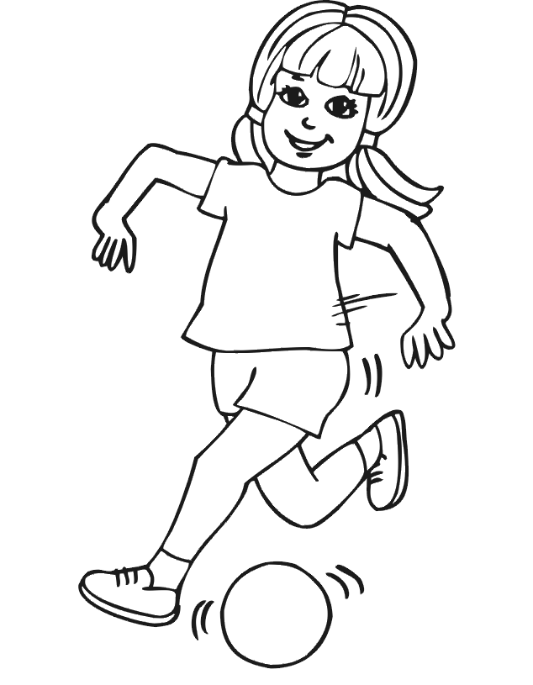
?

Slide 25
FIVE GIRLS

Slide 26
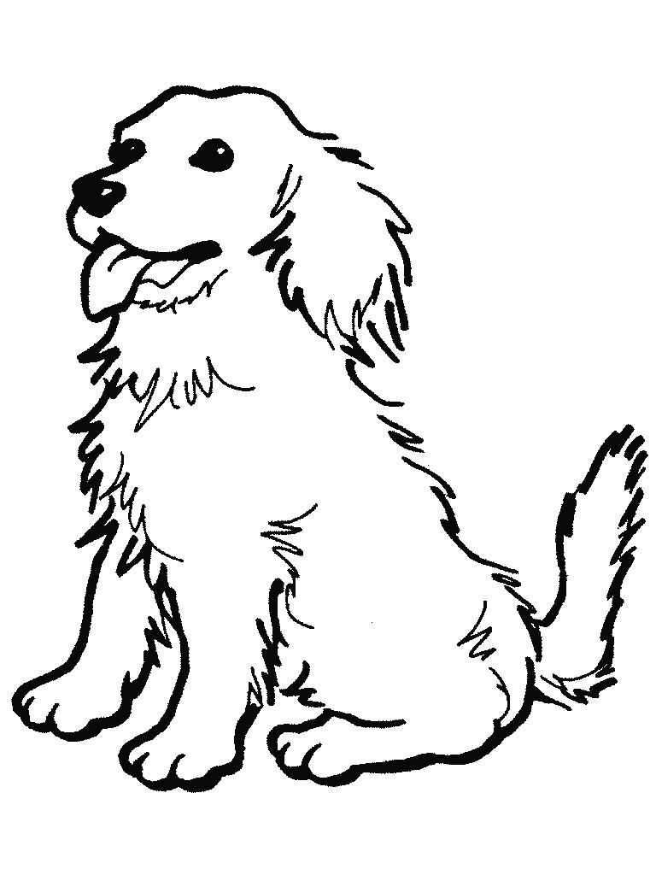
?

Slide 27
SIX DOGS

Slide 28
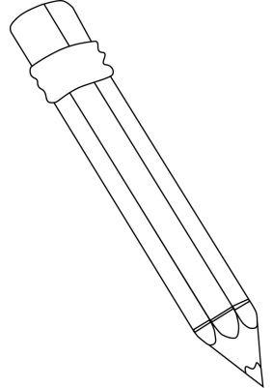
?

Slide 29
SEVEN PENCILS

Slide 30

?

Slide 31
EIGHT BUTTERFLIES

Slide 32

?

Slide 33
NINE FLOWERS

Slide 34

?

Slide 35
TEN APPLES

