Slide 1

Název školy: ZŠ a MŠ Zvole
Autor: Mgr. Jana Němcová
Název: VY_52_INOVACE_08 II Listnaté - listy
Téma: Člověk a jeho svět – Prvouka
Číslo projektu: CZ.1.07/1.4.00/21.0305

Slide 2
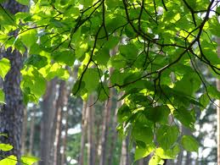
LISTNATÉ STROMY
LISTY

Slide 3
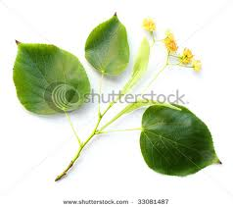
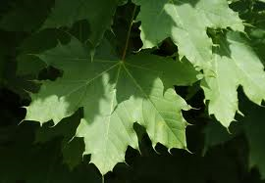
VYBER K LISTU SPRÁVNÝ STROM
BUK
LÍPA
DUB
JAVOR
SMRK
KAŠTAN
JEDLE
BOROVICE

Slide 4
VYBER K LISTU SPRÁVNÝ STROM
BUK
LÍPA
DUB
JAVOR
SMRK
KAŠTAN
JEDLE
BOROVICE

Slide 5
ODKAZY
http://t3.gstatic.com/images?q=tbn:ANd9GcTgWL_qREKl0QOqU58qPyXVLmhrAecffwXkdqFFlEgVNFVE_z1v
http://images.google.com/imgres?imgurl=http://image.shutterstock.com/display_pic_with_logo/164272/164272,1246655162,1/stock-photo-small-leaved-linden-tilia-cordata-linden-flowers-are-a-traditional-herbal-remedy-linden-flower-33081487.jpg&imgrefurl=http://www.shutterstock.com/pic-33081487/stock-photo-small-leaved-linden-tilia-cordata-linden-flowers-are-a-traditional-herbal-remedy-linden-flower.html&usg=__HEXA302uRzdgpvH41BUT9s09o70=&h=399&w=450&sz=55&hl=cs&start=33&sig2=jQ56fIxvT3ObiiAJ23xKGQ&zoom=1&tbnid=5IJioQz1xmNNtM:&tbnh=127&tbnw=152&ei=ykD-TZTgK9HLtAb8wMHzDQ&prev=/search%3Fq%3Dl%25C3%25ADpa%26hl%3Dcs%26sa%3DG%26biw%3D940%26bih%3D600%26tbs%3Diur:fmc%26tbm%3Disch&itbs=1&iact=rc&dur=263&page=3&ndsp=15&ved=1t:429,r:9,s:33&tx=90&ty=75&biw=940&bih=600
http://images.google.com/imgres?imgurl=http://www.frustfrei-lernen.de/images/biologie/ahorn-2-gross.jpg&imgrefurl=http://www.frustfrei-lernen.de/biologie/der-ahorn.html&usg=__5UkyrFEnf3YrP0YX_cRMiKIXHLk=&h=606&w=874&sz=89&hl=cs&start=8&sig2=iCqurc6NP-buiJFkXZmhHw&zoom=1&tbnid=RY18DEoS7_KdYM:&tbnh=101&tbnw=146&ei=mkH-TYv4F4fBswaJosTyDQ&prev=/images%3Fq%3DJAVOR%26hl%3Dcs%26sa%3DG%26biw%3D940%26bih%3D600%26tbs%3Diur:fmc%26tbm%3Disch&itbs=1&biw=940&bih=600

