Slide 2
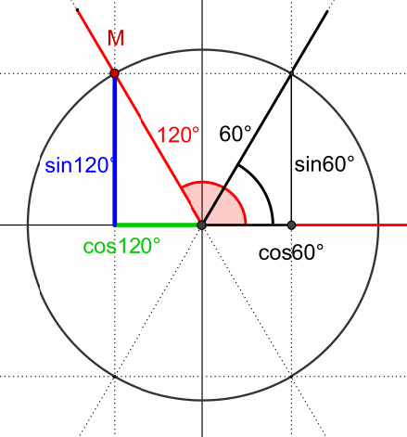

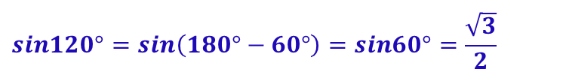
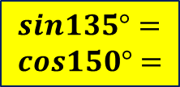
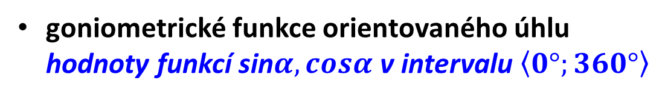





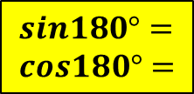
GONIOMETRIE A TRIGONOMETRIE
goniometrické funkce orientovaného úhlu
hodnoty funkcí sin$α,cosα$ v intervalu $\left\langle 0°;360°\right\rangle$
$$\sin\left(π−α\right)=sinα$$
I
$$\sin\left(180°−α\right)=sinα$$
II
$$sin120°=sin\left(180°−60°\right)=sin60°=\frac{\sqrt{3}}{2}$$
$\cos\left(π−α\right)=−$cos$α$
$\cos\left(180°−α\right)=−$cos$α$
$$cos120°=cos\left(180°−120°\right)=−cos60°=−\frac{1}{2}$$
???
$$sin135°= \\ cos150°=$$
$$sin180°= \\ cos180°=$$
Notes:
Chyba!!!!!!

Slide 3
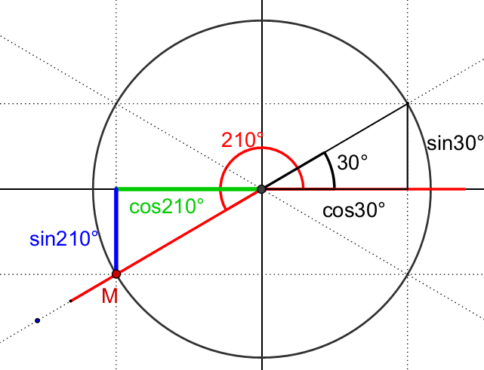
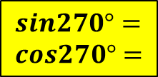
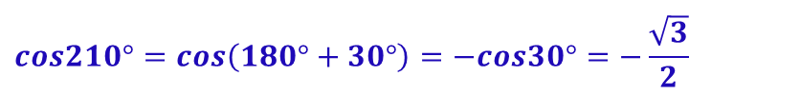
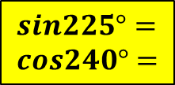





GONIOMETRIE A TRIGONOMETRIE
goniometrické funkce orientovaného úhlu
hodnoty funkcí sin$α,cosα$ v intervalu $\left\langle 0°;360°\right\rangle$
$$\sin\left(π+α\right)=−sinα$$
I
$$\sin\left(180°+α\right)=−sinα$$
$$sin210°=sin\left(180°+30°\right)=−sin30°=−\frac{1}{2}$$
$\cos\left(π+α\right)=−$cos$α$
$\cos\left(180°+α\right)=−$cos$α$
$$cos210°=cos\left(180°+30°\right)=−cos30°=−\frac{\sqrt{3}}{2}$$
III
???
$$sin225°= \\ cos240°=$$
$$sin270°= \\ cos270°=$$

Slide 4
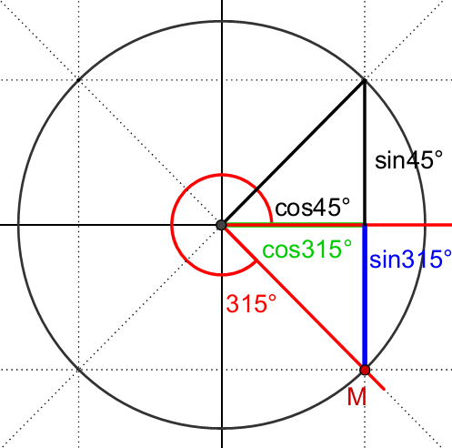

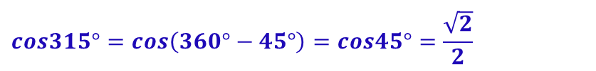
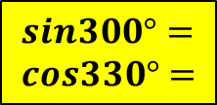
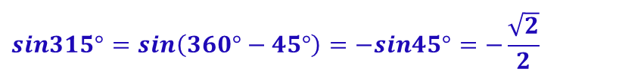



GONIOMETRIE A TRIGONOMETRIE
goniometrické funkce orientovaného úhlu
hodnoty funkcí sin$α,cosα$ v intervalu $\left\langle 0°;360°\right\rangle$
$$\sin\left(2π−α\right)=−sinα$$
$$\sin\left(360°−α\right)=−sinα$$
$$sin315°=sin\left(360°−45°\right)=−sin45°=−\frac{\sqrt{2}}{2}$$
$\cos\left(2π−α\right)=$cos$α$
$\cos\left(360°−α\right)=$cos$α$
$$cos315°=cos\left(360°−45°\right)=cos45°=\frac{\sqrt{2}}{2}$$
IV
???
$$sin300°= \\ cos330°=$$

Slide 5

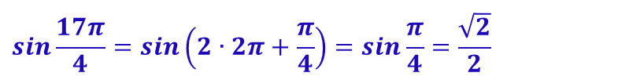


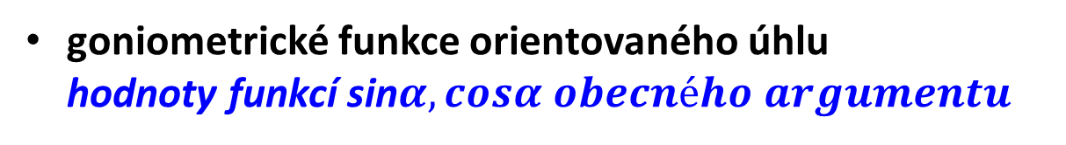
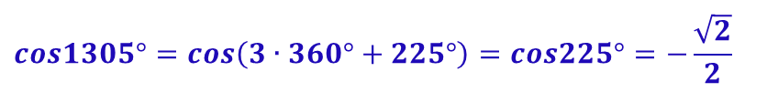



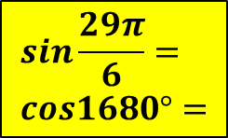

GONIOMETRIE A TRIGONOMETRIE
goniometrické funkce orientovaného úhlu
hodnoty funkcí sin$α,cosα obecného argumentu$
$$\sin\left(2kπ+α\right)=sinα$$
$$α∈R;k∈Z$$
$$\sin\left(k∙360°+α\right)=sinα$$
$$sin\frac{17π}{4}=sin\left(2∙2π+\frac{π}{4}\right)=sin\frac{π}{4}=\frac{\sqrt{2}}{2}$$
$$sin810°=sin\left(2∙360°+90°\right)=sin90°=1$$
$\cos\left(2kπ+α\right)=$cos$α$
$\cos\left(k∙360°+α\right)=$cos$α$
$$α∈R;k∈Z$$
$$cos\frac{22π}{3}=cos\left(3∙2π+\frac{4π}{3}\right)=cos\frac{4π}{3}=−\frac{1}{2}$$
$$cos1305°=cos\left(3∙360°+225°\right)=cos225°=−\frac{\sqrt{2}}{2}$$
???
$$sin\frac{29π}{6}= \\ cos1680°=$$

Slide 6
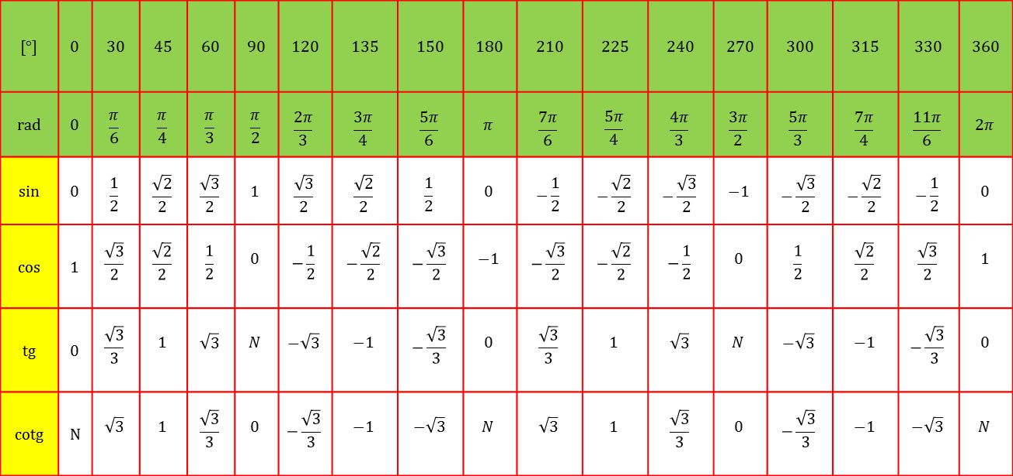
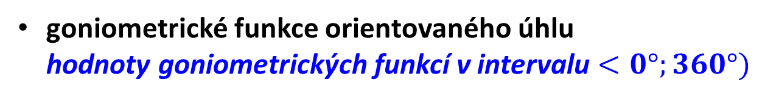
GONIOMETRIE A TRIGONOMETRIE
goniometrické funkce orientovaného úhlu
hodnoty goniometrických funkcí v intervalu $<0°;360°)$
tahák
[°] | 0 | 30 | 45 | 60 | 90 | 120 | 135 | 150 | 180 | 210 | 225 | 240 | 270 | 300 | 315 | 330 | 360
rad | 0 | $$\frac{π}{6}$$ | $$\frac{π}{4}$$ | $$\frac{π}{3}$$ | $$\frac{π}{2}$$ | $$\frac{2π}{3}$$ | $$\frac{3π}{4}$$ | $$\frac{5π}{6}$$ | $$π$$ | $$\frac{7π}{6}$$ | $$\frac{5π}{4}$$ | $$\frac{4π}{3}$$ | $$\frac{3π}{2}$$ | $$\frac{5π}{3}$$ | $$\frac{7π}{4}$$ | $$\frac{11π}{6}$$ | $$2π$$
sin | 0 | $$\frac{1}{2}$$ | $$\frac{\sqrt{2}}{2}$$ | $$\frac{\sqrt{3}}{2}$$ | $$1$$ | $$\frac{\sqrt{3}}{2}$$ | $$\frac{\sqrt{2}}{2}$$ | $$\frac{1}{2}$$ | $$0$$ | $$−\frac{1}{2}$$ | $$−\frac{\sqrt{2}}{2}$$ | $$−\frac{\sqrt{3}}{2}$$ | $$−1$$ | $$−\frac{\sqrt{3}}{2}$$ | $$−\frac{\sqrt{2}}{2}$$ | $$−\frac{1}{2}$$ | $$0$$
cos | 1 | $$\frac{\sqrt{3}}{2}$$ | $$\frac{\sqrt{2}}{2}$$ | $$\frac{1}{2}$$ | $$0$$ | $$−\frac{1}{2}$$ | $$−\frac{\sqrt{2}}{2}$$ | $$−\frac{\sqrt{3}}{2}$$ | $$−1$$ | $$−\frac{\sqrt{3}}{2}$$ | $$−\frac{\sqrt{2}}{2}$$ | $$−\frac{1}{2}$$ | $$0$$ | $$\frac{1}{2}$$ | $$\frac{\sqrt{2}}{2}$$ | $$\frac{\sqrt{3}}{2}$$ | $$1$$
tg | 0 | $$\frac{\sqrt{3}}{3}$$ | $$1$$ | $$\sqrt{3}$$ | $$N$$ | $$−\sqrt{3}$$ | $$−1$$ | $$−\frac{\sqrt{3}}{3}$$ | $$0$$ | $$\frac{\sqrt{3}}{3}$$ | $$1$$ | $$\sqrt{3}$$ | $$N$$ | $$−\sqrt{3}$$ | $$−1$$ | $$−\frac{\sqrt{3}}{3}$$ | $$0$$
cotg | N | $$\sqrt{3}$$ | $$1$$ | $$\frac{\sqrt{3}}{3}$$ | $$0$$ | $$−\frac{\sqrt{3}}{3}$$ | $$−1$$ | $$−\sqrt{3}$$ | $$N$$ | $$\sqrt{3}$$ | $$1$$ | $$\frac{\sqrt{3}}{3}$$ | $$0$$ | $$−\frac{\sqrt{3}}{3}$$ | $$−1$$ | $$−\sqrt{3}$$ | $$N$$

