Slide 1


ŠKOLA: | Gymnázium, Chomutov, Mostecká 3000, příspěvková organizace
AUTOR: | Jana Neradová
NÁZEV: | VY_32_INOVACE_04C_O9_Elizabeth I
TEMA: | REÁLIE
ČÍSLO PROJEKTU: | CZ.1.07/1.5.00/34.0816
DATUM TVORBY: | 4.7.2O13

Slide 2
ANOTACE
Materiál je určen žákům úrovně A2, B1, B2
Časově je koncipován na jednu vyučovací hodinu.
Jeho obsah je určen k přehlednému výkladu o nejvýznamnější postavě Tudorovské dynastie.
Navazuje na předchozí DUMy v sadě, rozvíjí je a dotváří obsah celku Reálie anglicky mluvících zemí.
Cílem prezentace je připravit žáky na souvislý projev o důležité osobnosti britské historie.
Slidy 4 – 17: Studenti sledují prezentaci a výklad vyučujícího a píší si poznámky do sešitů.
Zároveň s výkladem si zaznamenávají novou, tématickou slovní zásobu.
Slidy 18 – 19: Studenti pomocí digitálního pera Qdraw vpisují pojmy do tabulky podle zadaného úkolu.
Slidy 2O – 21: Studenti požadované údaje vpisuji digitálním perem, nebo činí totéž na tabulce, projektované na interaktivní tabuli, prostřednictvím barevných kříd, nebo fixů.
Cílem obou aktivit je shrnout a zopakovat fakta a zároveň aktivizovat žáky.
Materiál je určen k interaktivní výuce.

Slide 3
Elizabeth I
1558-1603
A big personality

Slide 4
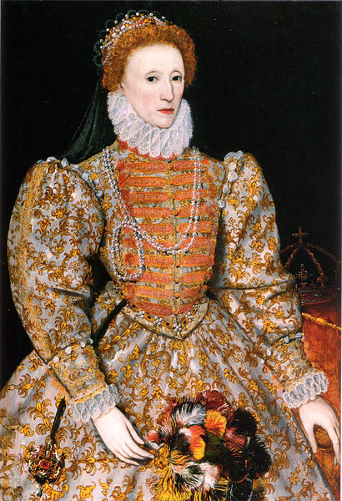
Portrait of the Queen

Slide 5
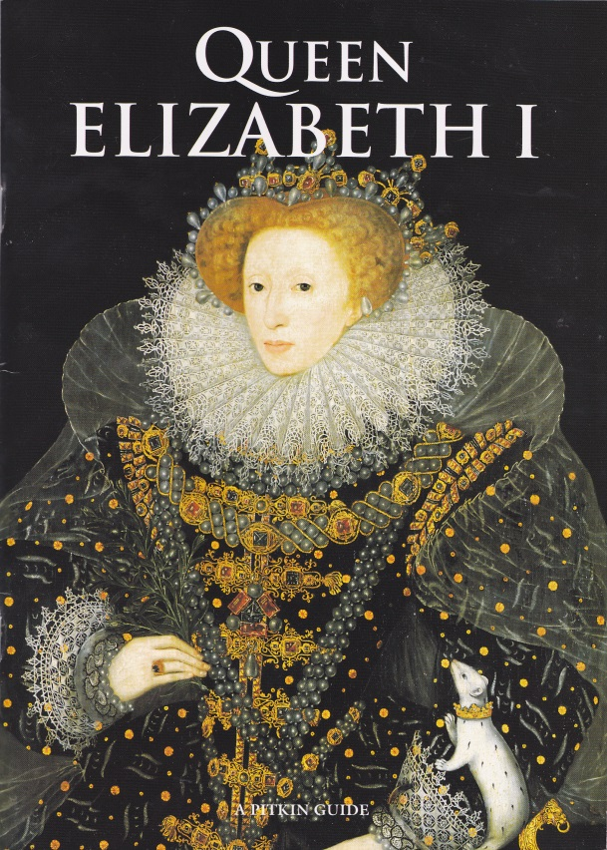
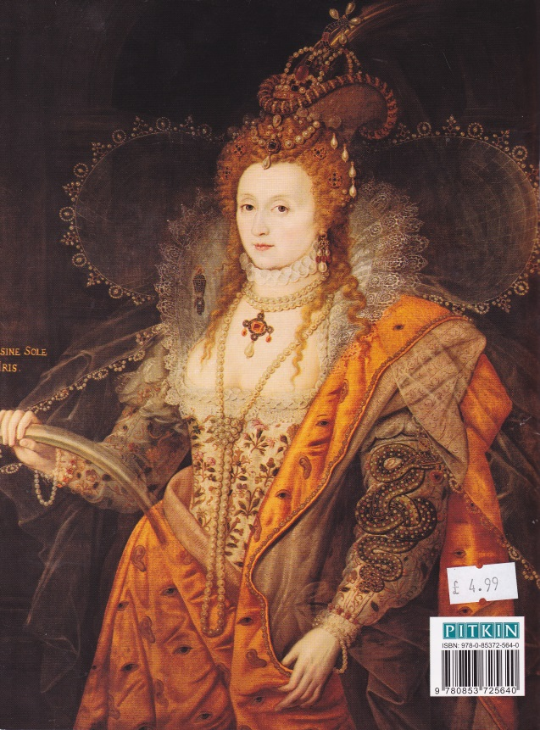
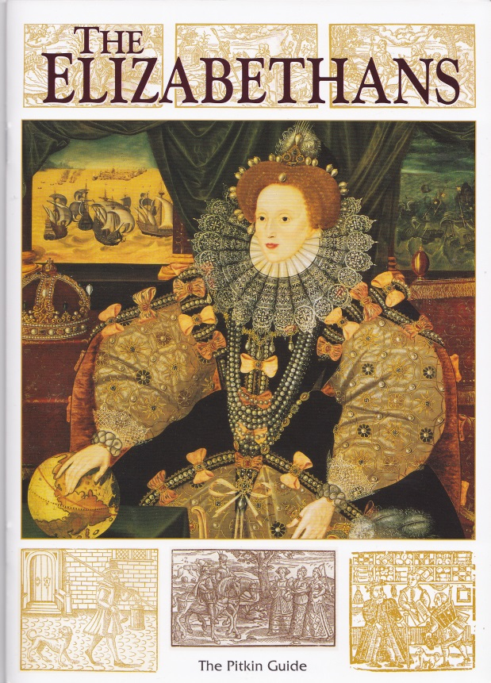
Example of original leaflets about Elizabethan Period

Slide 6
Beginning:
born 7th September 1533 at Greenwich
Henry VIII and Ann Boleyn (2nd wife)
troubled childhood
her siblings: Mary I, Edward VI
royal bastard ?
death of mother (executed 1536)

Slide 7
Woman on the throne?
her character – strong, educated, clever
her friend: Robert Dudley, Earl of Leicester
her advisers: Sir W. Cecil, Sir F. Walsingham
her playwright: W.Shakespeare
her pirates: Sir F. Drake, Sir M .Frobisher
her explorers: Sir Walter Raleigh

Slide 8
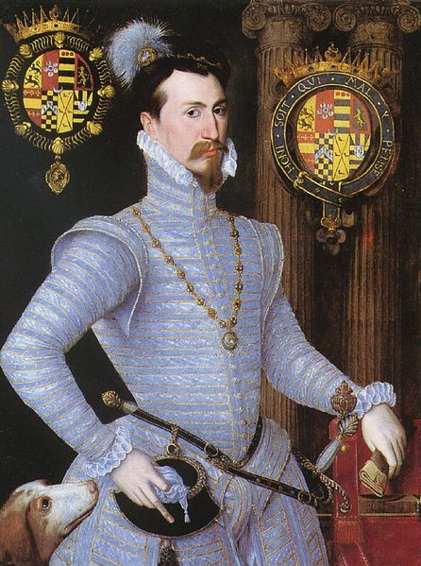
Her riend and true love:
Robert Dudley, Earl of Leicester

Slide 9
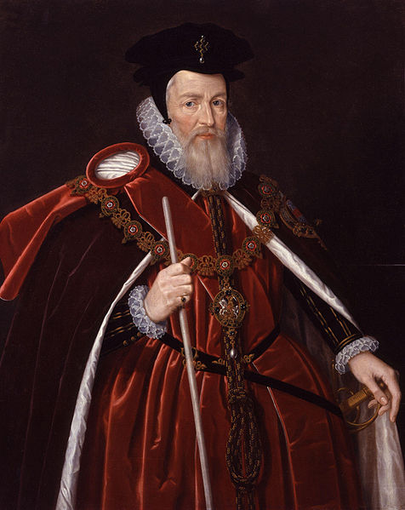
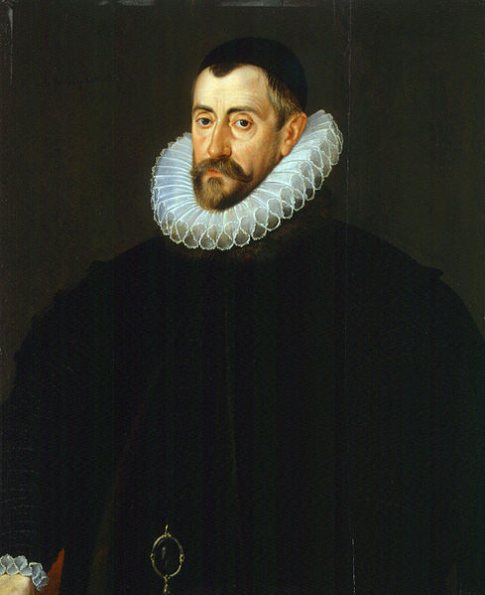
Politicians: her advisers
Sir William Cecil Sir Francis Walsingham

Slide 10
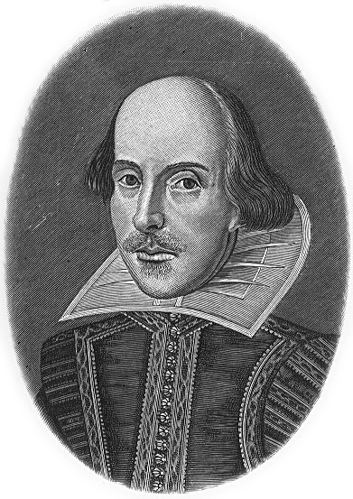
William Shakespeare

Slide 11
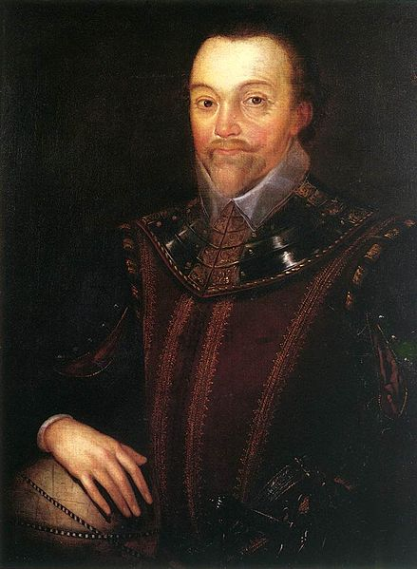
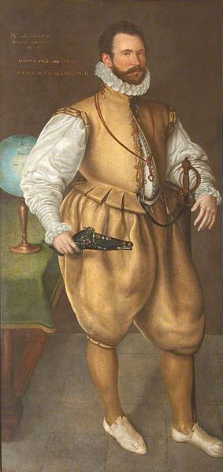
VIP Pirates:
Sir Francis Drake Sir Martin Frobisher

Slide 12
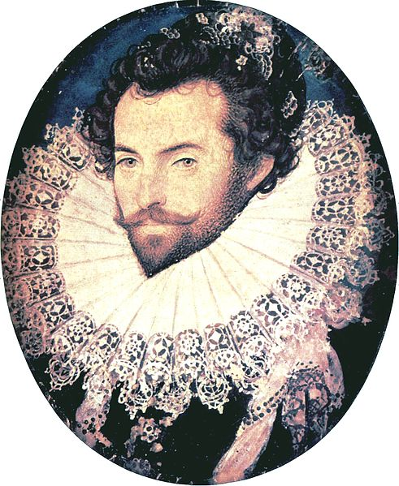
Sir Walter Raleigh - explorer

Slide 13
Elizabeth, renaissance, Golden Era
Protestant→Catholic→Potestant
rise of economy – support of:
a) trade companies:(the Levant Company,
the East India Company)
b) new discoveries: Virginia, plundering Spanish craft…
c) culture: support of the theatre
William Shakespeare

Slide 14
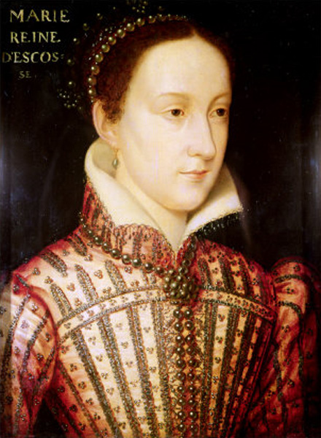
Mary Queen of Scots
shortly her lifestory
- 1568 - fled to England
- found dangerous
- kept in the Tower
- 1587 - executed

Slide 15
England - the Power on the Sea
success in the war against Spain:
1588 – the Battle of Wight/Gravelines
a famous victory of the English fleet
the Spanish Invincible Armada defeated

Slide 16
The Death of the Queen
† 24th March 16O3
She wished her cousin, James VI of Scotland, to be her successor.
The Period of the Tudor dynasty was over.
James, the son of Mary Queen of Scots, became
James I Stuart

Slide 17
Write the right name:
Who was the famous explorer in Her period:
Who was Her older sister?
Who was Her mother?
Who sailed around the world in Her time?
Which of Her relatives was executed in 1587?
Who helped Her in many political decisions:
Whose army was defeated by the English fleet?
Who was Her real friend for most of Her life?
Who was the best playwright in Her period?
Who was appointed her successor?

Slide 18
Write the right name:
Who was the famous explorer in Her period: | Raleigh / Drake / Frobisher
Who was Her older sister? | Mary I
Who was Her mother? | Ann Boleyn
Who sailed around the world in Her time? | Francis Drake
Which of Her relatives was executed in 1587? | Mary Queen of Scots
Who helped Her in many political decisions: | Walsingham + Cecil
Whose army was defeated by the English fleet? | Philip II, Spain
Who was Her real friend for most of Her life? | Robert Dudley (of Leicester)
Who was the best playwright in Her period? | Shakespeare
Who was appointed her successor? | James VI of Scotland (James I)

Slide 19
WHO IS WHO?
William Cecil
Francis Drake
Philip II
Mary Queen of Scots
Bloody Mary
Ann Boleyn
Robert Dudley
William Shakespeare
Walter Raleigh
James I

Slide 20
WHO IS WHO?
William Cecil | Spanish king
Francis Drake | Queen´s faithful friend
Philip II | Her older sister, Catholic
Mary Queen of Scots | famous poet and playwright
Bloody Mary | pirate, sailor, commander
Ann Boleyn | famous explorer and sailor
Robert Dudley | Her executed cousin
William Shakespeare | Her successor
Walter Raleigh | a faithful adviser
James I | Her executed mother

Slide 21
Odkazy na použité zdroje:
http://en.wikipedia.org/wiki/William_Cecil,_1st_Baron_Burghley
http://en.wikipedia.org/wiki/Francis_Walsingham
http://cs.wikipedia.org/wiki/Soubor:Robert_Dudley_Leicester.jpg
http://cs.wikipedia.org/wiki/Al%C5%BEb%C4%9Bta_I.
http://cs.wikipedia.org/wiki/Francis_Drake
http://cs.wikipedia.org/wiki/Walter_Raleigh
http://cs.wikipedia.org/wiki/Marie_Stuartovna
http://cs.wikipedia.org/wiki/William_Shakespeare
http://en.wikipedia.org/wiki/Martin_Frobisher
Úkoly: autor prezentace
Slide 5: foto autor

