Slide 1
SPORTS

Slide 2

FOOTBALL

Slide 3

TENNIS

Slide 4

BASKETBALL

Slide 5

HOCKEY

Slide 6

CHESS

Slide 7

SWIMMING

Slide 8
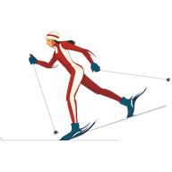
SKIING

Slide 9

SLEDGING

